Slide 1
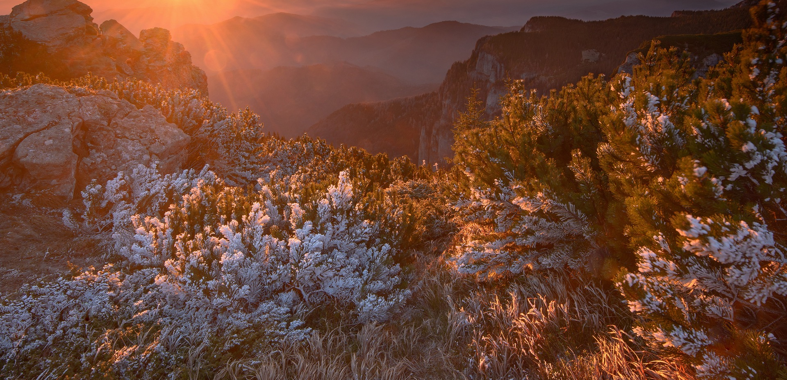
FITTER (PROTECTED) LANDSCAPES
IN A CHANGING WORLD
WHAT CAN WE CHANGE IN A CHANGING WORLD?

Slide 2
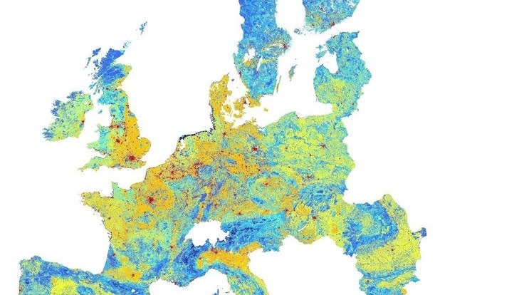





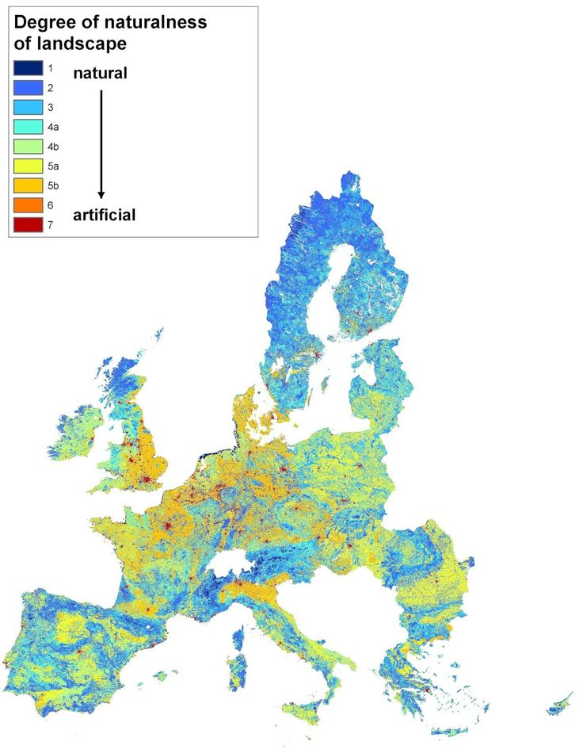

Propark Foundation for Protected Areas
Retezat National Park Administration
EAI
RO
WWF Danube Carpathian Programme
Notes:
https://uk.pinterest.com/pin/degree-of-hemeroby-in-european-union-landscapes-19962005-map--650348002456824262/

Slide 3
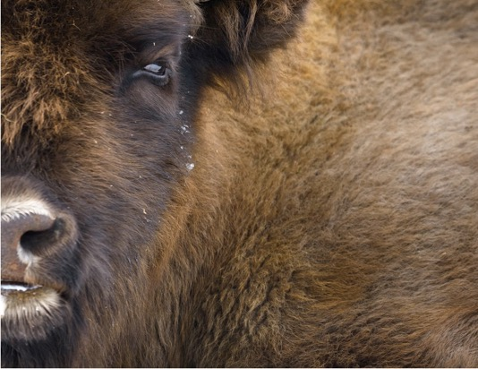
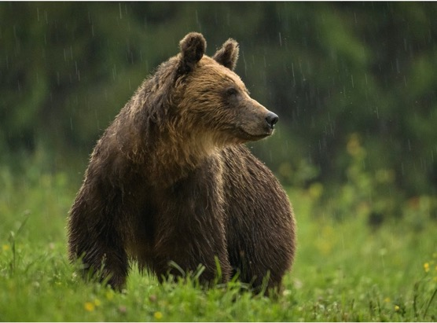
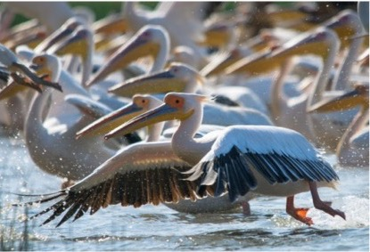
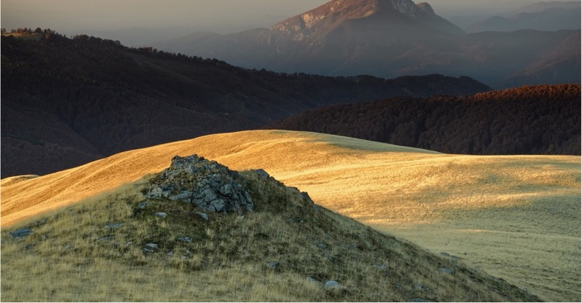
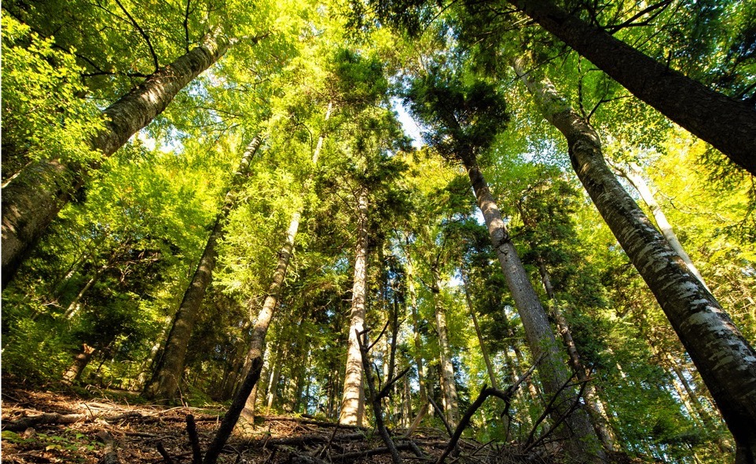
Eastern European to Western European Conservationists???
Eastern Europe:
Lots to conserve / maintain – very few human and other resources
25 years of PAs / conservation (more than 100 years of PAs in the world)
still a huge need for effective conservation management
No political will
Very low public awareness

Slide 4
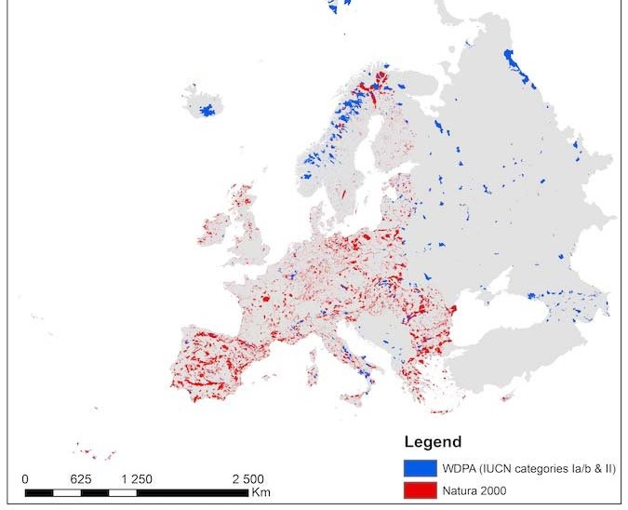
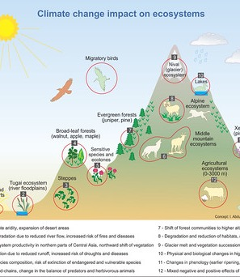

Slide 5
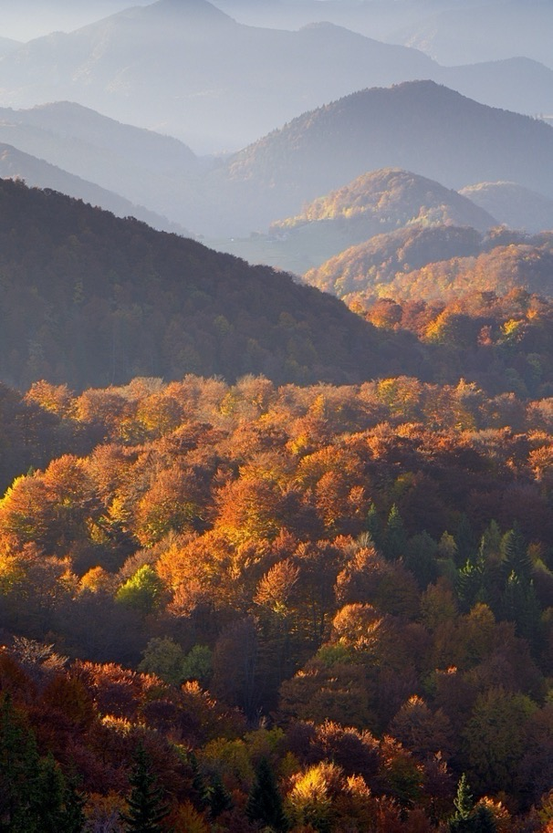
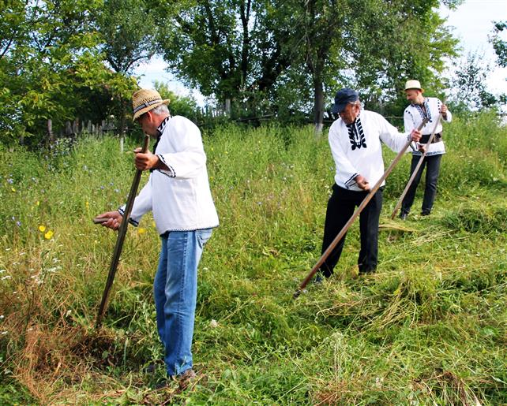
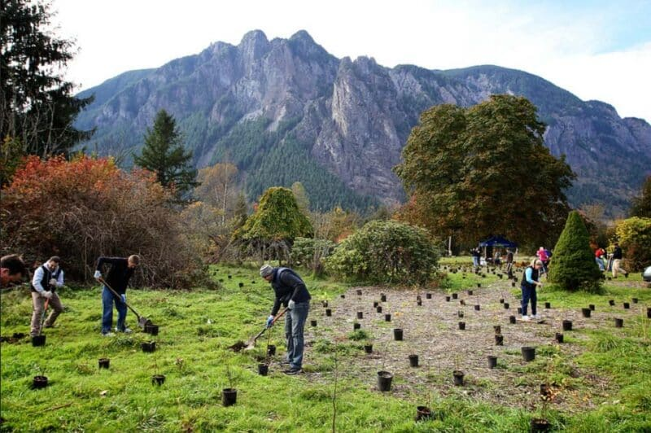
1872 (Yellowstone NP) – 2024 (aiming for 30x30)
NATURE PROTECTION
BD CONSERVATION
(strict) protection
FITTER (PROTECTED) LANDSCAPES
IN A CHANGING WORLD
WHAT CAN WE CHANGE IN A CHANGING WORLD?
responsible resource management
restoration
Notes:
HOW CAN WE DELIVER

Slide 6
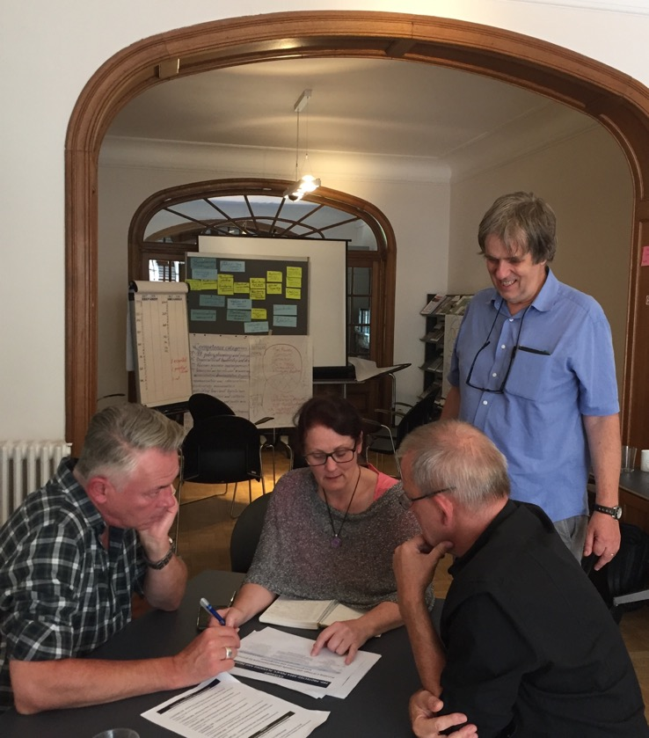
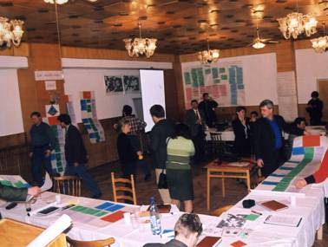
Participative PA Management
2001 Romanian PA Law
Scientific Councils
Consultative Councils
2024
- participative management?
- functional Councils?
This is not working!
Keep working on it!

Slide 7
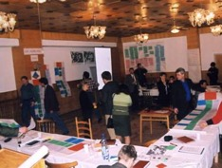
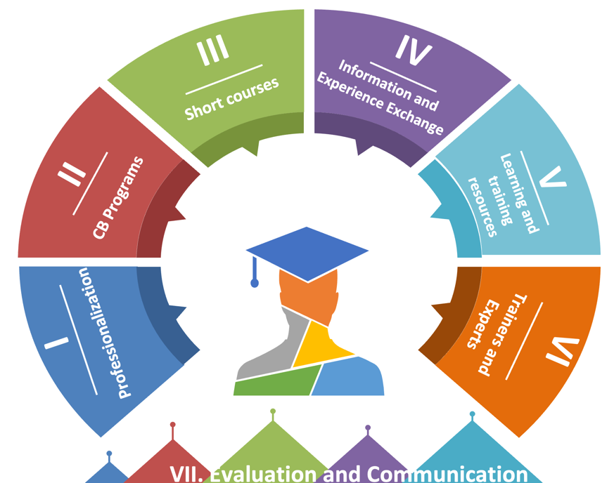

Participative PA Management
Keep working on it!
Local Leader Networks

Slide 8
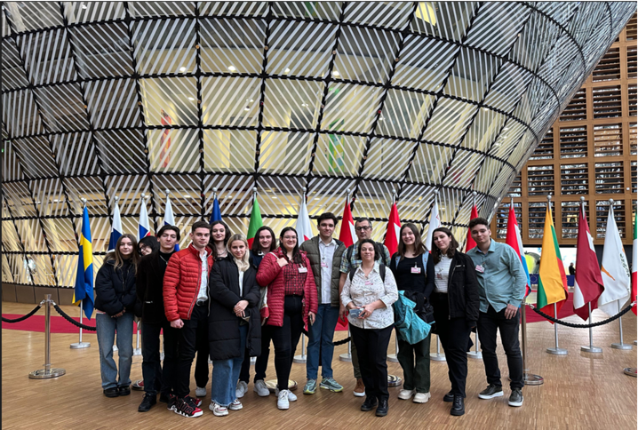
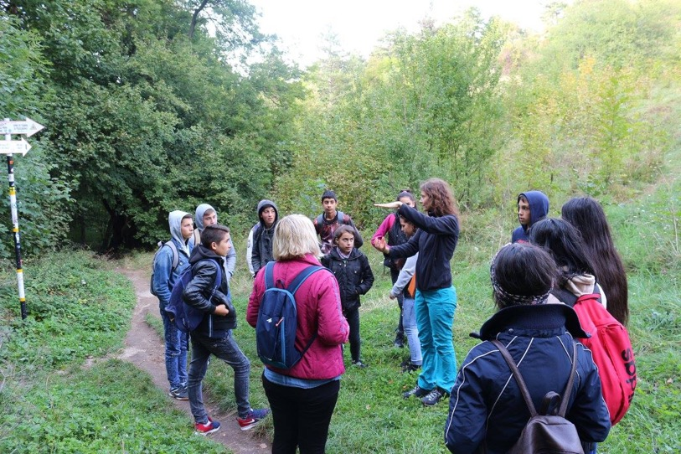
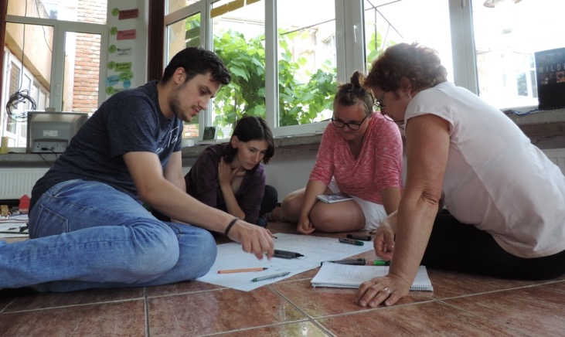
Keep working on it!
Participative PA Management
Youth Leader Networks
2021 – 2024
Testing 2021-2024 – does it work?
Not yet!
Youth Scientific Councils
Youth Consultative Councils
Future Leaders for Conservation
Keep trying!

Slide 9
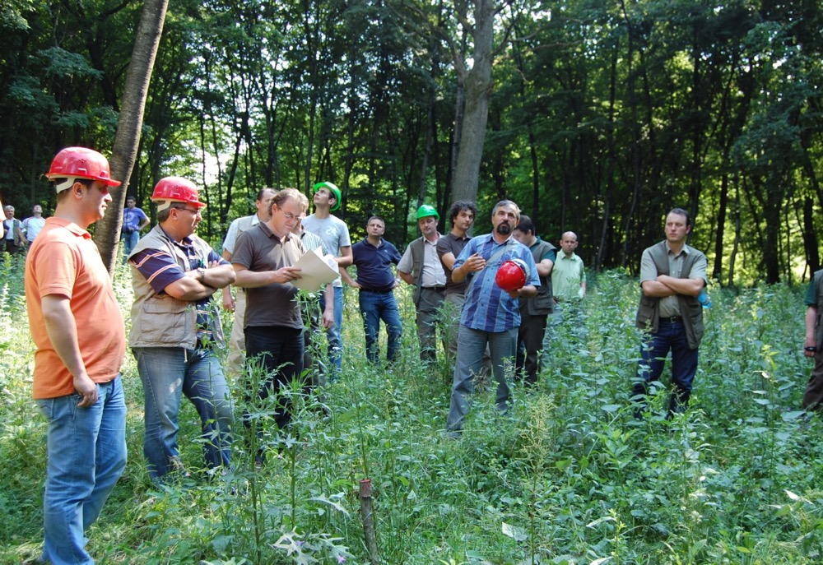
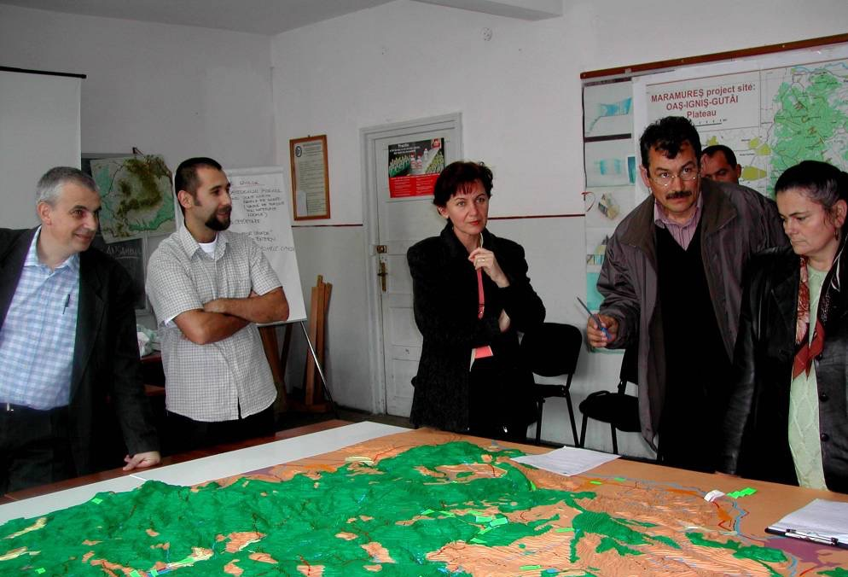
Working together
2015: Guidelines for including BD conservation in strategic planning for various sectors:
  Territorial Planning
  Forest management
  Water management
  Agricultural land management
  Game management
2015 – 2024: no real take-up
What did we do???

Slide 10
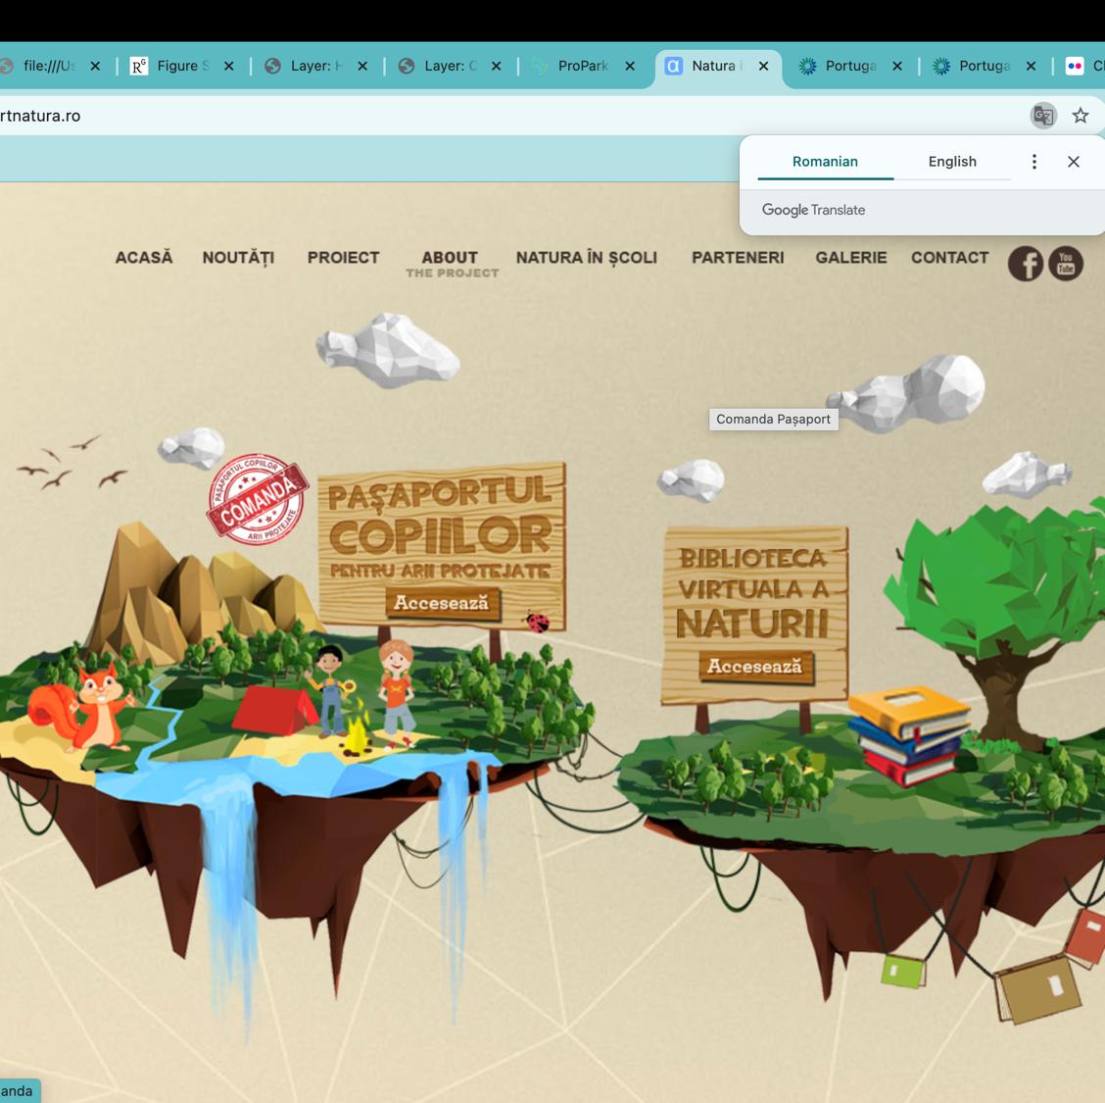
Protected Area Passport
2014 - 2015 in partnership with another entity as lead partner
2016 on - Lead Partner has a difficult time promoting it …
What did we do?

Slide 11






From field work and civil efforts to government / decision making (political involvement?)
Notes:
Chasm (kazm), abyss
Ladislav Miko – Czech Republic: parcurs de silvic la CE
Theodore Roosevelt (Fost vanator - During his presidency (1901-1909), he preserved more than 230 million acres (93 million hectares) of wilderness, created the U.S Forest Service, aggressively pursued soil and water conservation, and established more than 200 national forests, national monuments, national parks and wildlife refuges.)
Ken Livingstone - London mayor (https://grist.org/article/politicians

Slide 12
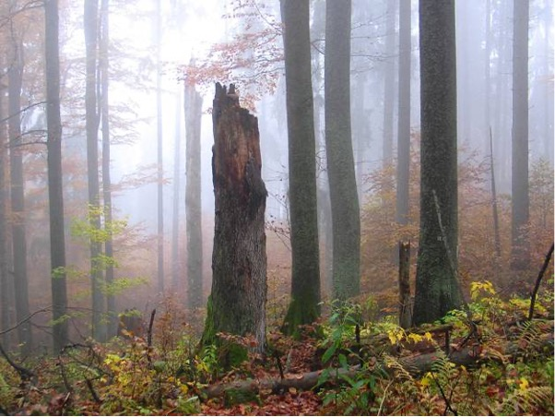

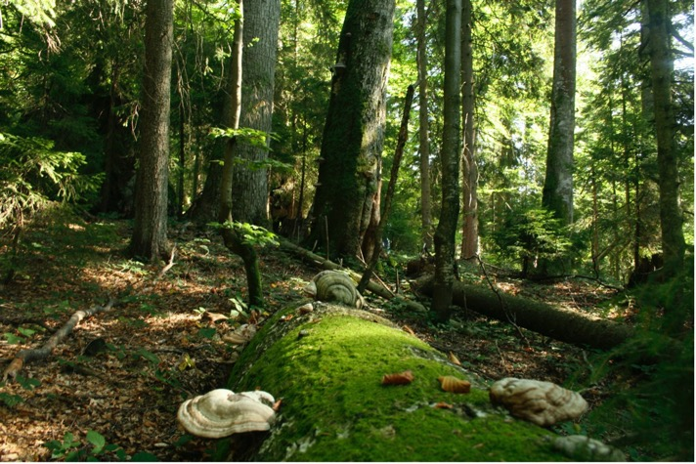

Virgin Forest Catalogue >72.000 ha strictly protected
9 months
Virgin Forest protection procedure Governmental Decision
First version of Virgin Forest Catalogue
Fines!
Protecting Primeval Forests
12 years
Identification Criteria
Strict protection – de jure (Ministerial Order)
No protection – de facto

Slide 13
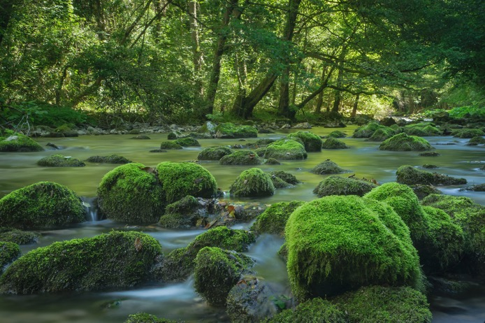

9 months
EC Decision + Draft Government Decision
Compensation payments for conservation and environmental service
- forest owners -
10 years
no result

Slide 14

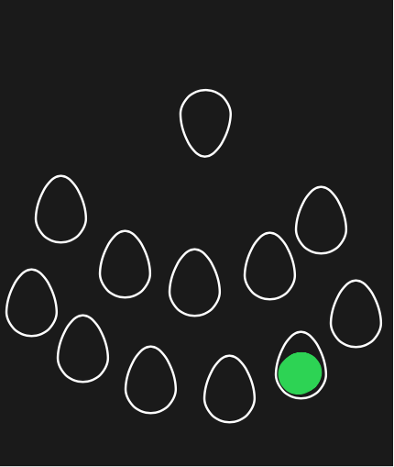
From civil efforts to decision making
PA, NGOs
Government entities
High level decision makers
Do we want to make the leap?
Are we ready?
Changing the legislation – yes
Approve and oversee the activity of the Government
Resource allocation - decision
% Legislation: lobby – time!
Resources for conservation effort, time, lobby
Making things happen on field
% Bringing people together – yes, but no authority
Changing the legislation – yes %
Decisions within the existing legal framework
Resource allocation – lobby and decision
Bringing people together – authority

Slide 16
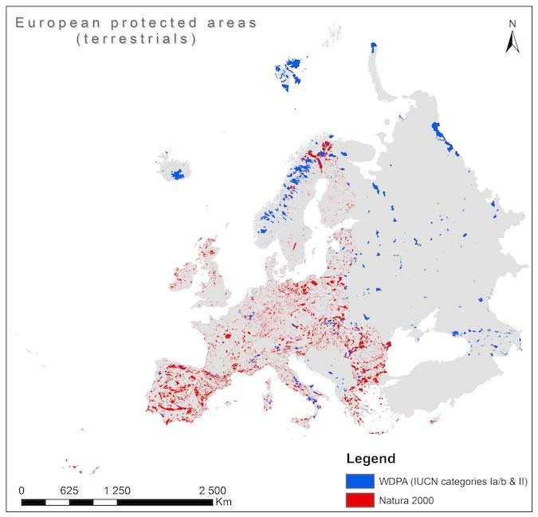
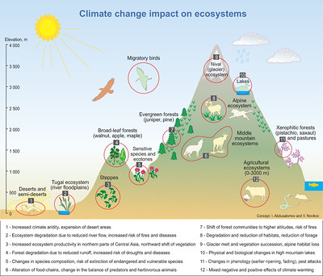
Keeping and Changing conservation approaches
Protected Areas = Model approaches for landscape management

Slide 17

Keeping and Changing conservation approaches
Notes:
Us, conservationists pleaching and teaching
Us listening, understanding and finding solutions – how

Slide 18

Stepping out of our comfort zone – for the future of our Landscapes
High level decision
Or by building knowledge, understanding and capacity with RESPECT and TRUST in all Stakeholders
National / State Parliaments
European Parliament
Local / national authorities
Local / county councils
Ministries
Territorial Planning consultants
Law enforcement entities
…
Conservationists or knowleadgable / conscious supporters
Personal involvement / experience
Field level
…
Natural Resource Management
Schools
PA / CA Management

Slide 19

Can we find the balance
Between ”old” ways and new technologies?
To provide continuity, to build!
Virtual world
Brigning Nature to People, not necessarily People to Nature
New technologies
AI

