Slide 1
Evolving Landscapes Learning from the linear
Richard Bennett CEnv
Nature Recovery Manager
Notes:
We have a 2000 mile, multifunctional network of rivers, canals, docks and reservoirs across England & Wales. We’ve been on a continuing journey, as custodians of this network, to maintain and improve their them, engage communities, and demonstrate their value. I’ll show you some of these-and opportunities to learn and collaborate- but FIRST, to set the scene on this network in the context of landscape and nature recovery.

Slide 2
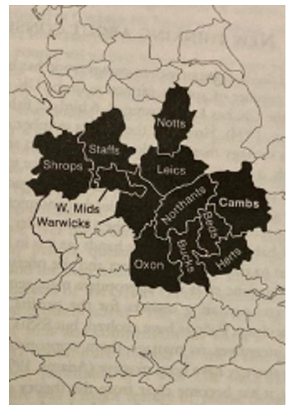
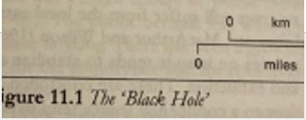
Colston A. (1997) Conserving Wildlife in a Black Hole, ECOS, 18.1: 61-67
‘The Black Hole’ - This was the area of England with:
No National Parks
No AONBs (Protected Landscapes)
Less than half the national average area of SSSI’s.
(Much of ‘lowland England’- the challenge for nature conservation)
Notes:
In 1997- Adrian Colston then at Beds,Cambs & Northants WT- now Exeter University engaged with Dartmoor National Park- wrote a paper ‘Conserving Wildlife in a Black Hole’ for the journal ECOS. It showed the area with no Protected Landscapes, National Parks and less than half the national average of SSSI’s. The map showed a large part of lowland England- most of you here represent areas outside this hole I guess?. Its old- but it helped (then) justify the start of large-scale habitat re-creation- eg Wicken Fen for the WT. This is where enclosure led to modernised agriculture, and industrial growth led to urban expansion. Much has happened since- but in the current context of 30*30 commitments etc- the data can be looked at differently.

Slide 3
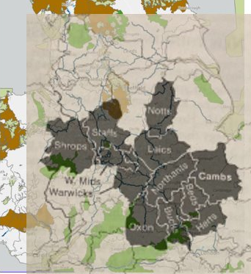
Colston A. (1997) Conserving Wildlife in a Black Hole, ECOS, 18.1: 61-67
‘The Black Hole’ - This was the area of England with:
No National Parks
No AONBs (Protected Landscapes)
Less than half the national average area of SSSI’s.
Notes:
Overlay this black hole, on our network of canals and rivers: The Protected Areas- Nat Parks, Protected Landscapes, Special Areas of Conservation arethe colours are around the edge- and in the black hole space- most of the canal and navigable river network. That’s no accident- human history, geology and economy shaped it- they were transport routes linking towns, cities, agricultural/mineral production to markets.

Slide 4
Colston A. (1997) Conserving Wildlife in a Black Hole, ECOS, 18.1: 61-67
‘The Black Hole’ - This was the area of England with:
No National Parks
No AONBs (Protected Landscapes)
Less than half the national average area of SSSI’s.
Presence of Canal & River Trust network.
Half of the network has a nature conservation designation.
Notes:
More clearly here. The ‘black hole is crossed. They reach into the uplands- providing diversity there- but mostly spreading from the lowland Midlands .
Now- while you can play with data, the recent State of Nature Report shows that – in urban or rural areas, nature isn’t doing well. And the challenge for Nature Recovery is everywhere- not just current Protected Areas/Sites

Slide 5
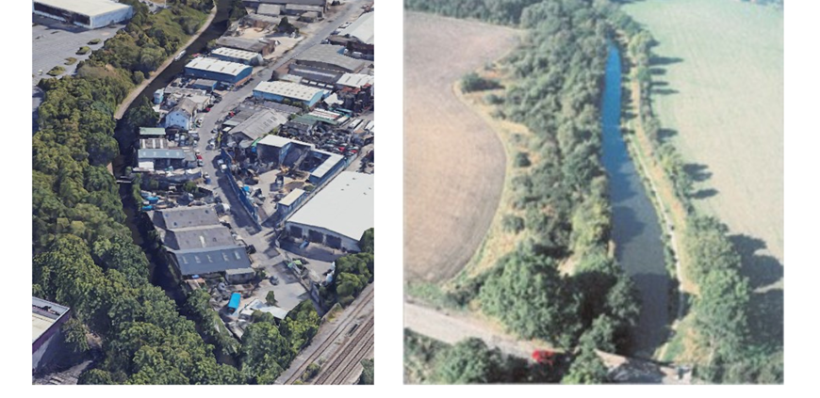
Linear Nature Network
Notes:
Zoom in- this is what those lines are- Mostly- note water- but semi-natural habitat features, themselves industrial relics, colonised and refuges for nature in a more barren landscape. ribbons of multiple habitats, close together, accessible freshwater, grassland, woodland and scrub; and post-industrial structures- running through nature-poor urban and rural contexts. Hedgerows- planted to protect stock 250 years ago- but immune to the pressures of farmed land, or urban construction. Scrub and woodland- shelter and refuge to species. Scrub – woodland edge- is known now to be very important for many species- growing on the ‘embankments and cuttings’ of these artificial structures. These features now provide ecological connectivity and connection nature poor urban and rural areas. These marginal spaces are where nature can recover from- into the wider (semi-natural) landscape
Filling in the gaps of the map- we called the black hole earlier- by improving, joining up from these margins. In your wider Protected Landscapes- think how these can and to contribute…
We have begun discussions (Canal & River Trust, National Highways, National Trails and Network Rail) called the ‘Linear Nature Network’ .
SO- what are doing here? What are the challenges? What have we learnt to do- that can help you?

Slide 6
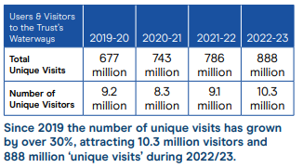
Notes:
The location of this network means it does impact millions of people: 9m people living within 10-15mins walk; 8m people in urban areas. And overwhelmingly- those people acknowledge their importance to their areas. As a charity- having those people value and actively contributing to their canals- not just passively enjoying, is essential. Here are some of the ways we’ve done it….

Slide 7
Notes:
These mini-landscapes pass through urban areas- with diverse groups, who could benefit from access to green/blue space.
Encouraging access is more than physical- you need to work on the reasons (for example) why black women tend not to do water-based activities? Find out what these barriers are, tackle them, and change the narrative. That’s what we’ve done in with Sport England support in Nottingham….
Carol Burrell wins Equity Award for transformative Swim Sista Swim programme
East Midland’s Community Wellbeing Coordinator, Carol Burrell, has been honoured with the 2024 Equity Award at the Nottingham ICB (Integrated Care Board) Health & Care Awards for her inspiring and innovative "Swim Sista Swim" program. This award highlights her dedication to empowering Black and African Caribbean women by helping them conquer long-standing fears, gain confidence in the water, and open doors to new adventures on our waterways.
Read more
Like | Comment

Slide 8
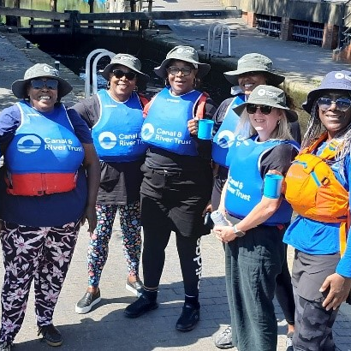
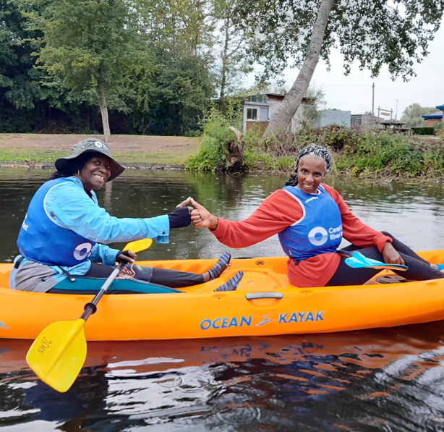
Notes:
Last years first cohort- of ‘Swim Sistas’- now confident to be able to enjoy our water-based and waterside activities. Unlocks these spaces for people who otherwise are marginalised, but now able to get the wellbeing benefits of being by water and blue/green space.

Slide 9
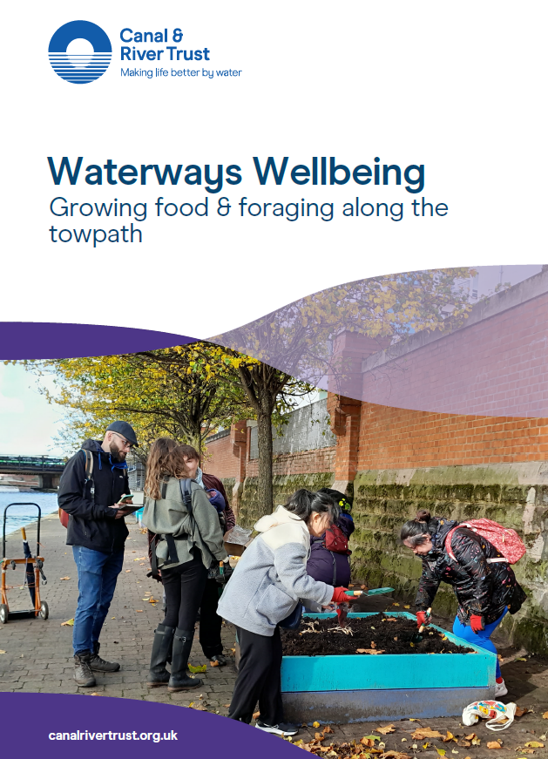
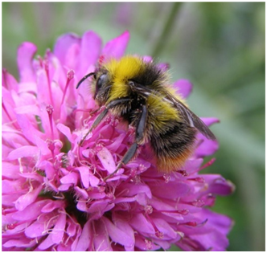
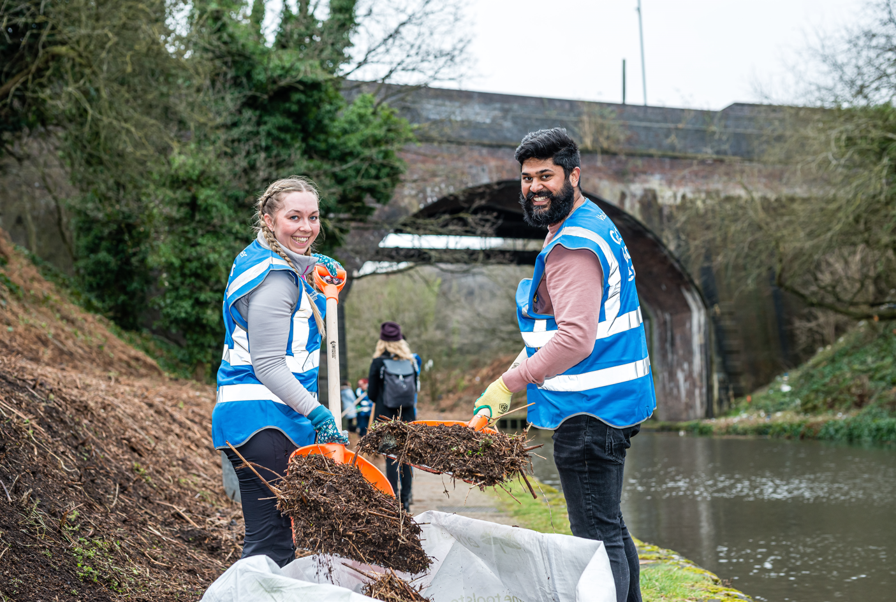
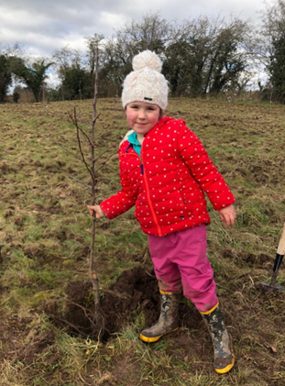
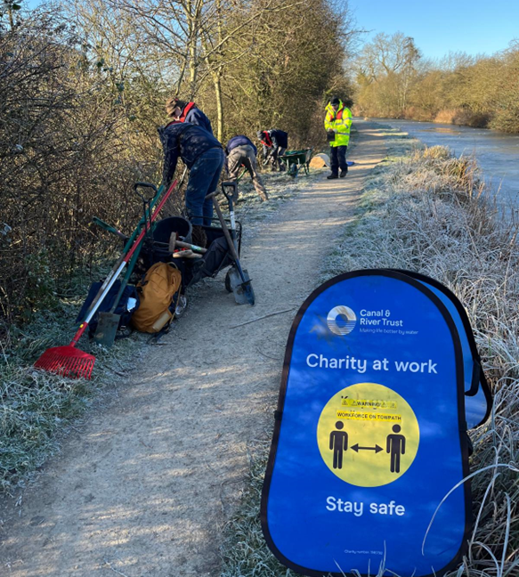
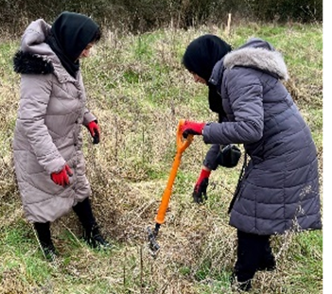
Notes:
Another example - but similar initiatives from our Wellbeing Programmes in may urban areas- Food growing- reconnecting and maintaining those marginal spaces at the edge of the towpath. New groups are actively helping maintain these spaces.

Slide 10
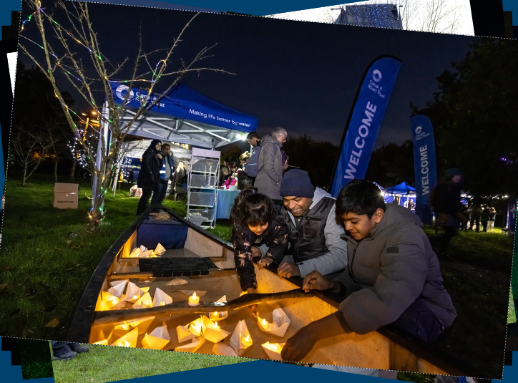
Community Roots
Notes:
With Postcode Lottery support- many urban areas have had Community Roots programmes and officers- engaging with local communities who might not value their waterway In Leicester- the canal and river run right through the City. South Asian groups- though schools, and Diwali ‘festival of light’ celebrations- are creating new cultural connections with that waterspace .

Slide 11
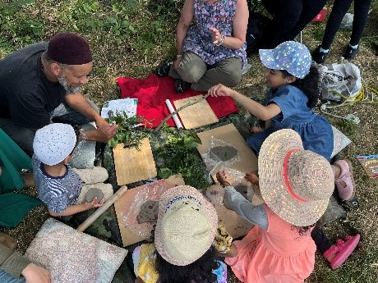
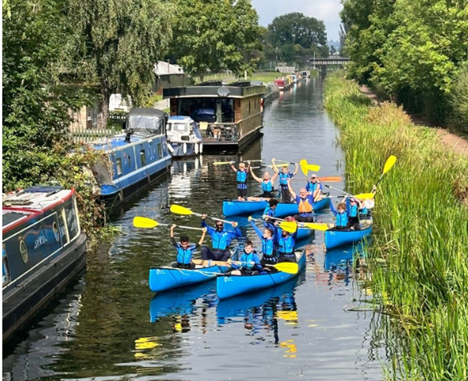
Young Explorers
Notes:
Young people- though our Explorers schools programme- are reconnecting in new ways with their canal spaces. Our programmes of Wellbeing activities- including paddling- has helped (in this case a local football team) enjoy the benefits of being by water, while helping tackle litter and plastic pollution.

Slide 12
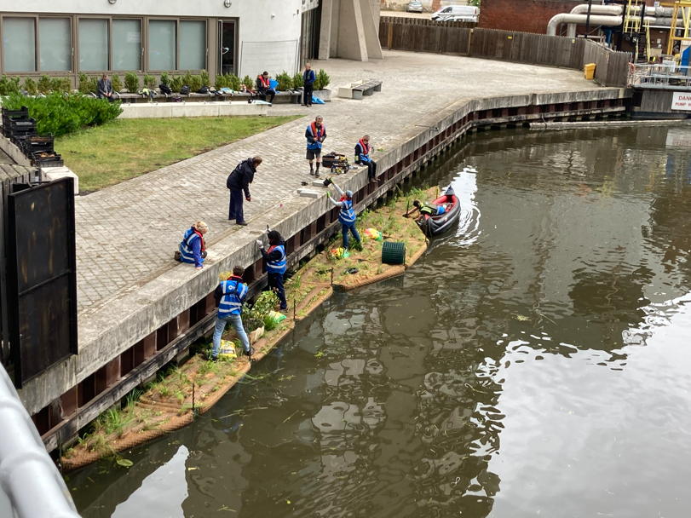
Business Partners
Notes:
Businesses- these ‘floating ecosystems’ in urban Nottingham, and other urban sites and been funded by businesses- Coca Cola European Partners, Severn Trent Water, and also the Transforming Cities Fund, and (next year) Species Survival Fund

Slide 13
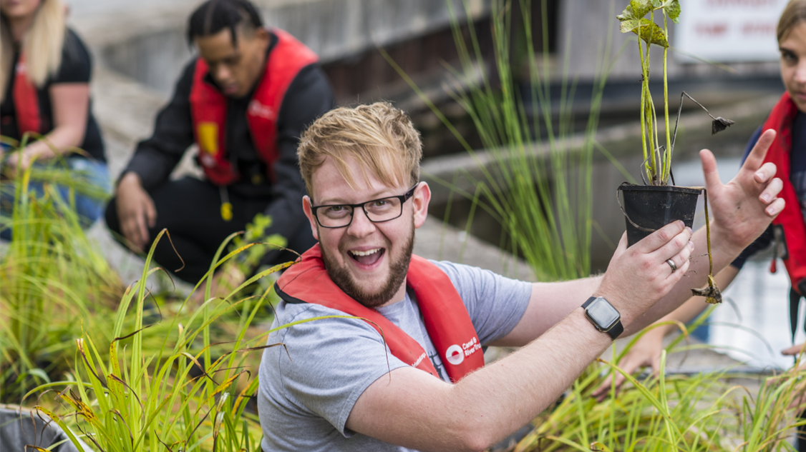
Notes:
They’ve an office nearby, and employees voted for this use of their annual charitable funds to pay for it- softening the hard grey urban landscape. Many other ‘corporates’ enjoy activities and contribute in various ways to these spaces (examples this year in Nottingham)

Slide 14
Strategic partnership delivered projects
Externally funded projects
2021 – 2023 Green Recovery Challenge Fund grant of £1.7 million - 50km of habitat restoration - water vole recovery, 550 orchard trees planted , 8km of hedgerow restored, 11km of heathland mosaic habitat expanded, 7 SSSi improved, 9 ponds created, 7 urban areas enhanced and over 50 people upskilled in nature conservation.
2023 – 2025 Unlocking Biodiversity Severn Trent funding of £670k – works to date;
34km of aquatic margin, 17Ha of reedbed restoration and expansion, 40km of hedgerow restoration, 61km of grassland wildflower enhancement,

Slide 15
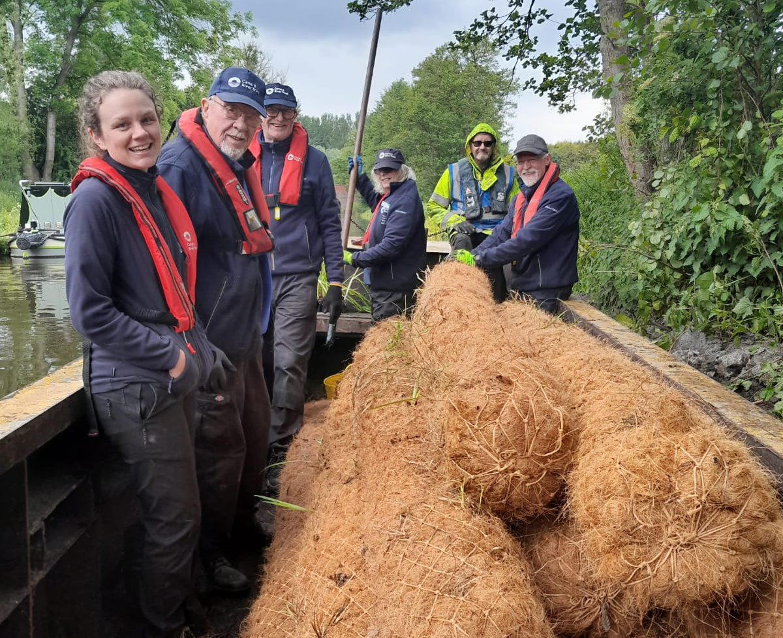
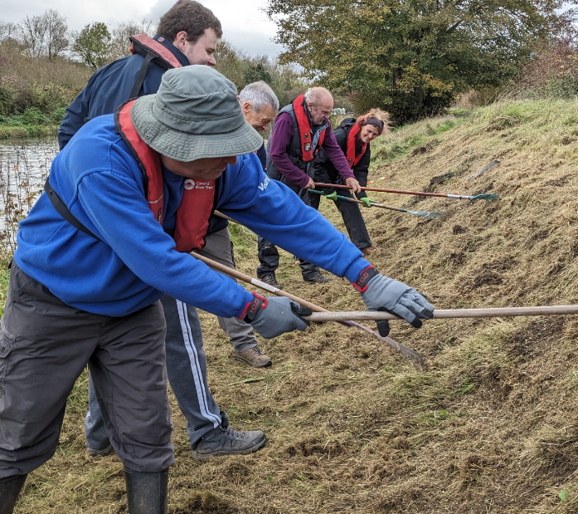
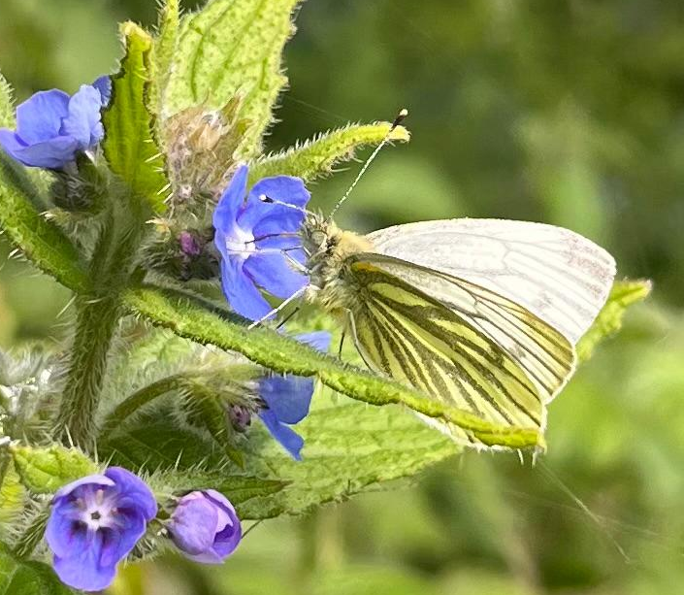
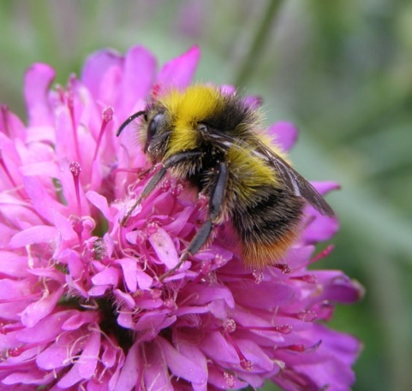
Landscape scale connectivity
Our canal network can offer a mosaic of connected habitat recovery
Aquatic margin habitat creation
Pollinator habitat enhancement
Hedgerow restoration and creation
Heathland restoration and expansion
Priority S41 and red list species focus
SSSi, SAC, SLINC and CWS corridor connections
John Gooday ©
Notes:
Reconnecting a fragmented landscape – canals offer a linear blue and green corridor of mosaic habitats across the British countryside and through some of our most urban areas – including fresh water, aquatic margin, grassland, wildflowers, hedgerows, woodland and heathland.
A diverse range of species use and live in and alongside our canals , including Section 41 and Red list species. Pic inc heathland restoration- Purple Horizons
Nature is under threat and a sharp focus on conservation action and habitat enhancements connecting our landscape is integral to stabilise these declining populations and move towards species recovery.

Slide 16
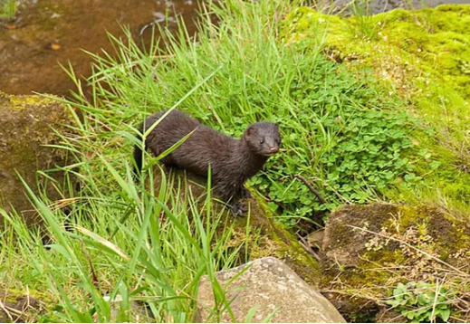
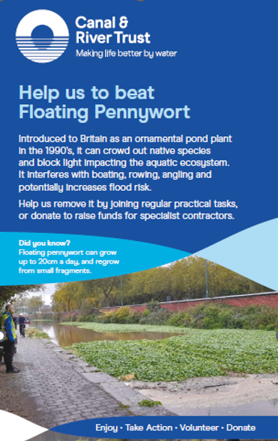
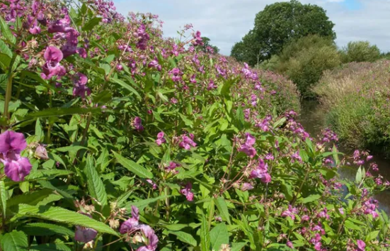
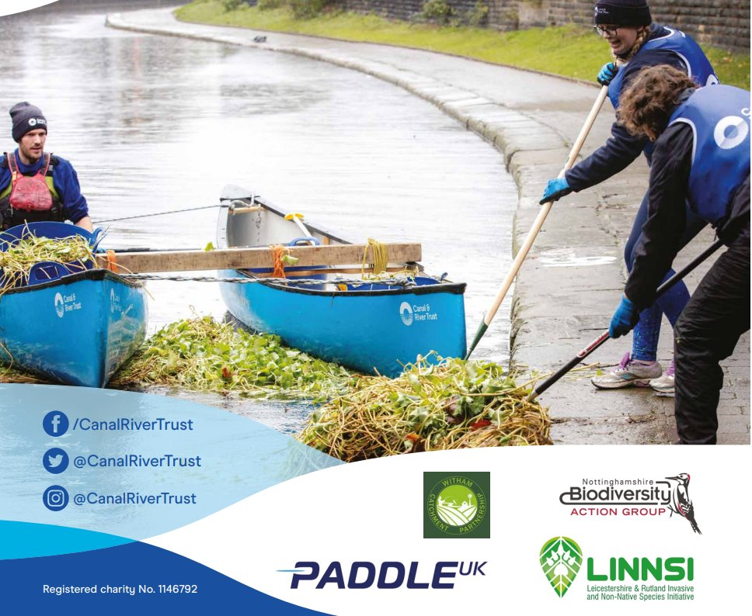
Invasive Species
Notes:
One of our challenges is the spread of invasive species- like Hydrocotyle- Floating Pennywort. We have regular groups of volunteers all over the network- Towpath Taskforces who do all kinds of jobs and are absolutely critical. Here they’re helping with paddle clubs (working with Paddle UK and other partners) and are absolutely key to control and eradication. Working with landscape partners on Mink; and a 4 year year project funded by severn trent in the Midlands to deliver invasive reduction and eradication inc biological control.
Partnership with CABI (formerly Commonwealth Agricultural Bureaux) to introduce biocontrol of the North American Weevil to control Azolla (an invasive water fern) and the South American weevil to tackle Pennywort on our network

Slide 17
Citizen Science
Notes:
Volunteers- helping survey for signs of the endangered water vole : as part of our Vole Patrol (Unlocking Biodiversity Project- funded by GCRF , STW)

Slide 18
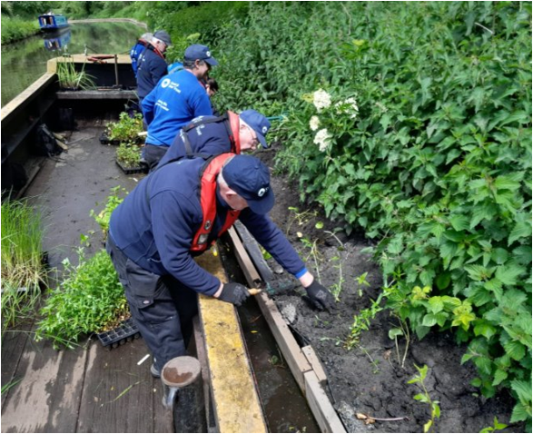
Marginal habitats
Notes:
An example as part of the same project- volunteers helping establish the marginal habitats so important for water vole, and many other species. This is part of the essential maintenance work needed to keep these landscapes alive.

Slide 19
Hedgerows
Notes:
Hedgerows- here maintained and renewed by volunteers – trained in the traditional craft of hedgelaying- managing 100’s of metres each year. The classic semi-natural landscape feature: key to canals (to prevent stock drowning when the canals were built)-and we have 100’s of miles of them have been protected from the longer term threat of agricultural intensification. The benefits of this habitat extends out into the adjacent countryside…

Slide 20
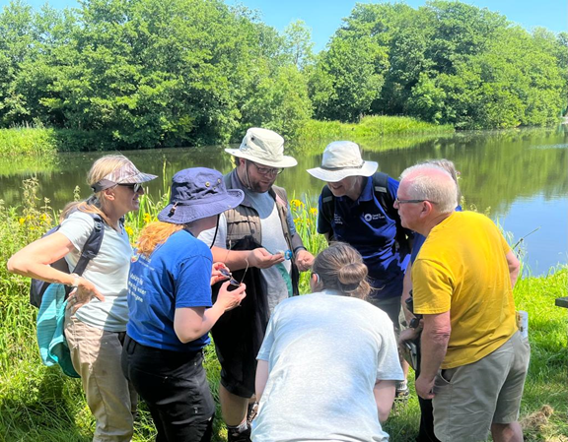
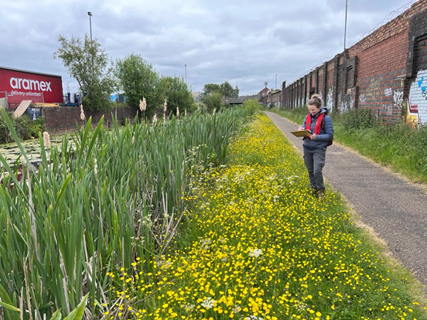
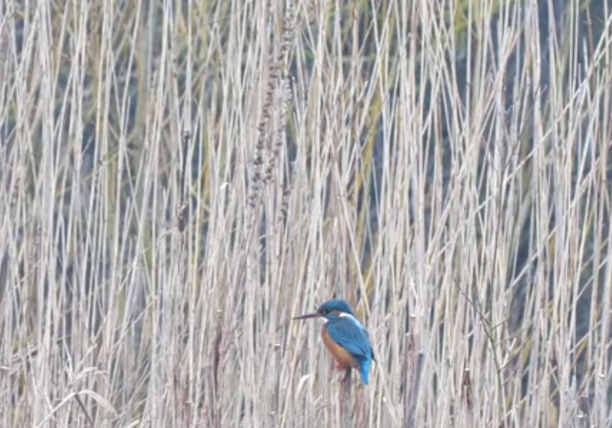
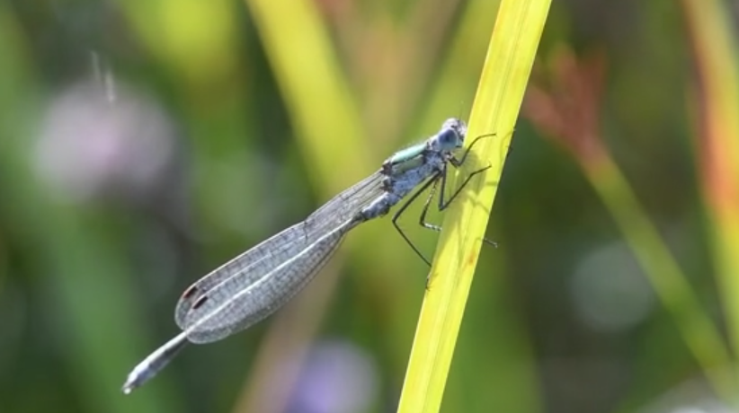
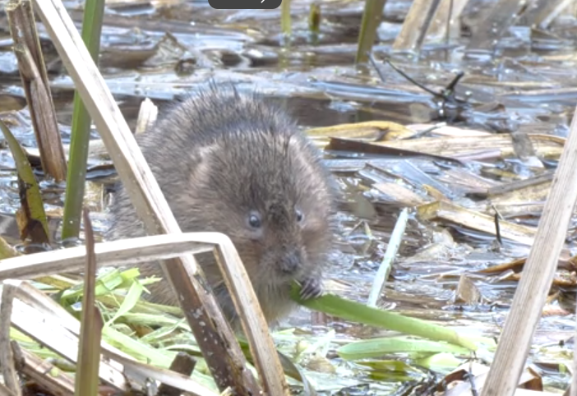
Connection to nature
Notes:
Finally- Contact with nature- the experience not necessarily the rarity of the plant or animal itself- the ‘Unexpected in the Everyday’. Canals provide easily accessible places for these experiences- Nature Recovery is – and starts with personal change- people actually being affected by nature. The canal network can then be the gateway to further environmental concern and action elsewhere.

Slide 21
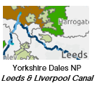
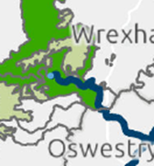
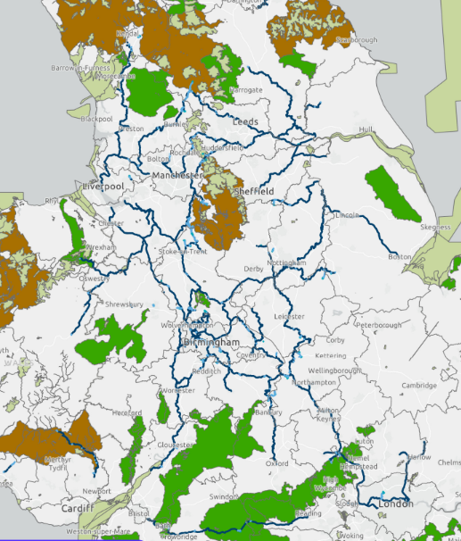
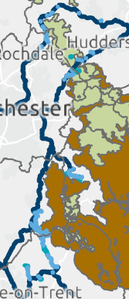
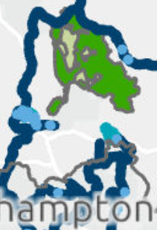
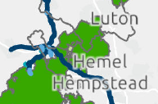
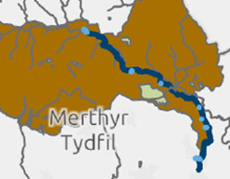
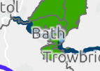
Connection to Protected Landscapes
Peak District NP
6 Reservoirs &
Feeders
Huddersfield
Narrow Canal
Clwydian Range NL
Llangollen Canal
Chilterns NL
Reservoirs, GU &
Wendover
Arm Canal
Cannock Chase NL
T&M,
S&W Canals
Bannau Brycheiniog
Mon & Brec Canal
Cotswolds NL
K&A Canal & Feeders
North Wessex Downs NL
K&A Canal, Reservoir and feeders
Notes:
So- you’ve seen some of what we’ve learnt to do in that ‘Black Hole’- BACK TO THE MAP. The network does actually extend into some Protected Landscapes- around the edges- Do you work in these places?

Slide 22
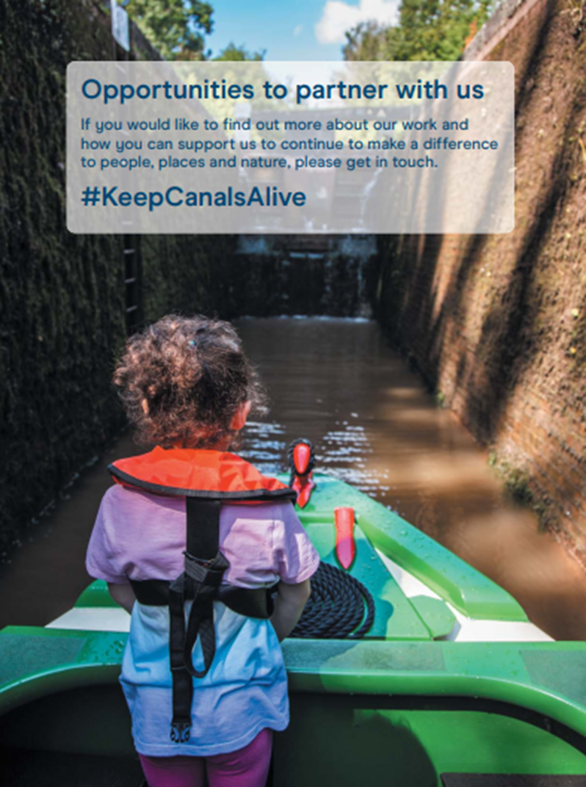
Connection to Protected Landscapes
Peak District NP
6 Reservoirs &
Feeders
Huddersfield
Narrow Canal
Clwydian Range NL
Llangollen Canal
Chilterns NL
Reservoirs, GU &
Wendover
Arm Canal
Cannock Chase NL
T&M,
S&W Canals
Bannau Brycheiniog
Mon & Brec Canal
Cotswolds NL
K&A Canal & Feeders
North Wessex Downs NL
K&A Canal, Reservoir and feeders
Notes:
So- you’ve seen some of what we’ve learnt to do in that ‘Black Hole’- BACK TO THE MAP. The network does actually extend into some National Landscapes and Nat Parks- around the edges- Do you work in these places?- We'd like to discuss partnership opportunities

Slide 23
Please get in touch
Richard.bennett@canalrivertrust.org.uk
Or my colleague
Aimee-louise.malcolm@canalrivertrust.org.uk
Notes:
Thank you for listening any questions

