Slide 1
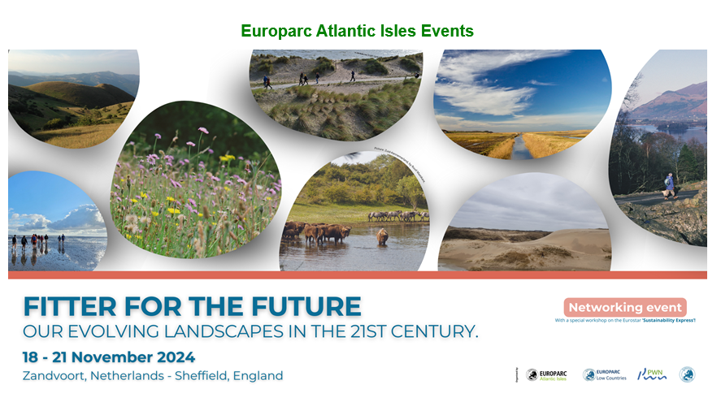
Creating opportunities to train a workforce within a National Park

Slide 2
What did we do?
Met with Ernest Cook Trust to learn about their role investing in future managers of protected areas
Learned from Apprentices about their experiences entering the sector and discussed training and skills development
Explored Low Beckside Farm

Slide 3
What did we learn?
Most apprenticeships are linked up to a college or university
In many organisations people are in post for a long time – apprenticeships provide an entry level to bridge between traineeships and officer type roles
Making it easy to travel to work and a liveable wage help overcome initial employment barriers
Invest in the organisation to meaningfully integrate apprenticeships into a range of roles across different teams

Slide 4
Key messages
Sustainable apprenticeships require:
Learning partnerships
Motivating and rewarding placements
Collaborative and inclusive work culture
Employability support and liveable wages
Investment in resources and capability

