Slide 1
Protected Landscapes vs. Landscape Partnerships
Webinar on 6th November with the three principal speakers:
- Santtu Kareksela, Metsahallitus
- Mike McClure, Landscapes Northern Ireland
- Catherine Mealing-Jones, Bannau Brycheiniog
Different approaches to managing designated and non-designated protected areas
Strengths and weaknesses of each

Slide 2
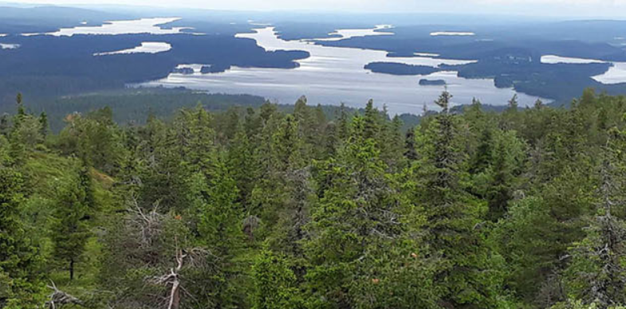
Metsahallitus
Detailed data and evidence-led analysis of protected areas
Identification of cost-efficient areas for nature restoration
Private & public lands
Negotiation and compensation for private owners
PriodiversityLIFE

Slide 3
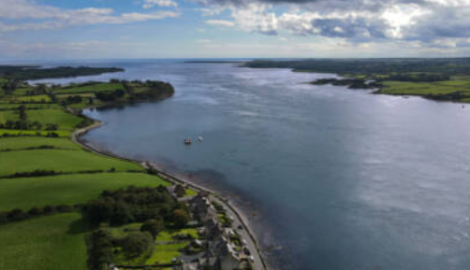
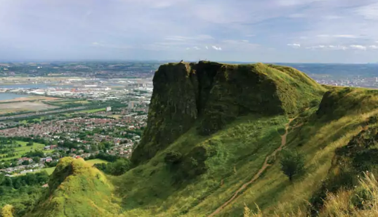
Landscapes Northern Ireland
Network of 16 landscape organisations, with dedicated lead officer
Representing landscapes at government level
Little or no core funding, largely project-based
Designated vs. non-designated
‘Manifesto for Landscapes in Northern Ireland’
Legislative change needed to strengthen protected areas

Slide 4
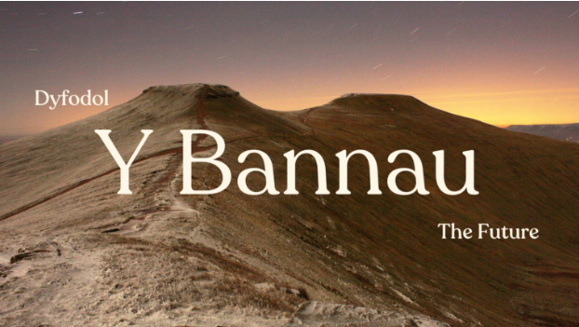
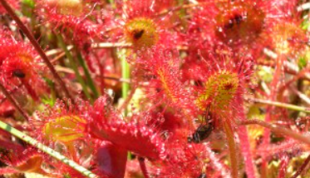
Bannau Brycheiniog NP
National Park designated in 1957
Different landscape partnerships and designations within the Park
Management Planning using ‘Doughnut Economics’ model
Government expectation to be exemplars in tackling the nature and climate emergencies
What are National Parks for? …becoming more politicised
Issues to be addressed takes NP beyond the boundary – housing, energy, transport

