Slide 1
Monitoring to Deliver Healthy Ecosystems (DHE)
Monitoring Reform in Scotland’s protected areas
Europarc Conference 2024
Lisa Davidson & Ruth Paterson
Protected Areas, Monitoring and Surveillance team
November 2024
Notes:
Hi all,
I’m Lisa Davidson, I’m ecosystem health officer at NatureScot. I am a part of a team that is working to reform Scotland's protected area monitoring program, which we call ’Monitoring to Deliver Healthy Ecosystems’ (DHE).
And that’s what I’d like to talk to you about today. I’m really keen to get on to all of the really exciting new stuff, but first I want to start of with a little bit of context.

Slide 2
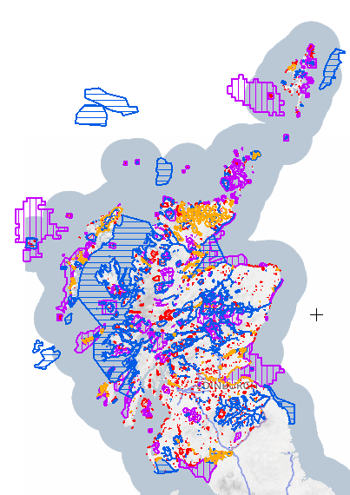
Scotland's Protected Areas
1880 sites SSSI, SAC, SPA, RAMSAR
5600 designated features
18% terrestrial Scotland
30%
Notes:
In Scotland we have 1800 protected areas hosting about 5500 designated features.
In total that makes up about 18% of terrestrial Scotland

Slide 3
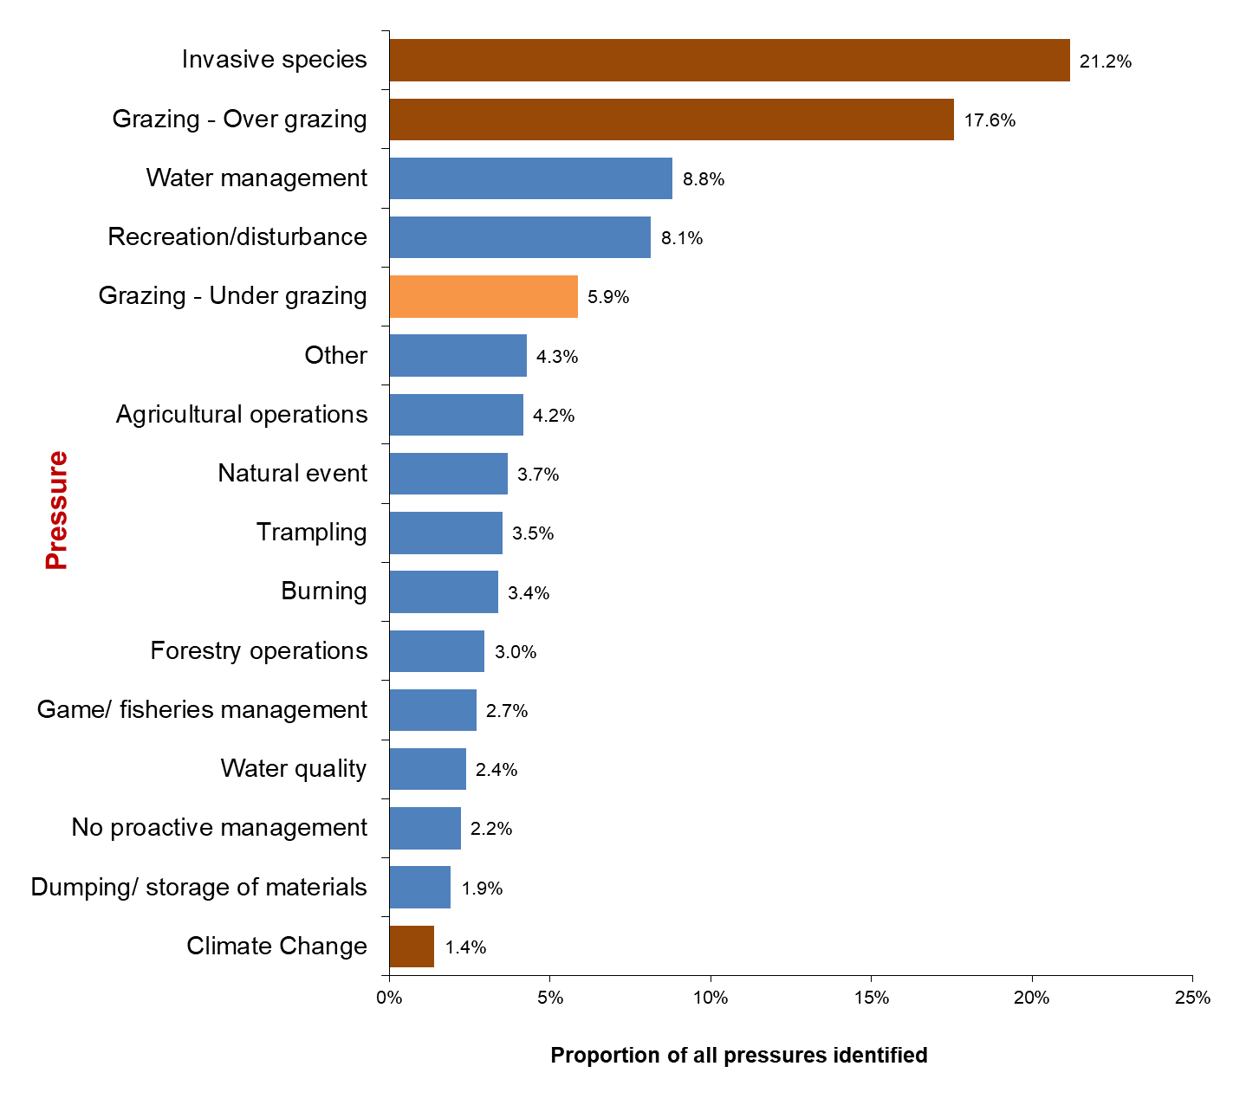
Has our monitoring delivered favourable features?
2022
Notes:
Given the current nature and climate crisis and our ambitious targets to halt the loss of nature by 2030 and to restore it by 2045, which includes our 30x30 commitment, we have an opportunity to review how we do things – can we do things better?
And we’ve come to the conclusion that, yes. We can.
Currently a quarter of our features are in unfavourable condition after more than 20 years of our current approach.
Analysis of the pressures and threats in our protected areas show that often they operate at scales beyond the site boundary such as invasive species and Over grazing, which will require landscape scale action – which is often missed when we apply our monitoring to only the site scale.
We are struggling to cover the 18% currently protected, a recent statistic show that 44% of our features have not been fully assessed in 10 years.
With climate change and the need to monitor increasingly dynamic habitats just compounds to the problem.
So with all of that in mind – its clear to us that somethings gotta change.

Slide 4
Protected area monitoring reform
A
T
F
A
T
A
T
How do we reform our monitoring to ensure:
Protected areas are effectively conserved and managed for nature
The loss of nature is halted by 2030 and restored by 2045
Informs urgent action
The programme is affordable and well-managed
Applicable to OECMS
Compatible with future reporting
S
F
A
T
A
T
F
A
T
A
T
SCM as it is today
Feature base approach
Condition monitoring focused
Pass/fail targets
Limited to feature scale
Potentially 100s attributes
Notes:
So, at the moment, our current approach is a featured based approach.
Site – Features – Attributes – targets (pass/fail) = Condition
Each of our 5500 features are monitored independently and often in isolation of each other
And looking towards reform.
Yes it needs to be affordable and well managed, that’s a given, but its clear to us that we need to reshape our monitoring approach that it enables more consistent coverage across Scotland to let us see the bigger picture across the land/sea scape
And to enable the restoration of our ecosystems at pace and scale so that we can meet our ambitious targets for nature by more directly informing practical conservation, while being applicable to OECMS and compatible with future reporting requirements.
We are struggling to monitor the 18% we have effectively – a recent stat showed that 44% of our features have not been fully assessed in the last 10 years.

Slide 5
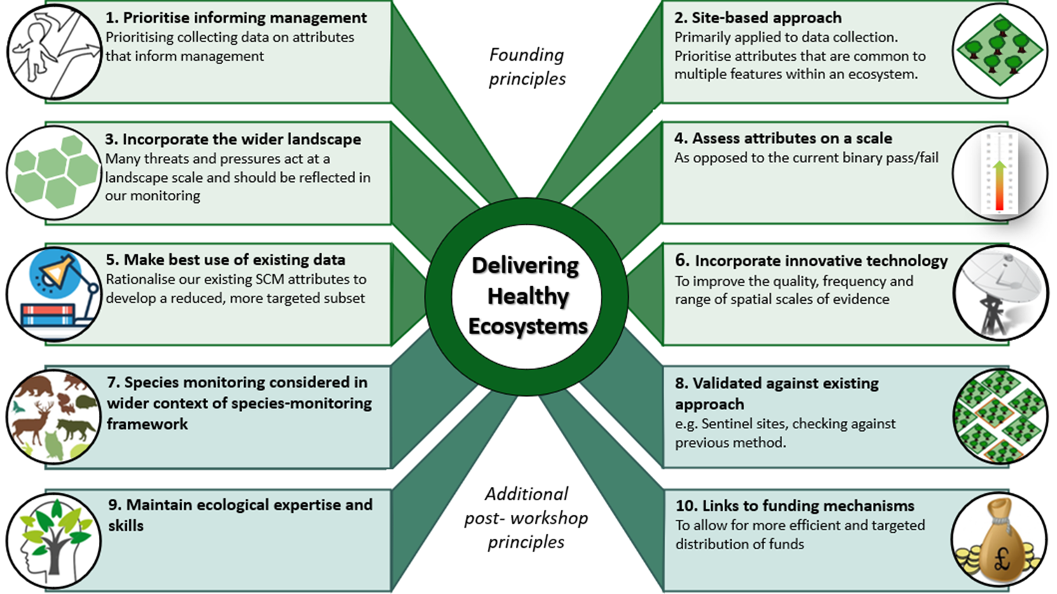
DHE guiding principles
Notes:
Which takes us to DHE – Monitoring to Deliver Healthy Ecosystem – the program of work to deliver protected area monitoring reform in Scotland
I'm not going to go through them in detail, given the time constraint. About 2 years ago we went through an 8 month consultation which resulted in these 10 guiding principles for reform.
To summarise the principles though:
The ambition with DHE, is to move to a site level assessment that prioritises informing management by emphasising and focusing on the pressures that drive change.
We want to incorporate evidence from the wider landscape into our site level assessments to look pressures at more appropriate scales - and also look at species monitoring at more appropriate scales. What we mean by that is we want to start asking the question is the protected area scale the best way to monitor this species, for some it will be, for others a wider species monitoring framework would be more appropriate
Its really important to us that we have a clear link with the various management and funding levers, to really tighten up the links with monitoring outcomes and restoration outcomes.
We also want to harness new and emerging technology and take advantage of third-party data, while reaffirming our ecological expertise and relationships with land managers.

Slide 6
Draft framework to deliver DHE
Loop 2
Is positive management happening?
Often when we speak to our colleagues, what we hear is that generally speaking we know where we want to go & what needs addressing but there is some blocker to implementing management. So part of this loop is capturing why? - what are the barriers?
Loop 3
Once we get to a stage where we've got positive management in place, the next step is to see if its effective – Are the pressures reducing.
We also want some mechanism for identifying new or emerging pressures.
Loop 4 – Once we've go tmanagement in place, and the pressures are reduce, then we want to see if its having the intended impact – is nature recovering. This might be looking at the response of certain features, however it might also be a currently undescribed holistic measure.
Effective management requires clear conservation priorities based on an understanding of pressures and threats
What are the management priorities?
Is positive management happening?
Establishing whether essential management is in place will enable evaluation of effectiveness & clarify barriers
Monitoring to deliver healthy ecosystems
To understand nature's recovery, we want to look at at combination of features specific and holistic measures.
Understanding how pressures are trending will inform our next steps either to revise management strategies or monitor state.
Is nature recovering?
Are pressures reducing?
Notes:
So in order to take our guiding principles and turn them into a coherent national monitoring program, we decided to develop a high-level delivery framework.
So heres the framework. We’ve been working on this since about August, on its second iteration, having gone through an internal process for feedback. The framework is a cycle made up of 4 ‘loops’. We’ve struggled in other versions to get the terminology right, but here we’ve named each loop after the main question its asking.
Management priorities Loop
- Starting at the top left, The first loop is asking 'What are the management priorities?’.
This is where we review what is already known about a site. I.e. what is its current state, what are the priority pressures and threats, what does prior monitoring tell us?
But also an opportunity to look towards the future, and build a consensus of what we want the area to achieve both long and short term.
Then looking at the second loop - 'Is positive management happening?’.
When we speak to colleagues and partners, what we often hear that required management for one reason or another hasn’t happened.
So this is where we want to establish if positive management is or isn’t in place, but also to take it a step further and identify the barriers to that management being in place, which we feel will become a really powerful reporting tool.
Then, Say we have evidence that management has taken place, the next step is to see its effective
- Are the known pressures that we outlined earlier in the process, reducing?
- We also want some kind of mechanism that identifies new or emerging pressures that need to be addressed.
Then finally – Say we have evidence positive management is in place, and we have evidence that the pressures have reduced, the next step is to assess whether that is having the intended impact and see if nature is responding. Is the site moving towards the its overall objectives, with more state focused metrics.

Slide 7
Draft framework to deliver DHE
What are the management priorities?
Is positive management happening?
Key take aways
Allows us to prioritise & focus monitoring on a case-by-case basis
By starting with a focus on management, we inextricably connect monitoring to restoration outcomes.
Reemphasises the one-on-one connection with land managers.
Monitoring to deliver healthy ecosystems
Is nature recovering?
Are pressures reducing?
Notes:
Some of the key takeaways
By breaking up the monitoring into these four loops, it means we can prioritse and focus our monitoring on a case by case basis. We've made re-evaluating conservation objectives a key part of this approach.
While we've depicted it in a cycle – its not necessarily a linear process. One of the areas we're working on as a team is to develop a decision tree, which is working through each loop, step by step and highlighting what decisions and scenarios you might come across and what might raise a red flag for re-evaluation – which may in turn affect what you decide to do next. For example if you know what needs to be done and theres no management in place, do we want to go out and monitor state in an area we know is still under pressure. We are suggesting that maybe we want to instead, go back to loop 2 for example and really hone in on adjusting that management.
Another key aspect of this framework is how it tilt out current approach on its head a bit by putting management first and then having the monitoring be responsive to that. We haven't necessarily got it all figured out – One critical areas that needs more consideration is species monitoring. We recently went out to speak to Scottish Environment Link and one of the questions was, what about Twin flowers – They need additional interventions beyond habitat restoration, they need translocations to help out with the genetic bottleneck. How do species like that fit into this approach? Well what we've been thinking is that, it would be identified in the conservation objectives in loop 1 as a site specific intervention, the rest of the information we collect in the other loops would just adjust to that. So while this approach is emphasising whole sale site restoration, and focusing on the big drivers of change, there is room for this kind of monitoring in theory
We haven't got it all figured out yet – we're taking an iterative approach, with continuous development – hoping to test some of it out in various pilots next year.
Examples
If the conservation priorities arent clear, maybe theres conflicting features, we should focus on loop 1
If we know what needs doing – have they already implemented that, if not why not. It would be best to focus on chipping away at barriers
If we know what needs doing and we know positive management is in place but the pressures aren't reducing then maybe the best use of our resources is to focus on tweaking management rather than continue to monitor the state of an area that continues to be under pressure

Slide 8
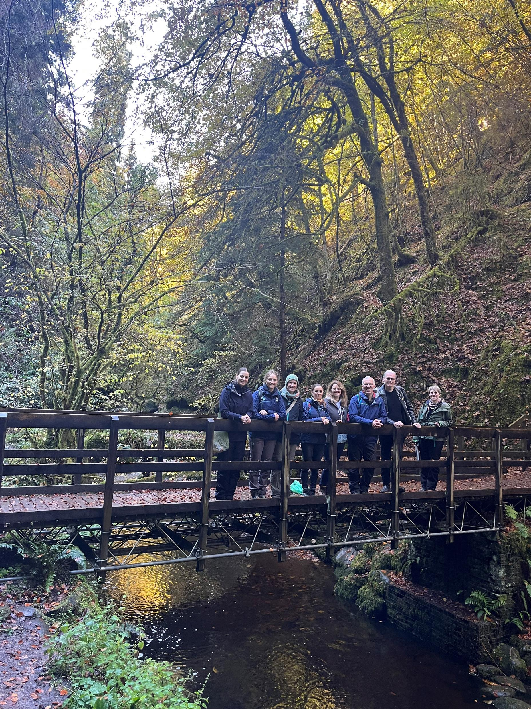
Thanks for listening!
Don’t hesitate to drop us an email with any questions or feedback!
Lisa.Davidson@nature.scot
Ruth.Paterson@nature.scot
Further reading:
Ross , B. and Genney, D. (2024) Protected Areas Monitoring Reform (SAC/2024/03/03). Scientific Advisory Committee meeting – 18th March 2024 – 67th Meeting. https://www.nature.scot/doc/scientific-advisory-committee-meeting-18-march-2024-67th-meeting
Davidson, L., Genney, D. and McGrory, S. (in press) Monitoring to Deliver Healthy Ecosystems in Scotland's Protected Areas, Workshop Feedback Report 2023. NatureScot Research Report 1351.
•The team's webpage where project progress will be posted: https://www.nature.scot/professional-advice/protected-areas-and-species/protected-areas/site-condition-monitoring/looking-future
Notes:
Thank you for listening to my whistle stop tour of the Protected area monitoring reform in Scotland.
I think we have some time for a question or two – however, if after that there is still more, you’d like to know, don’t hesitate to come and find me or get in contact – email, linkedin whatever. I’ve also got some further reading links here on the slide that might be helpful.

Slide 9
Site Condition Monitoring (cycles 1-3)
Review
Management
Change Management
+/-
Woodland
B
230 ha
Repeat monitoring every 10 years
D
10%
+/-
Deadwood beetles
SITE
SITE
20m³
10%
Review
Pressures
Bryophytes
+/-
D
0%
Lichens
C
Low
E
+/-
Follow-up actions
D
0%
A
+/-
Notes:
We currently monitor our designated features through Site Condition Monitoring, which is a feature based approach.
This means that we monitor each feature independently and often in isolation to each other.
Each feature has a set of attributes, derived from common standards, and each of those have targets which either pass or fail, which ultimately determine whether its favourable or unfavourable condition.
Through out the years we’ve been evolving the process to fit our needs, so at the moment we have a three tiered approach which is risk based, and operates on a 10 year cycle – which isn’t exactly ideal for monitoring restoration or facilitating adaptive management.

