Slide 1
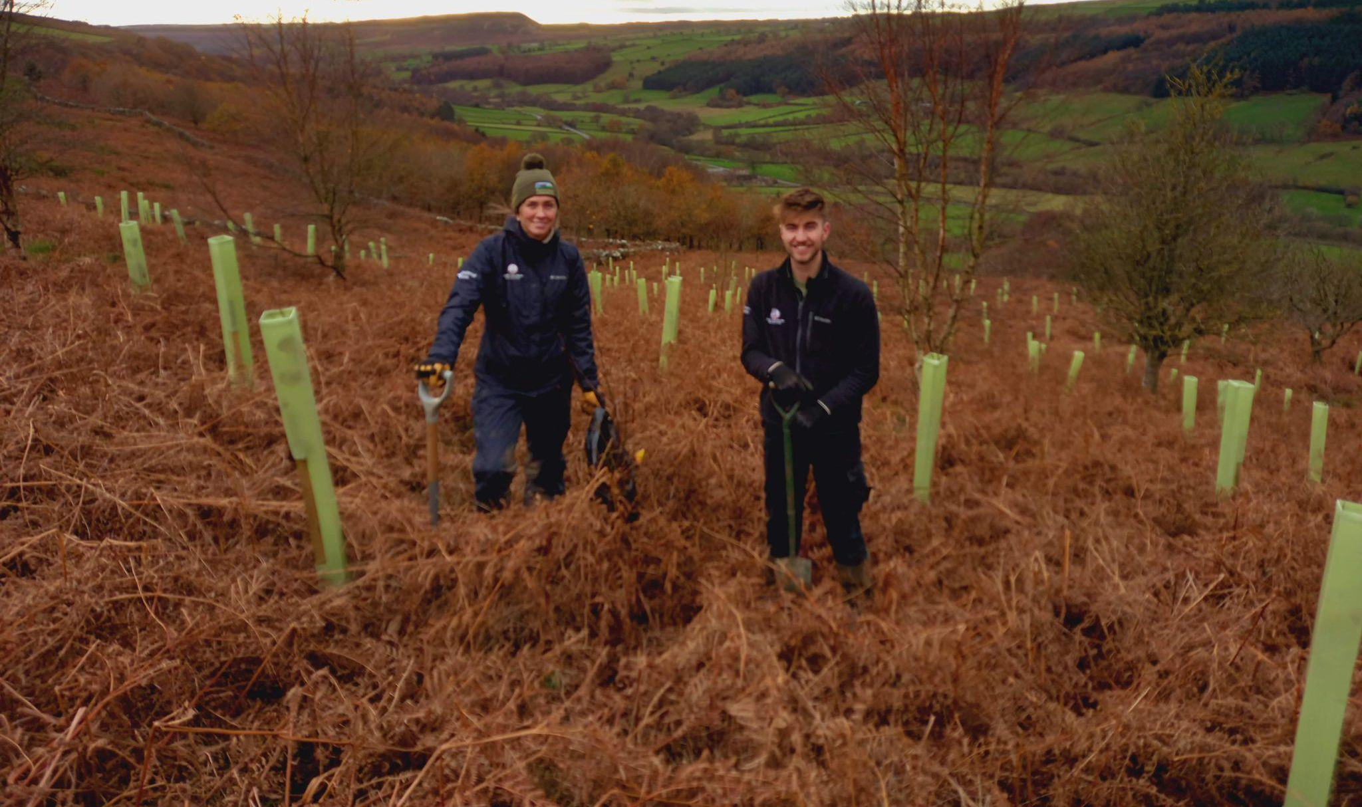
Youth Voice on Flourishing Communities

Slide 2
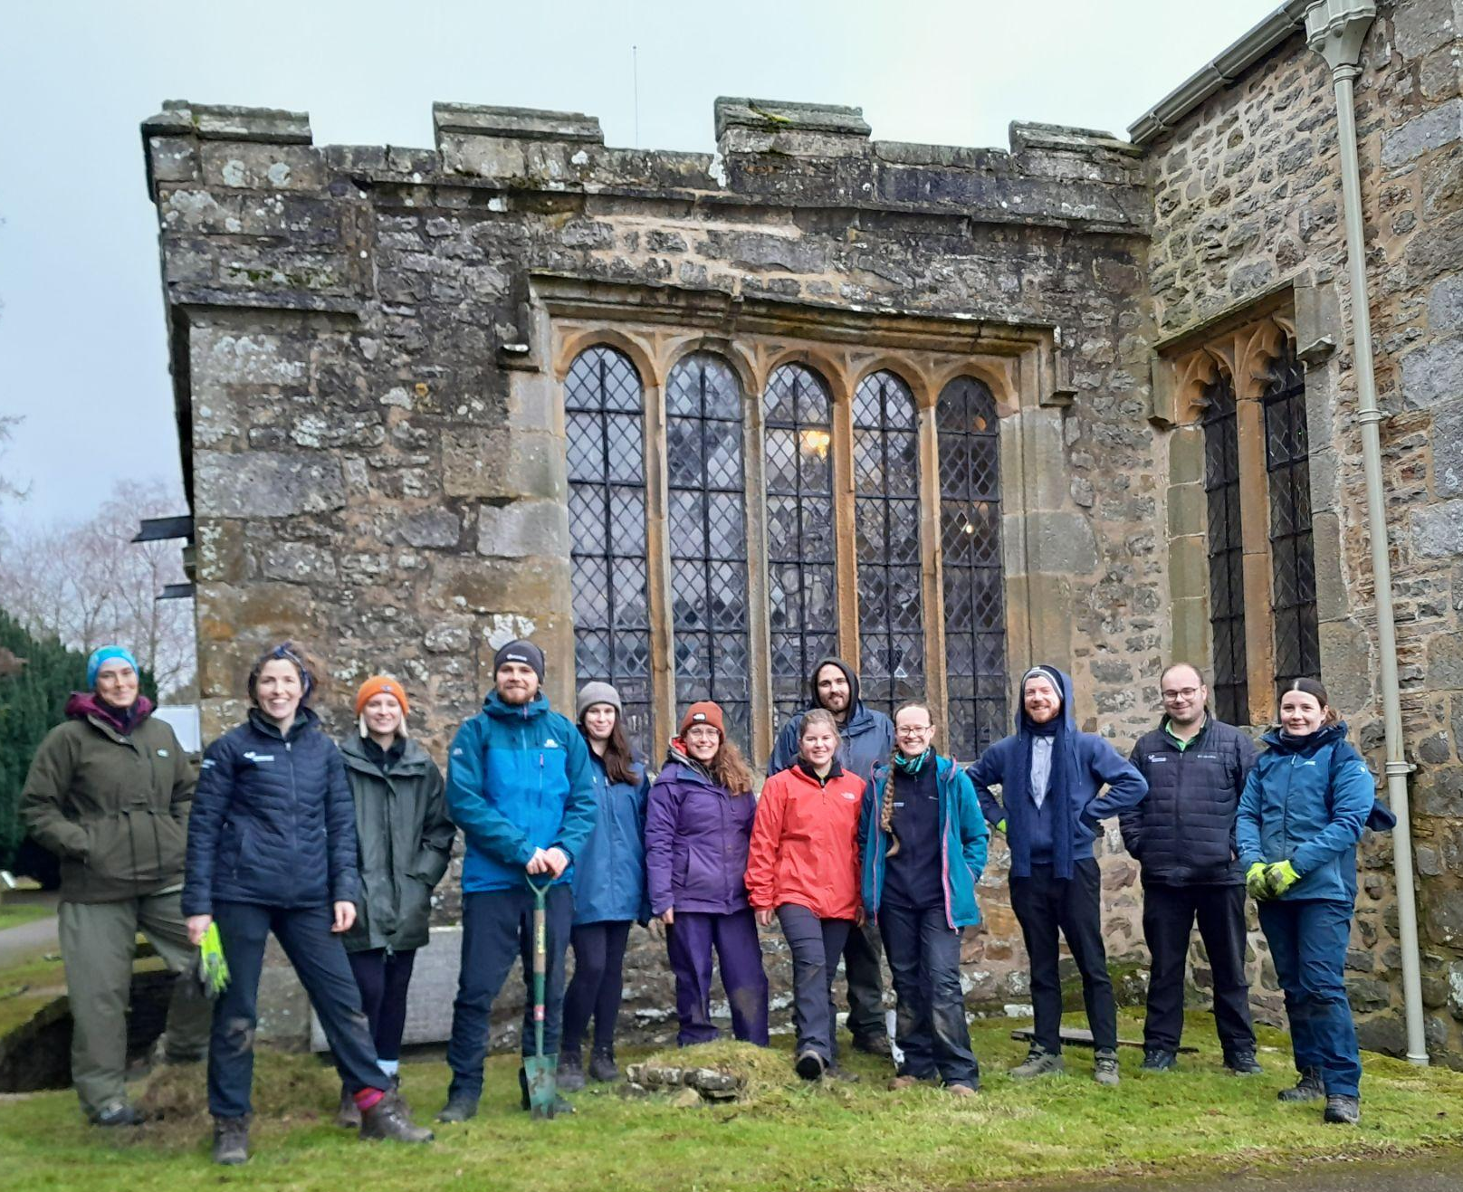
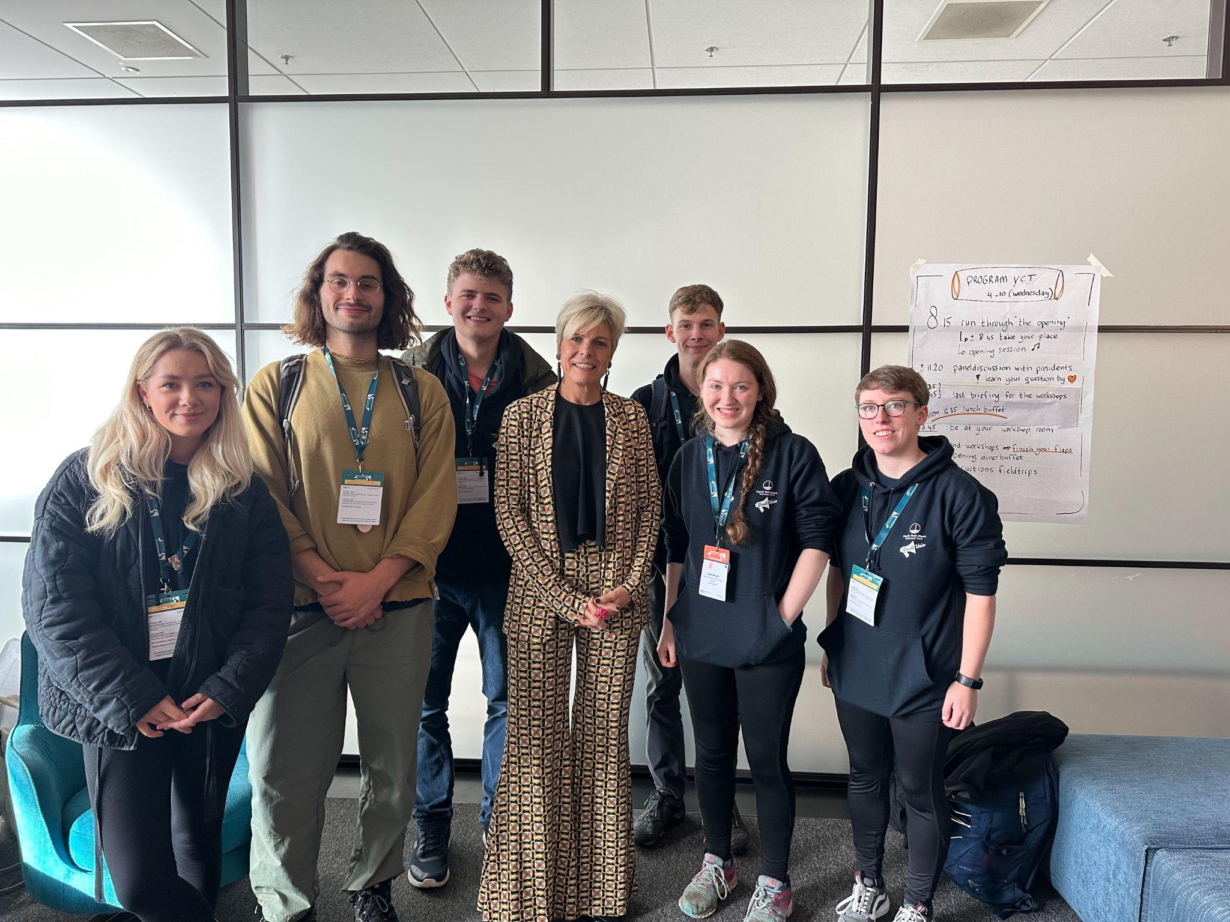
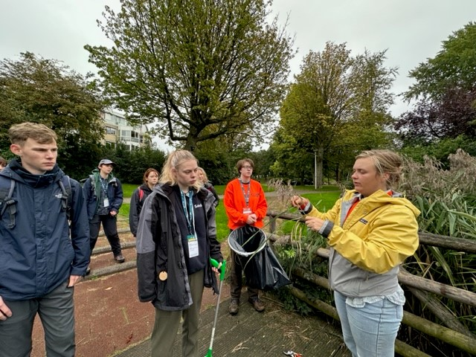
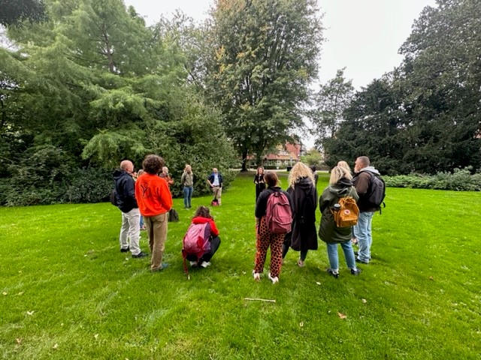
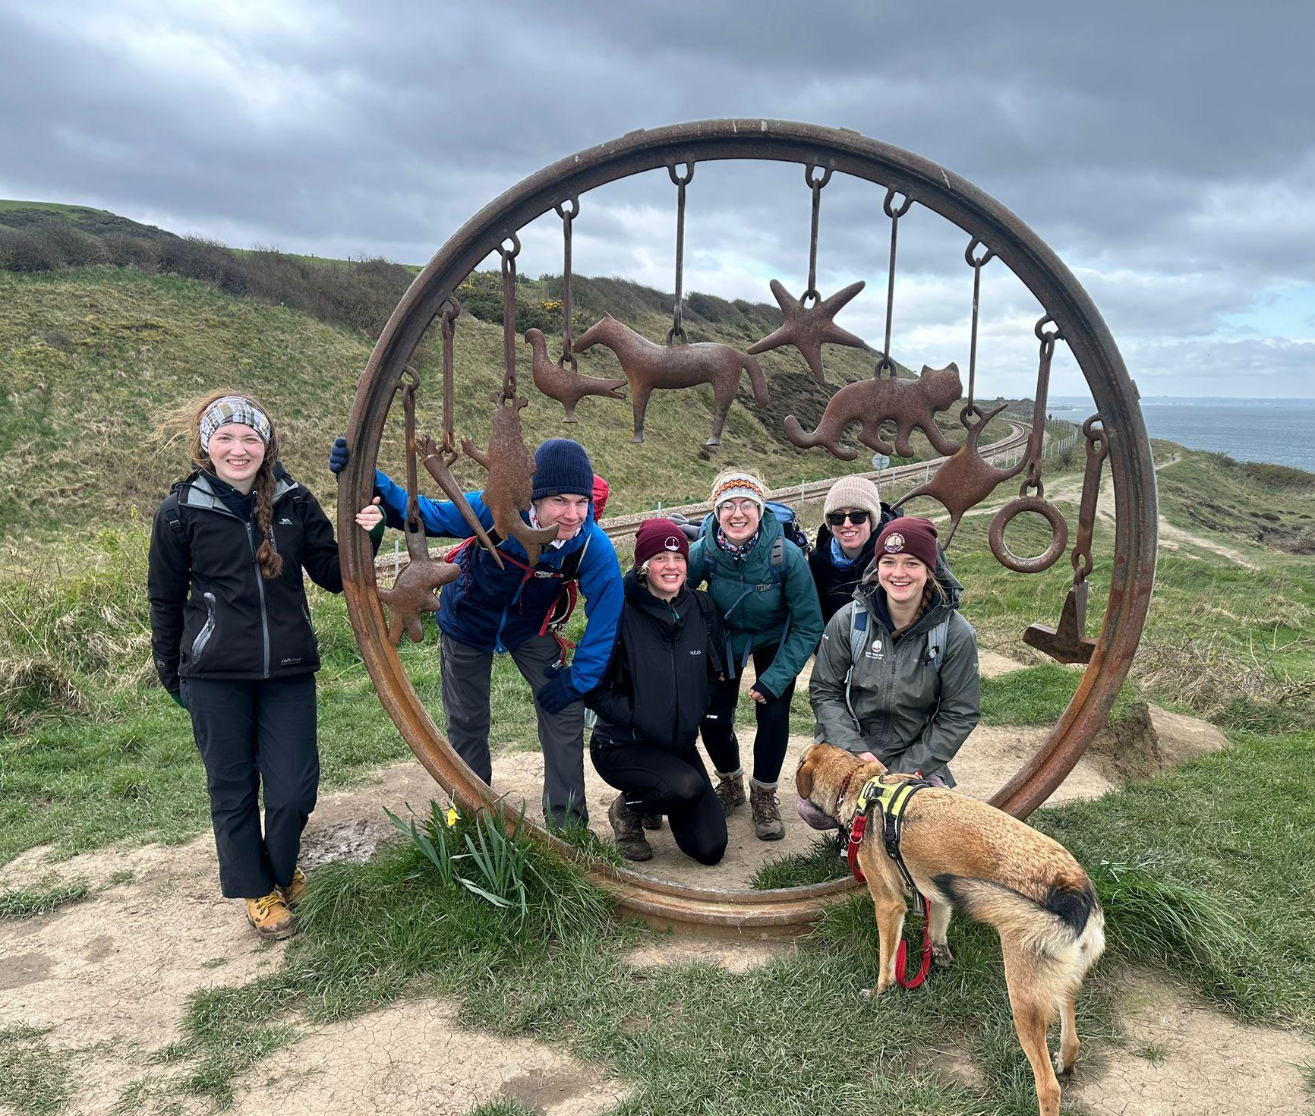
How can a community flourish in National Parks when they face so many ongoing barriers?
Only 6% of visitors to National Parks are under the age of 25
National Park communities are facing a lack of jobs and training opportunities
There are no consistent ways for young people to speak up and be heard in National Parks
There’s an ongoing housing crisis, how can young people afford to stay where they were raised?
Children and teenagers are growing up less connected to nature, are they educated on National Parks?
Notes:
National Parks should be places where everyone can thrive—but for many young people, enjoying these landscapes feels out of reach.
Only 6% of visitors to National Parks in England are under the age of 25. Children and teenagers today are growing up less connected to nature than any previous generation.
Beyond that, rural communities are struggling with a lack of local jobs, training opportunities, and affordable housing. How can young people stay in their communities when they can’t afford to live there? And how does heritage live on if young people are being pushed out of the villages and towns they were born into.
And with no consistent way for youth to have a voice in shaping the future of these spaces, why don’t all National Parks have something like Youth Voice or a Youth Council? And why are barriers still so apparent for young people?
The heritage and culture of our protected landscapes is so important, but how can we as a generation protect this if we are being forced away from the places we know. Who will pass on rural skills and knowledge if we can’t grow up surrounded by it.
From those who have grown up in National Parks, to those who’ve never even visited, we need to ensure National Parks are accessible to all young people—so we can help protect, inspire, and enhance these places for generations to come.
We are the future of National Parks. It's time to make sure our voices are heard are barriers are broken.
Together, we can make changes, so the future of National Parks can flourish.
We need to make our landscapes more accessible for all young people, so we can flourish to inspire, protect and enhance our National Parks for years to come. We are the future of National Parks.

Slide 3
Travel into National Parks
National parks have pledged to halve emissions in the landscape by 2030 by joining the ‘Race to Zero’ initiative.
Limited bus routes and timetables. Some routes only operate on Sundays.
Buses follow the hotspot routes.
Public has no awareness or incentive to use public transport.
As industry increases it may increase congestion during rush hour.
‘I didn’t know you could get there by bus!’ - Alternative travel links aren’t advertised enough.
Long commutes for employees of the NP who live outside the boundaries. Average 40 mile commute. No alternative travel options for some.
Mileage claims are unfair to those with large commutes. Only allowed to claim additional mileage after their average commute.
Notes:
A transition to sustainable travel to and from National Parks, reducing visitor travel emissions to near zero by 2050.
Combined and local authorities and others to use their powers and investment in the infrastructure and services needed for net zero transport and energy.
Tourists visiting the National Park are unaware or have no incentive to use public transport. We think it may be beneficial to implement some form of reward scheme for certain miles travelled via public transport. (Points system, reward at the end).
Our current buses operate on limited services, mainly travelling to hotpot routes. If we are to increase industry and opportunity to work within the park boundaries, we should supplement that with the ability to commute via public transport, slowing down potential congestion during rush hours.
Young employees who are unable to live within the National Parks have no choice but to commute long distances. The average commute across our parks combined is around 40 miles. Only after our commute are we able to claim back mileage.

Slide 4
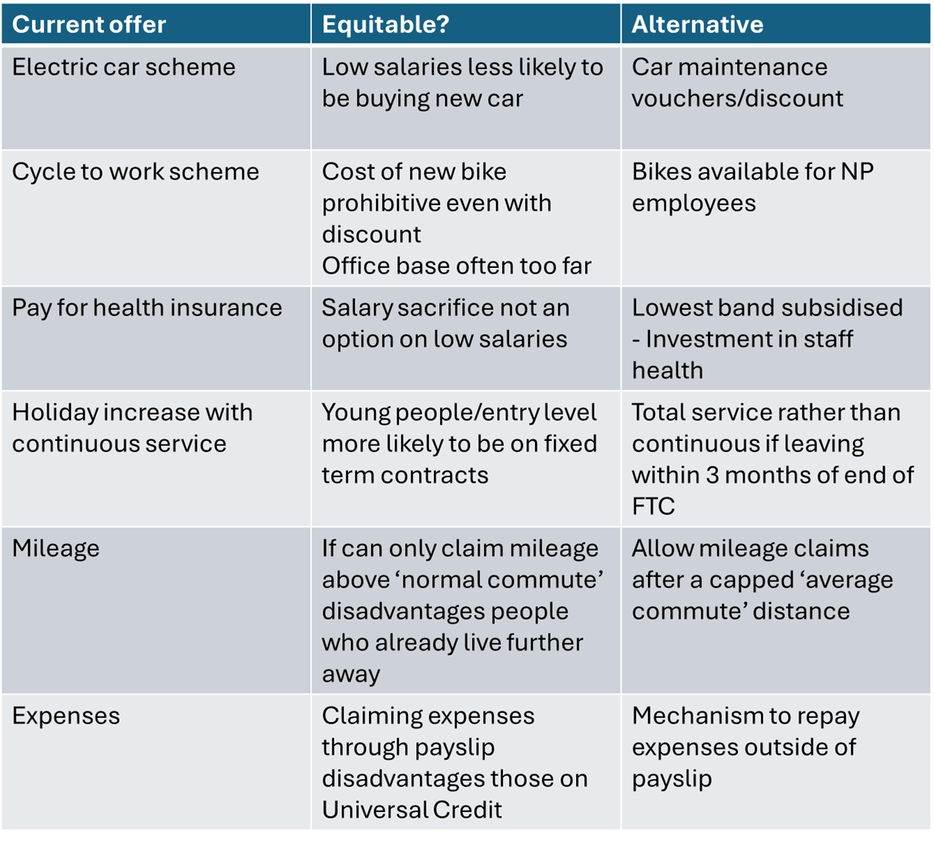
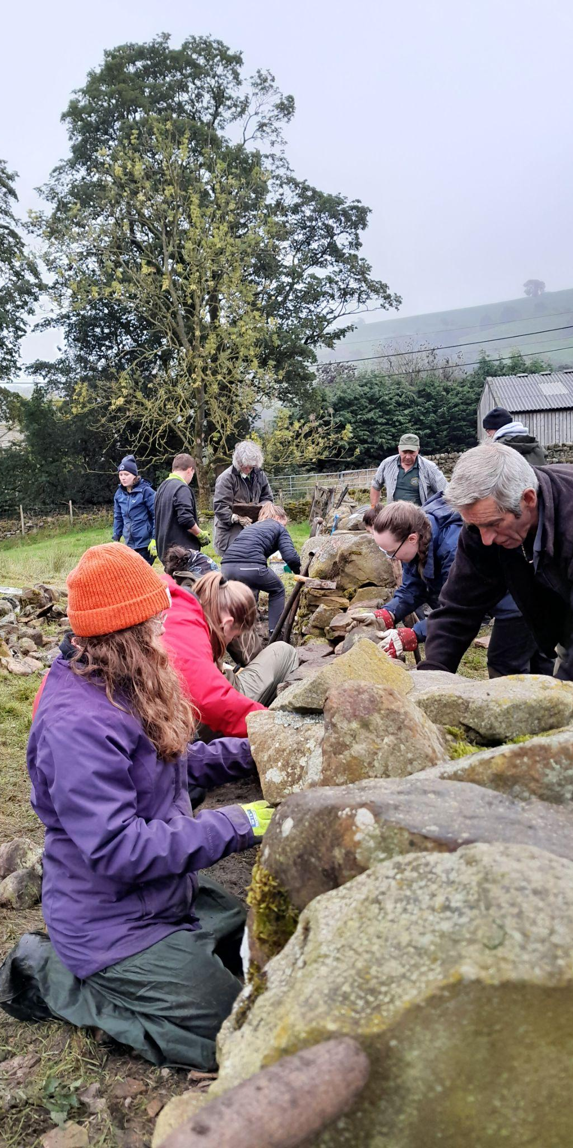
What can National Parks do, today, as employers?
Are your staff benefits equitable?
Be Bold - secure housing to run as HMOs for young employees?
Apprenticeships
Notes:
We are talking about here some big barriers to flourishing communities, particularly of young people, in National Parks. We know these are not easy fixes, and you might be sat thinking ‘well National Parks don’t control house prices, can’t increase council tax on second homes, and don’t even set our own budgets’. But there are things National Parks, can look to change as employers, in the short term, to help alleviate the symptoms of these big barriers, while we work on addressing the causes in the long term.
Many young people want to work for National Parks, but this can be really hard to do if you don’t already live within the area. We know National Parks have stretched budgets, reflected in salaries, and try to offer attractive benefits instead. But are these benefits equitable? Are they enough to bring young people into the area and into these roles? Some benefits, particularly salary sacrifice schemes, are often inaccessible for entry level roles, which are already disadvantaged in having a lower salary. Does your mileage claim policy disadvantage those who already live further away from the office and already incur higher commuting costs? Do you have diverse perspectives in the team which decides those benefits, or might you need to consult with young people?
Can we be bold? This presentation is outlining how much of a barrier housing is - can National Park look to secure housing, perhaps from existing holiday homes, to run as HMOs available for young employees who would otherwise struggle to move into the area? This could be a more accessible alternative to the relocation packages offered for permanent, higher level roles.
Sentence on apprenticeships to link to next slide

Slide 5
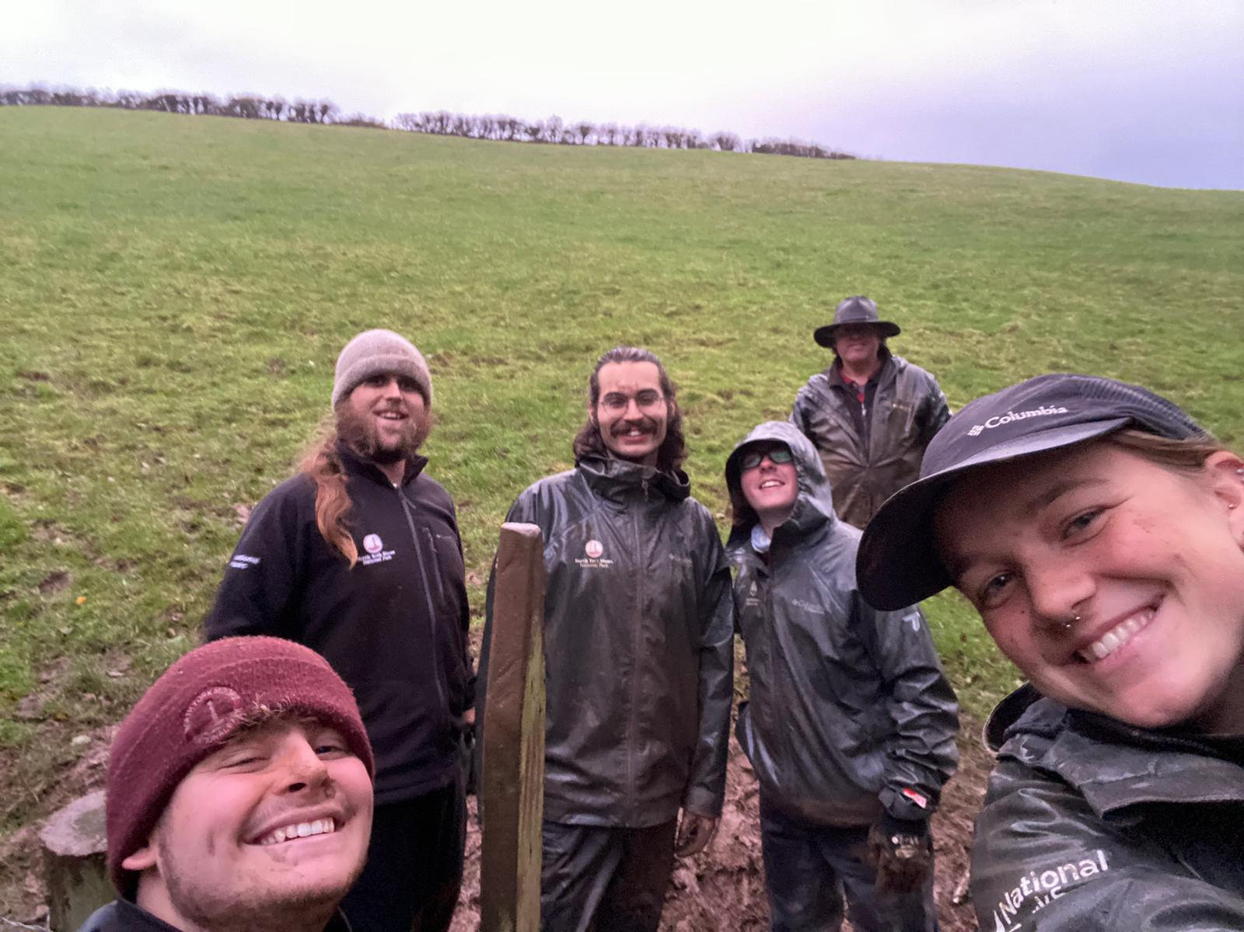
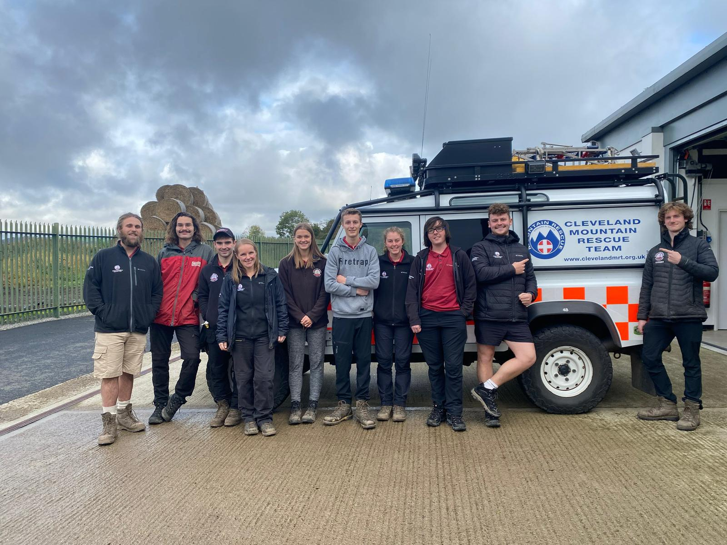
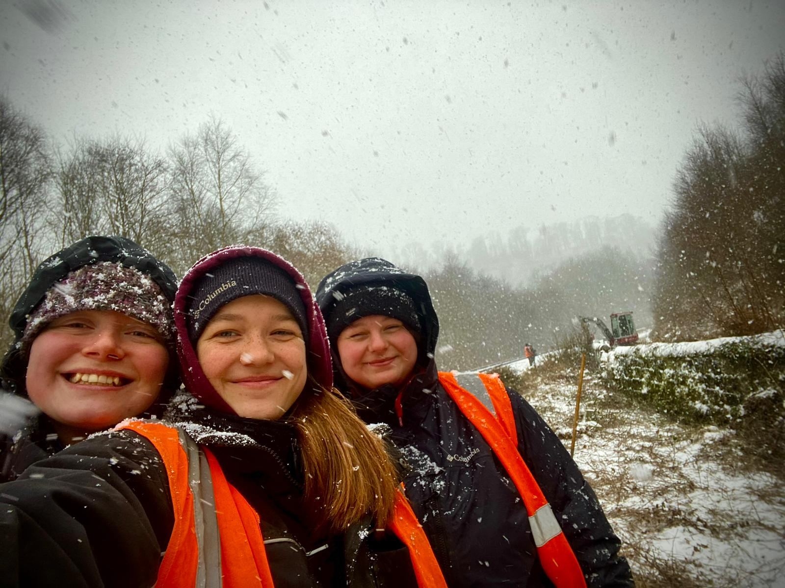
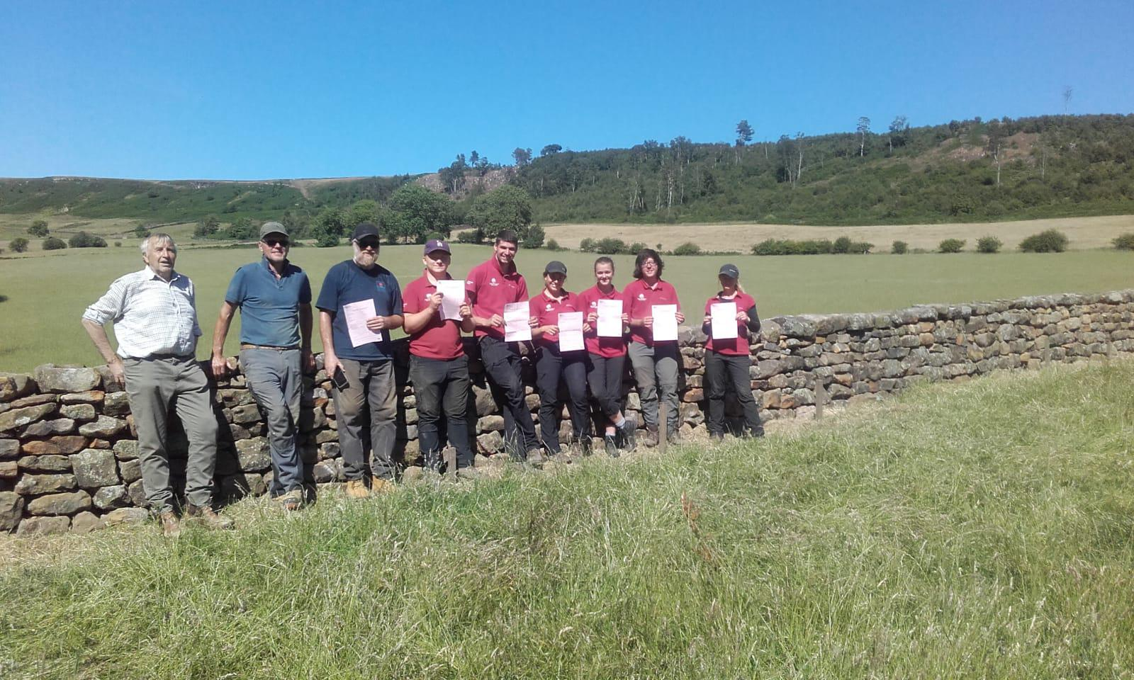
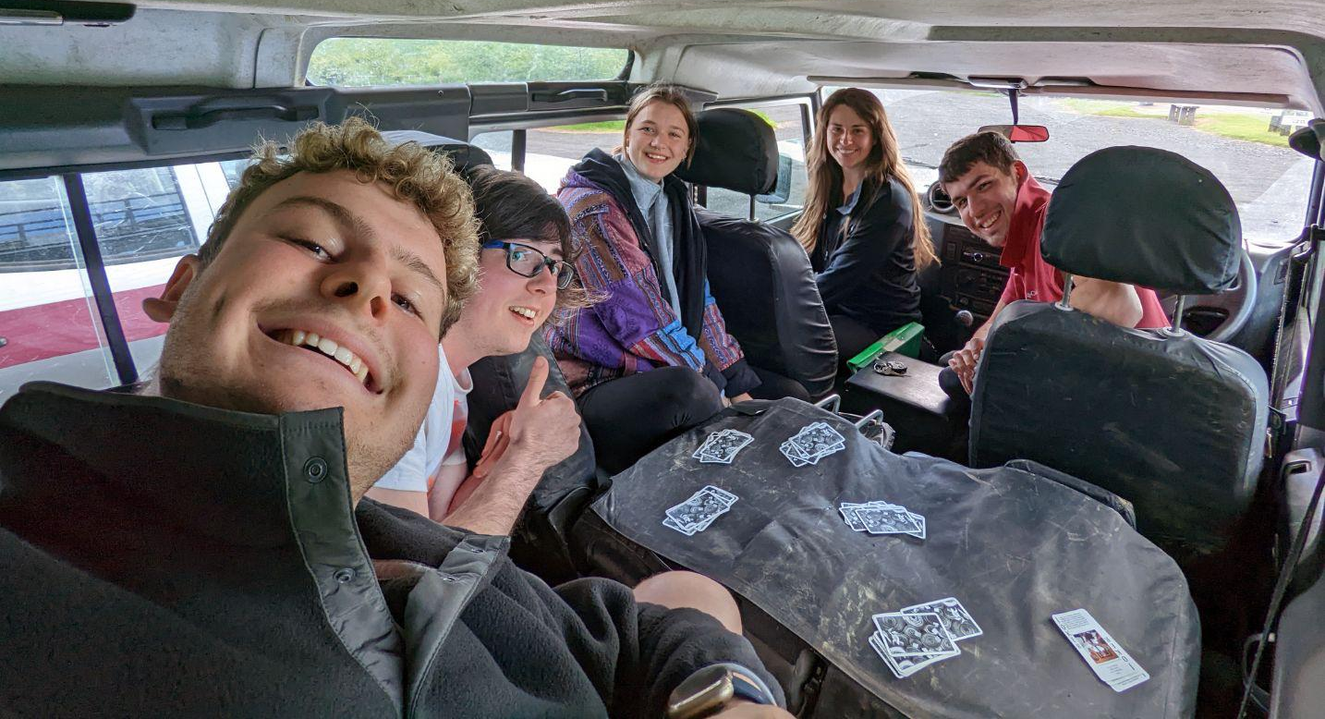
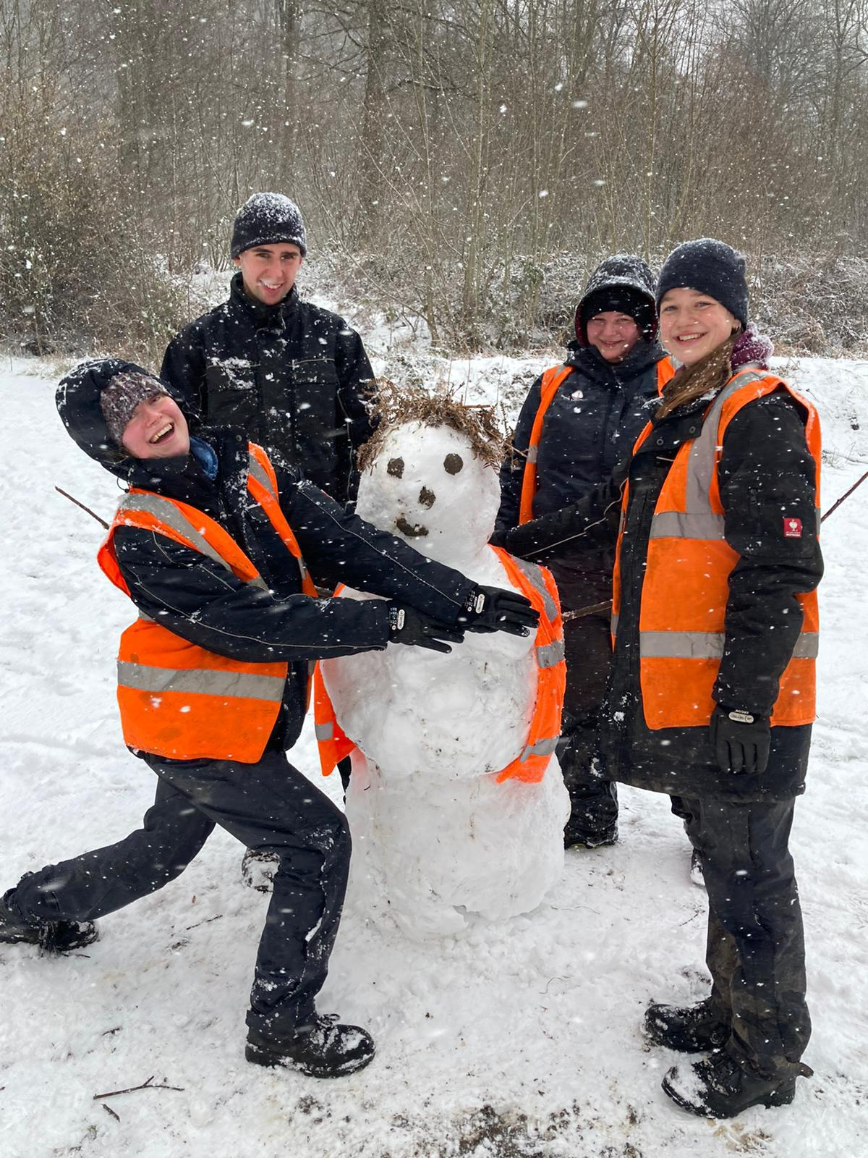
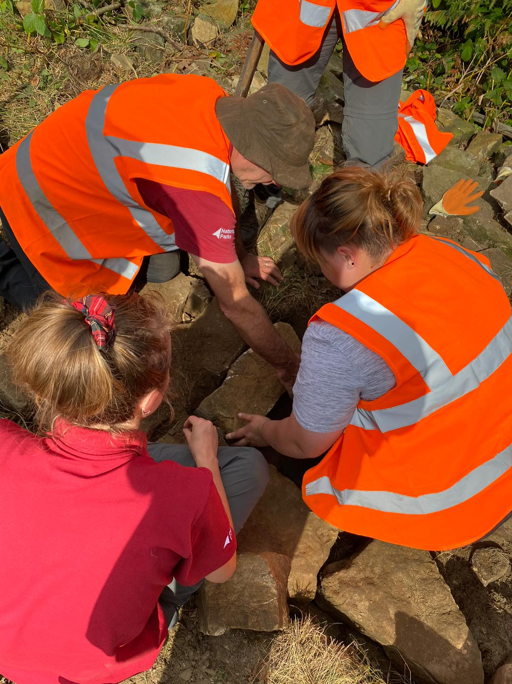
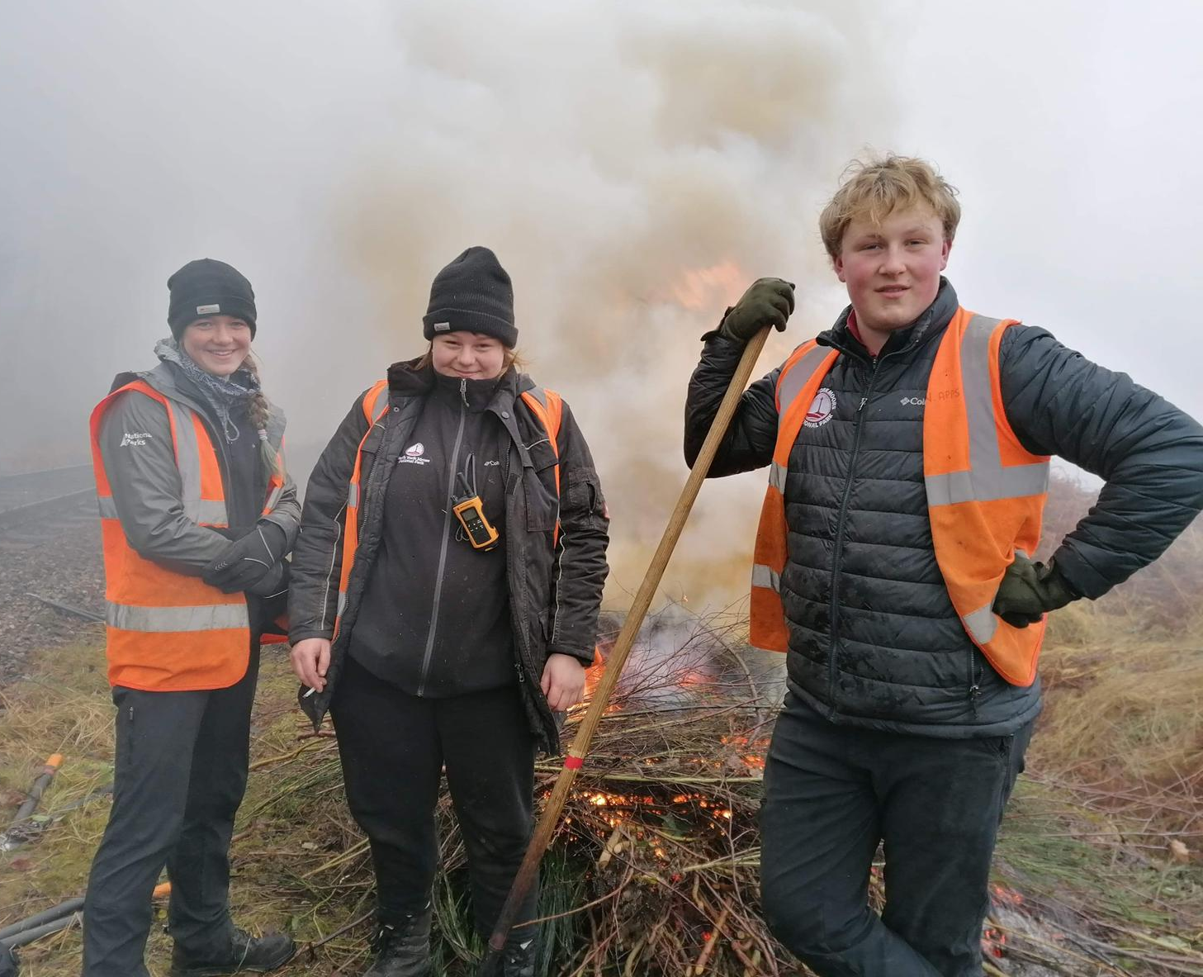
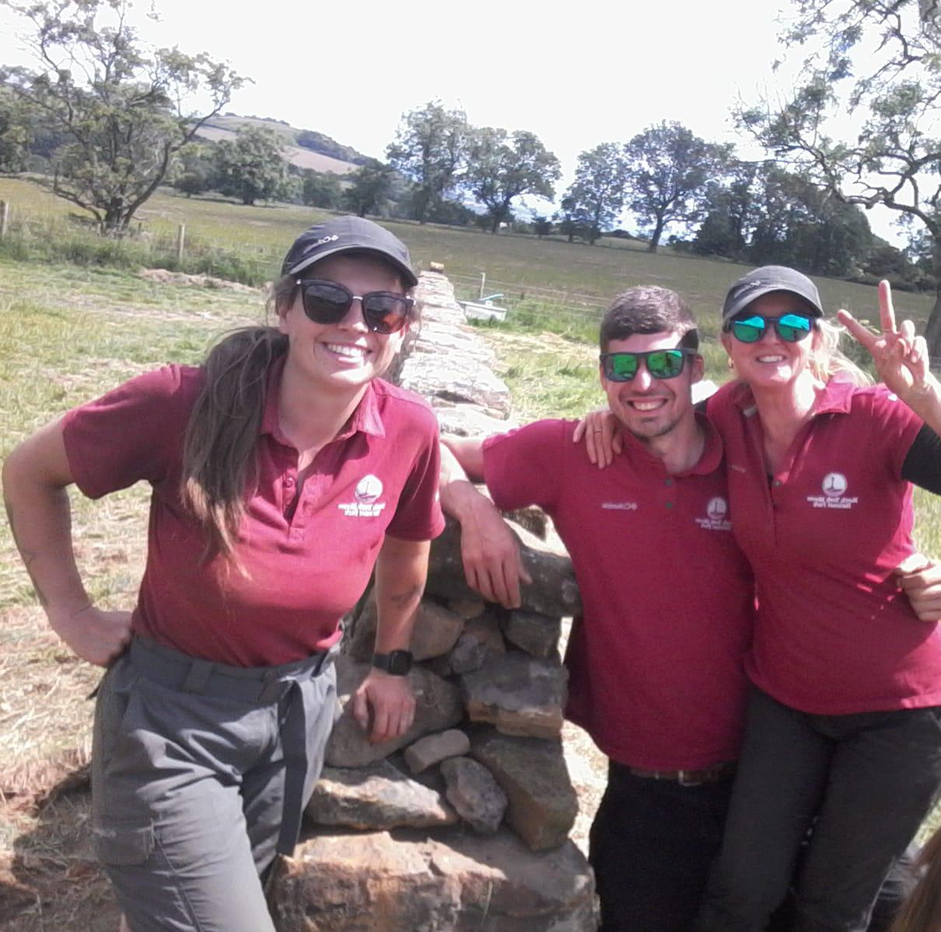
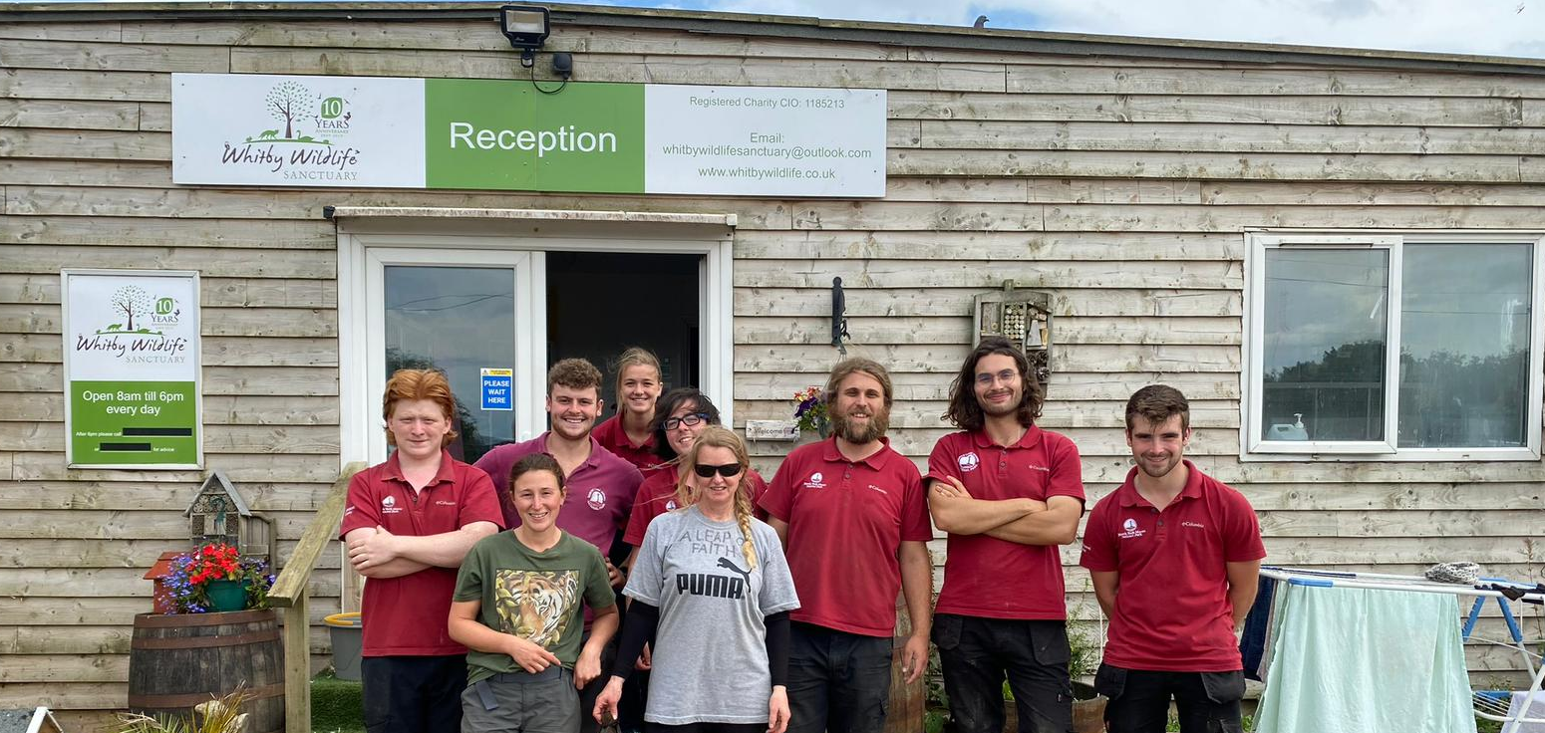
What are the barriers for young people when accessing apprenticeships?
Notes:
Apprenticeships are amazing opportunities that give hands-on experience and the opportunity to gain a qualification all while working and earning. They are great for young people to be able to set foot into the working world as jobs down the line can often be difficult without years of experience.
However there are many barriers young people face when accessing green apprenticeships.
One of the biggest barriers to being able to take on an apprenticeship is the pay. All apprentices regardless of their age or circumstance, for the first year, can get the apprentice wage. This is currently just £6.40 per hour. Despite being in full time education and taking on generally the lowest pay apprentices still need to pay council tax unlike college or university students. This makes moving from home to take on an apprenticeship really difficult let alone trying to support dependents.
Because of the low pay, many apprentices will need to live further away from work in more affordable areas often outside the national park. If public transport was reliable this would be an option but often times the timetables don't line up with the working day if there is a bus or train at all! This puts more added costs on to be able to buy and run a car. If a young person doesn’t have a car or is too young to be able to drive they will have to reply on other people to get to work.
This limits the diversity of individuals that are able to apply, often to people who are privileged enough to already live within National Parks and have access to a car.
Whilst ultimately National Parks set their pay for employers they’re are faced with massive pressures due to the funding from DEFRA. Especially the lack of budget increase in line with inflation. This makes funding for apprenticeships often rely on external funding which is unstable and not long term.
National Parks have no future without young people and without more support funding apprentices there will come a time where there is a massive gap in our workforce.

Slide 6
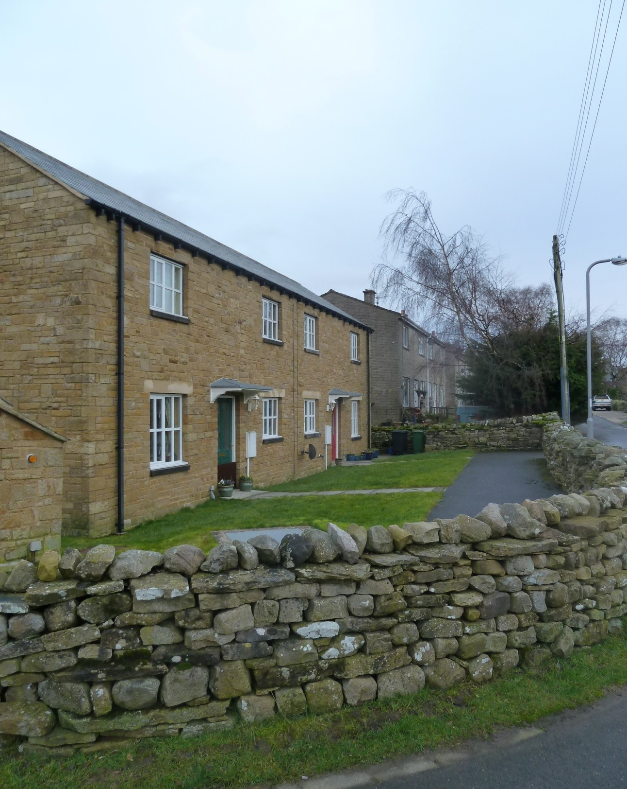
Housing across both Authorities
North York Moors National Park Authority | Yorkshire Dales National Park Authority
Population (2011 Census) 24% of population under 30 years old 50% of population 50-80 years old | Population (2017) 16% of population under 18 years old. 30% of population 65 years old and older Half the national average of working age people (18-44)
Second Homes 2,250 homes in the North York Moors are second homes or holiday lets. (2011) | Second Homes 3,500 homes in the Yorkshire Dales are second homes.
Housing Affordability Average house price in NYMNP: £389,591 (2023) Average individual income in the NYMNP is £24,600. | Housing Affordability Average house price YDNP: £357,351 (2021) Average UK house price: £282,000 (2024)
What is the Authority doing? Affordable housing developments. Occupancy restrictions - local connection criteria and principle residency housing. | What is the Authority doing? Plans to develop affordable housing in Threshfield/Grassington. 2 affordable homes renovated in Bainbridge. Target of 50 houses per year between 2025-2040
Notes:
•Housing in the Yorkshire Dales and the surrounding areas is often out of a young person’s price range (include average house prices).
•Houses within price range are often a significant distance away from the park, making it difficult for those who wish to live and work there.
•Lack of rental properties is also a challenge for young people who may not be in a position to buy (stats on rental properties in the NP).
•Young people struggle to compete with those buying second homes and cash buyers.
How is this issue being tackled by the Yorkshire Dales National Park?
Plans to develop affordable housing in Threshfield/Grassington.
More plans - can someone who works for YDNP please inform??
Target of 50 houses per year between 2025-2040 - which sets out policies to guide what development can and can’t take place within the Yorkshire Dales National Park.

Slide 7
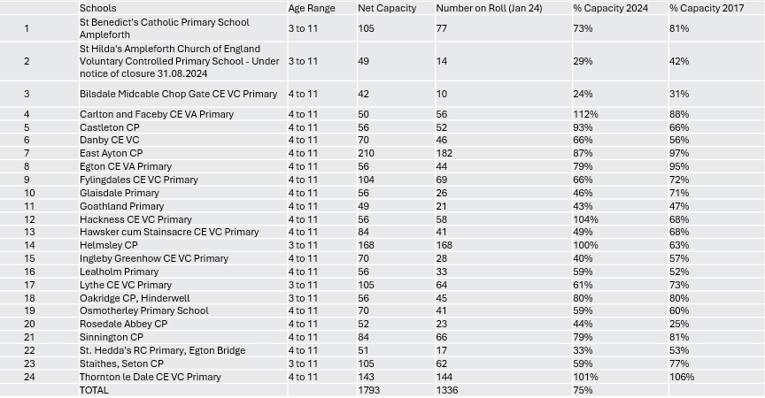
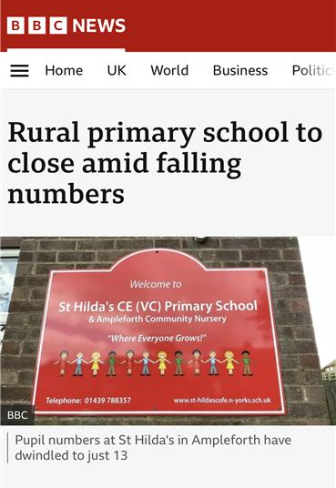
Schools in the North York Moors National Park
Source: North Yorkshire Council
Notes:
Lack of young people and families in the NYMNP means that schools are already seeing a decline in pupil numbers - there’s been a drop of 457 students in the last 7 years.
With 12 schools seeing a drop in students since 2017 and 7 of these schools have less than 30 students on roll - will they be at risk of closure?
More schools that risk closure will lead to the area being less attractive and appealing to young people wanting to settle down and start a family in the NYM.
Helmsley has seen a development of 45 new homes between 2020 and 2022 - you can see the positive impact this has had on the capacity of Helmsley CP school. If small plots of affordable housing can be built across the NP, this has the scope to positively impact our small, rural primary schools by enrolling more students and therefor securing jobs and futures.

Slide 8
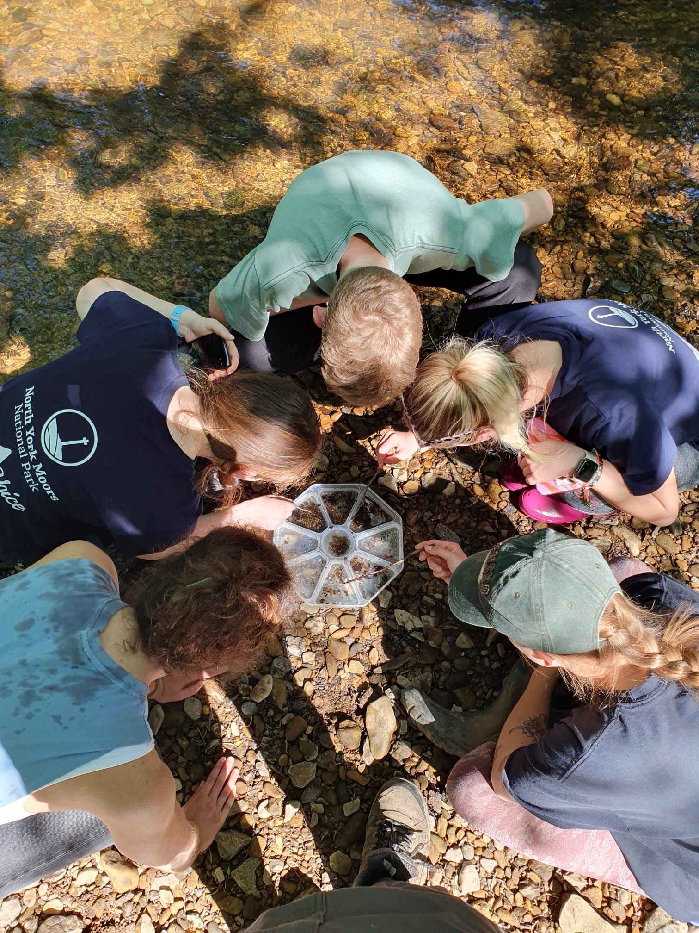
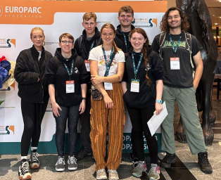
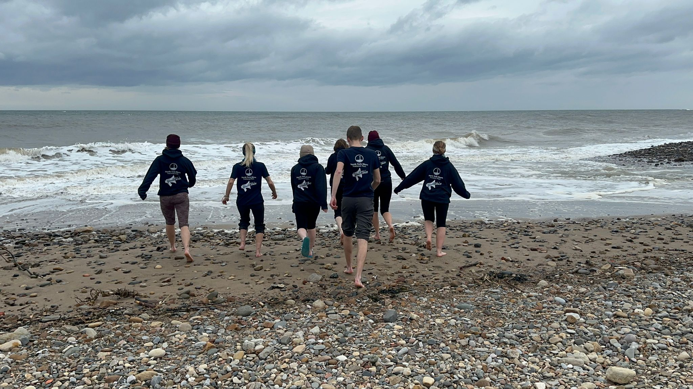
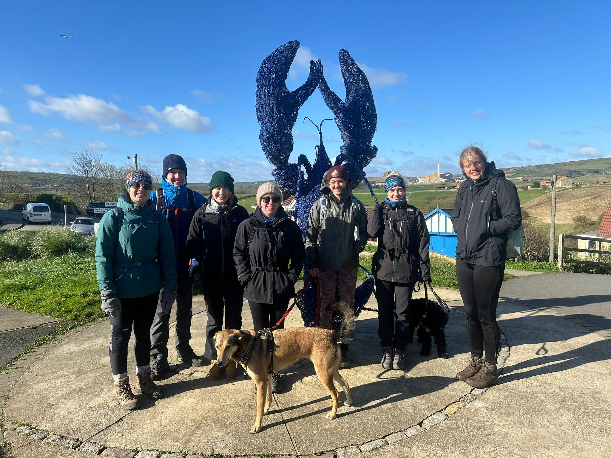
Suggestions for the future
Make our landscapes more accessible for all young people, so we can flourish to inspire, protect and enhance our National Parks for years to come.
Advertise the alternative travel available to get to National Parks.
Be Bold - Help house young employees, pay apprentices fair wages and commit to employment of young people.
Visit Schools, inspire and educate the Youth about the Parks.

Slide 9
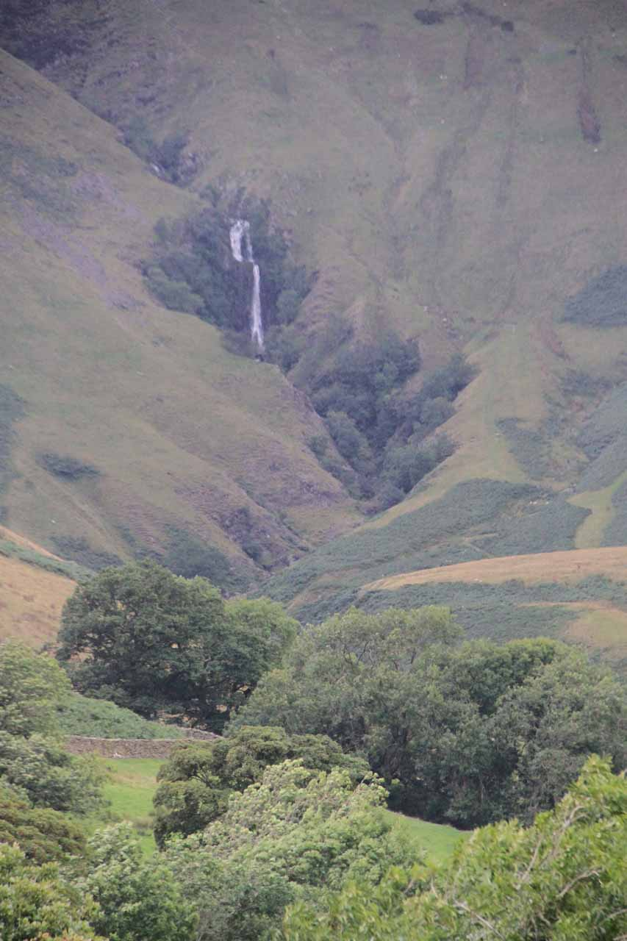
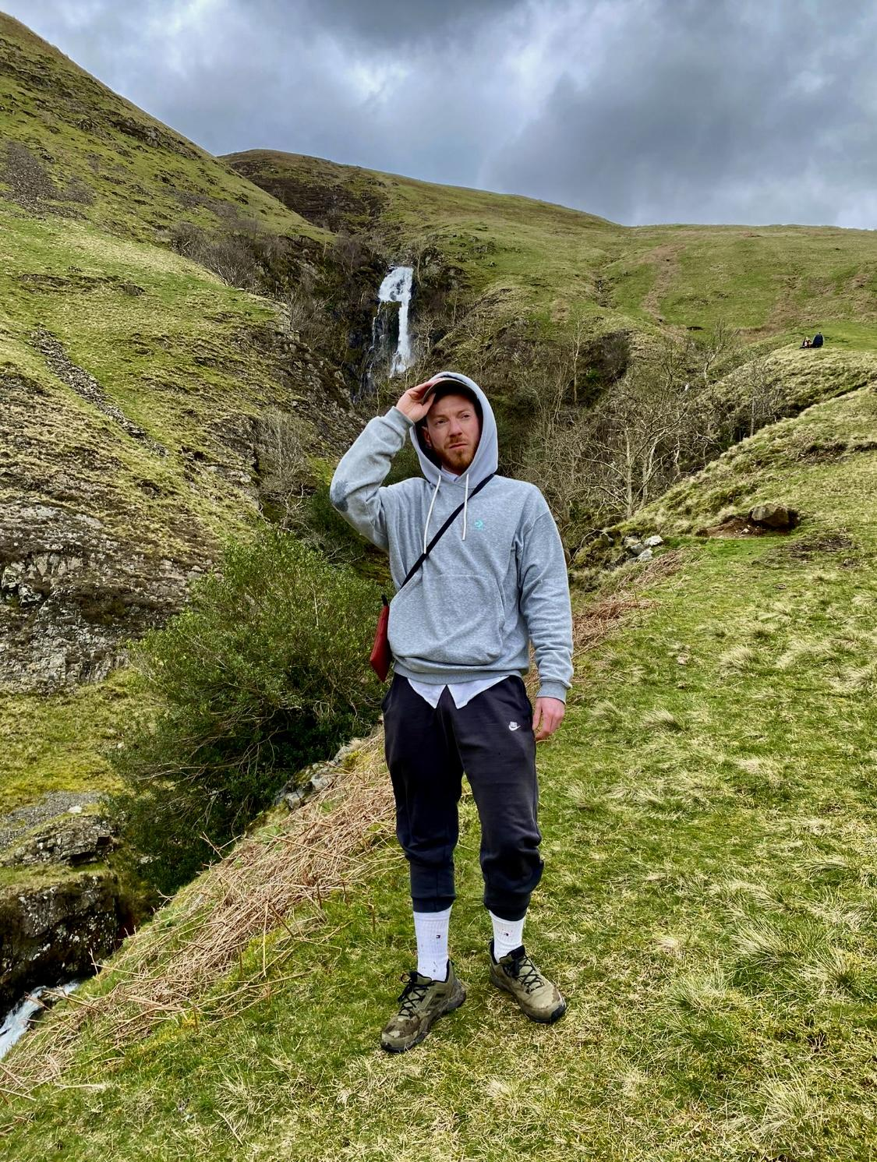
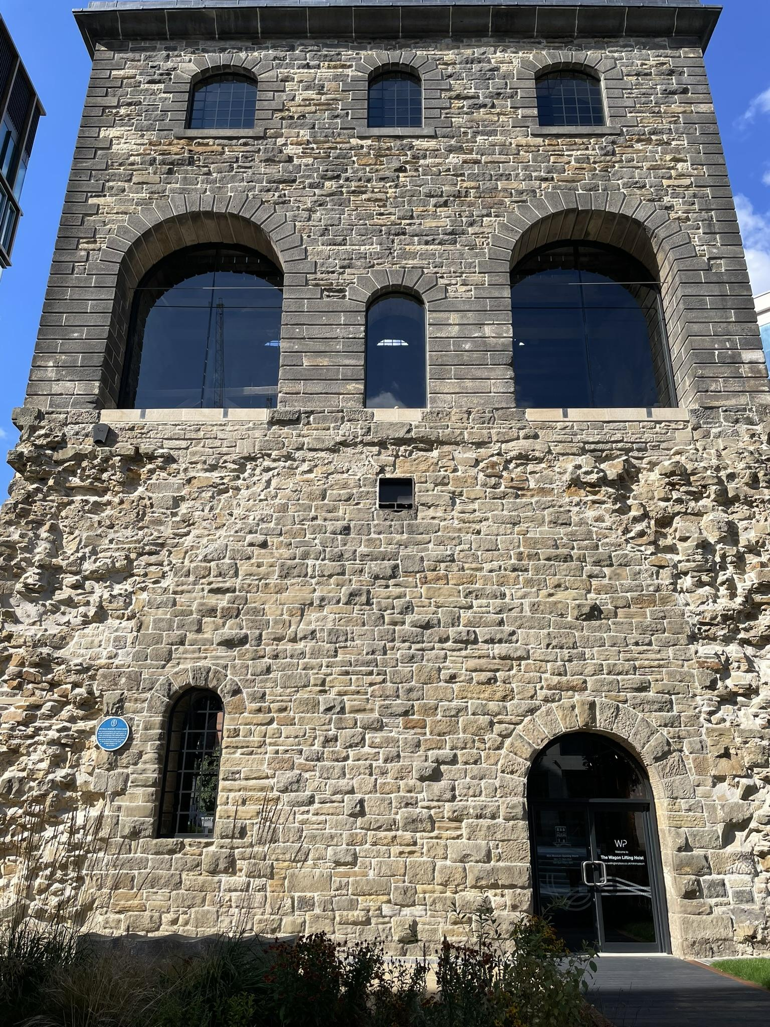
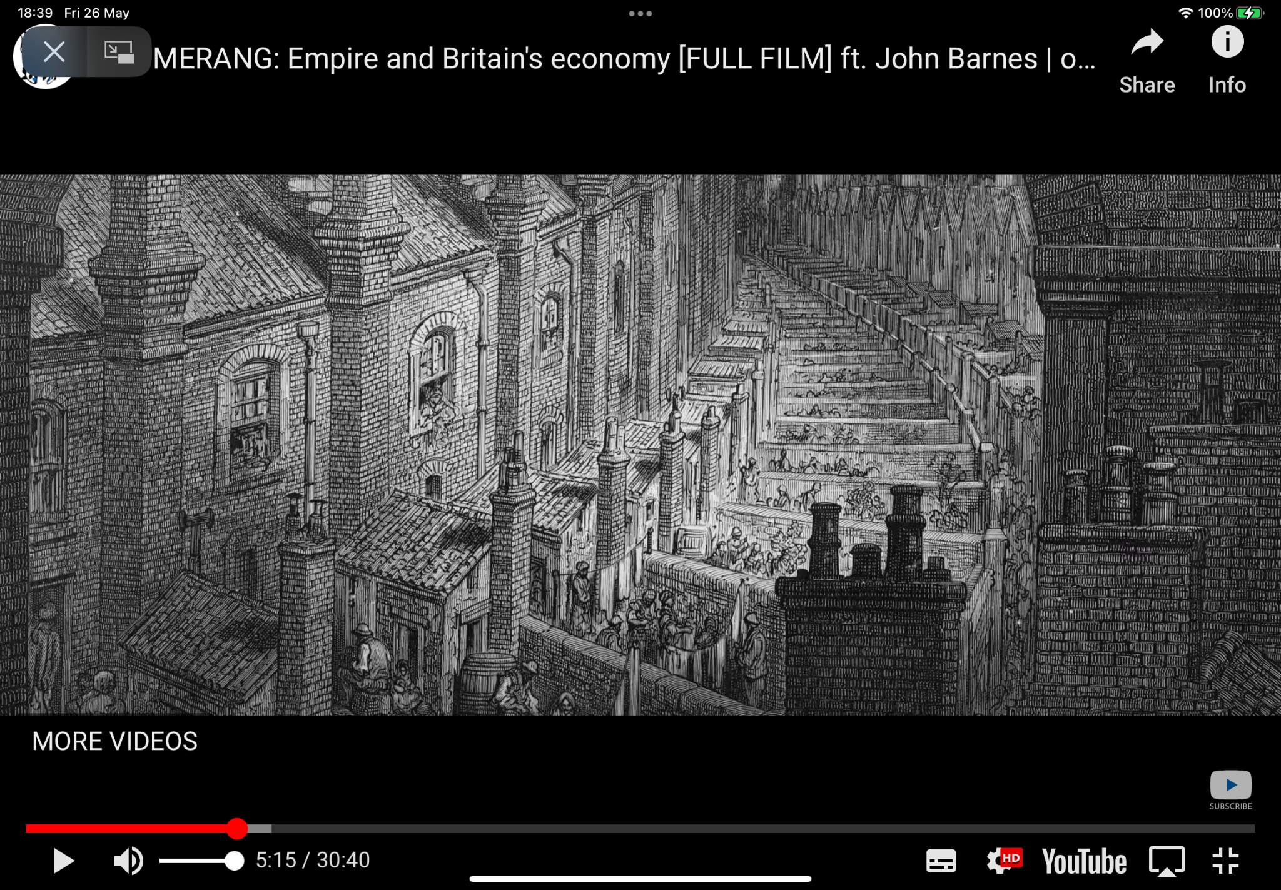
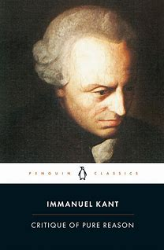
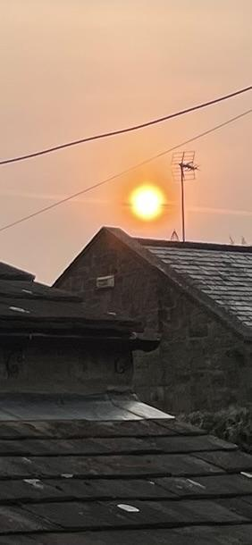
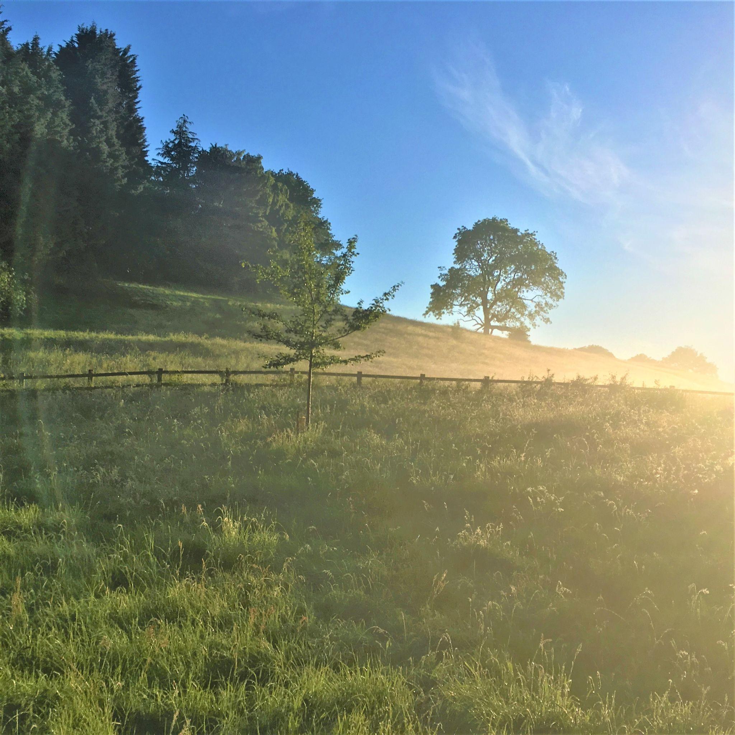
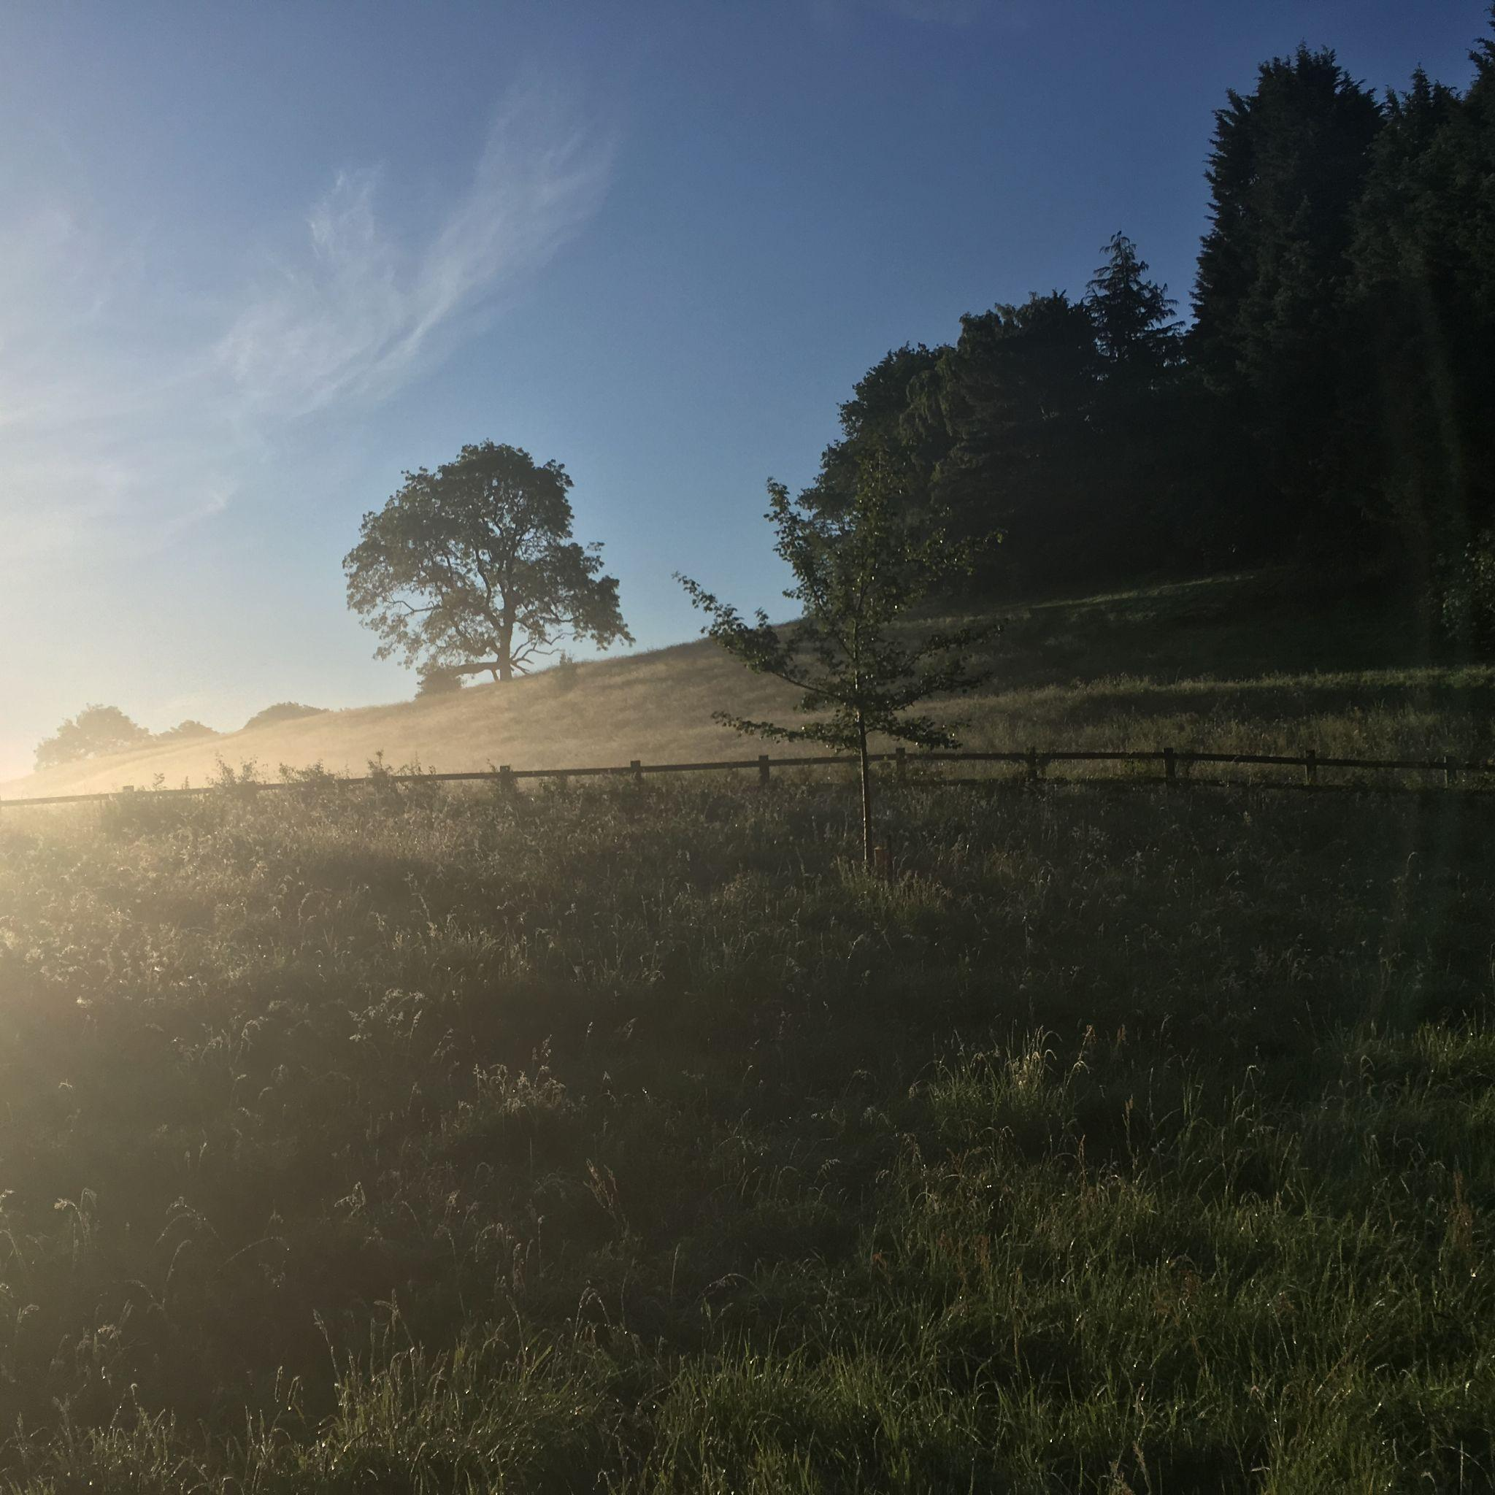
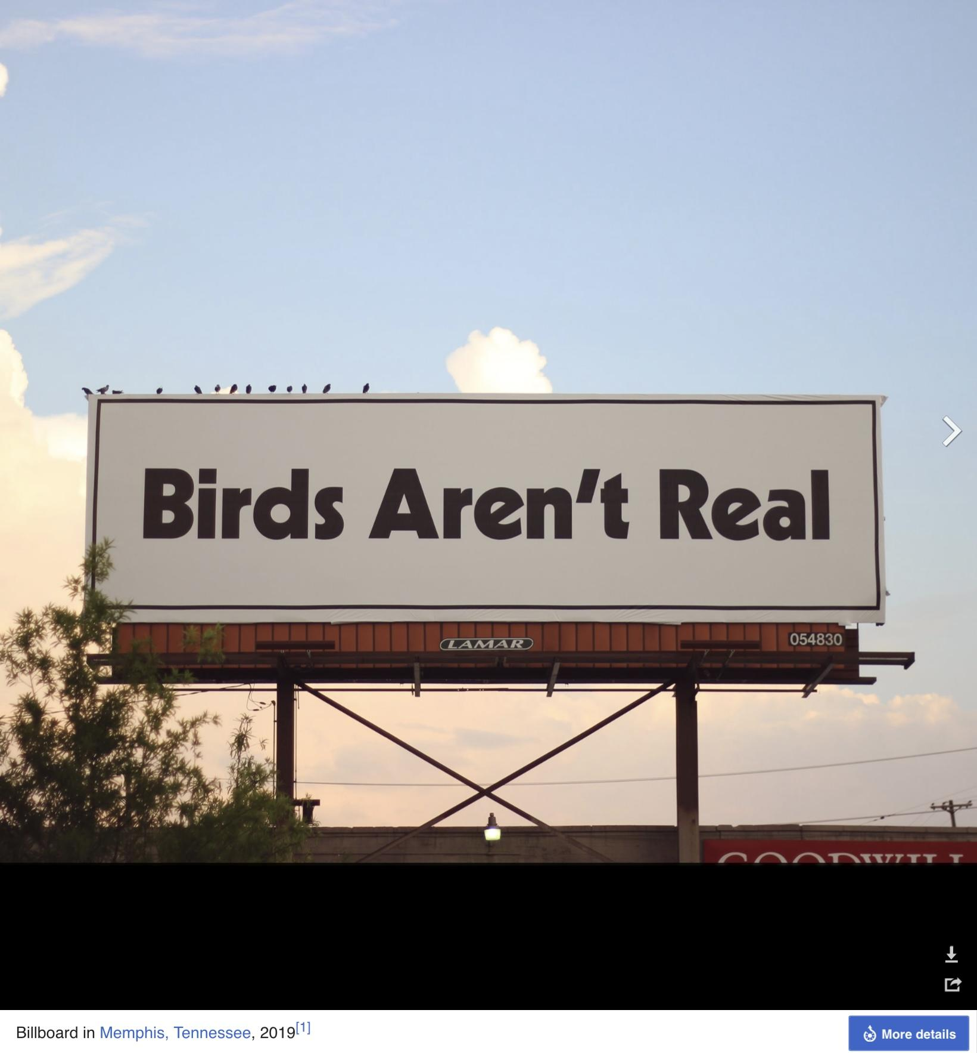
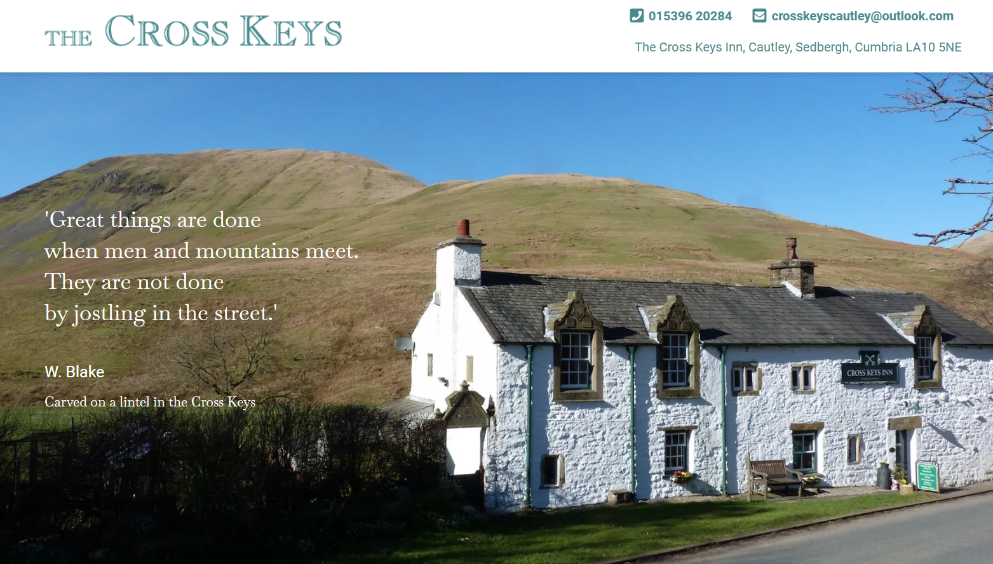
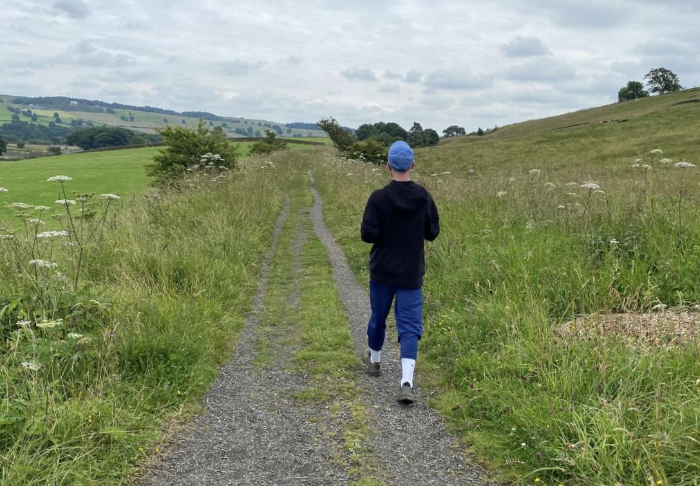
Nature For All

