Slide 1
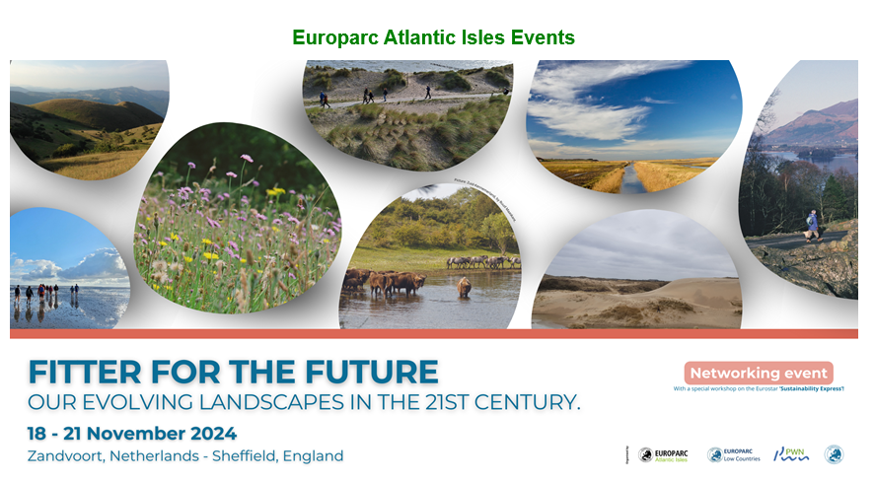
Bridging to a sustainable future – reflections from Zuid-Kennemerland field trip and Sustainability Express

Slide 2
Our session today…
Our field trips to Kennemerland and EUROPARCland
What is needed for protected landscapes to be fitter for the future
Break
Pain, Gain, Dream, Fear
Making our dreams a reality
Using Menti 1426 6821 go to www.menti.com

Slide 3
‘Experience the dream’
‘Meet with curiosity and an open mind’

Slide 4
Importance of storytelling → ‘meet people where they are’

Slide 5
‘Most of the time we are just move when it is to late’
‘Understand each other’s interests’ → ‘build a common ground to work from’
‘Make it memorable’

Slide 6
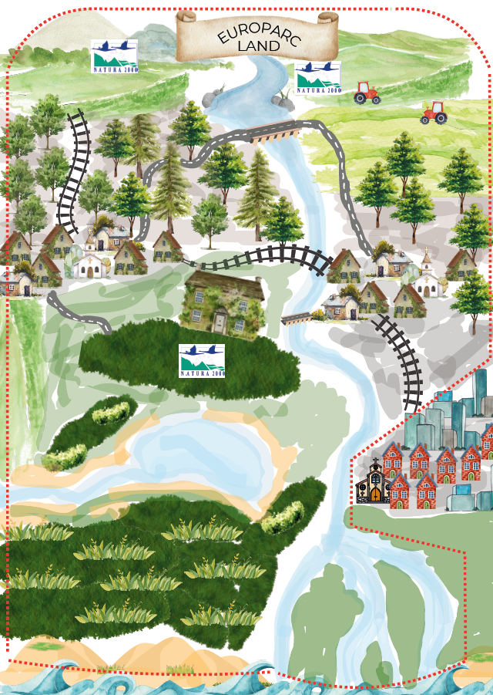

Slide 7
What is needed for protected landscapes to be fitter for the future?
Gain
what do you want to preserve for the future
Pain
what shall you leave behind?
Dream
what is it you want but don’t have now
Fears
what is holding you back making your dreams becoming reality

Slide 8
What do we need to do make our dreams a reality and be Fitter for the Future?
To move to a sustainable and fitter future, workshop participants agreed we need:
Connection to nature
Place based decision making that is collaborative, respectful of communities, includes youth voice, inclusive and equitable
Investment for our ambition
More nature

