Slide 1


A solutions focussed approach to navigating consenting and licensing challenges during delivering of 30by30
Tom Johnstone, PLP Nature Recovery Lead, NE
Leo Fisher, PLP Data and Evidence Lead, NE
Madeleine Lundholme, PLP Manager, NE
Please scan me and complete the attendee form

Slide 2
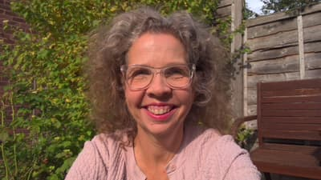
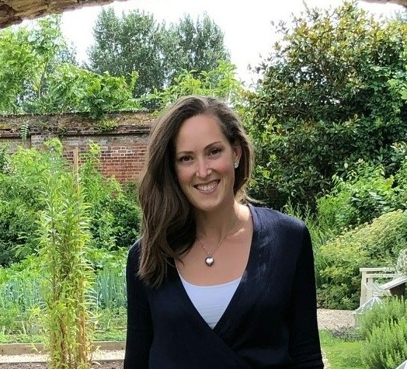
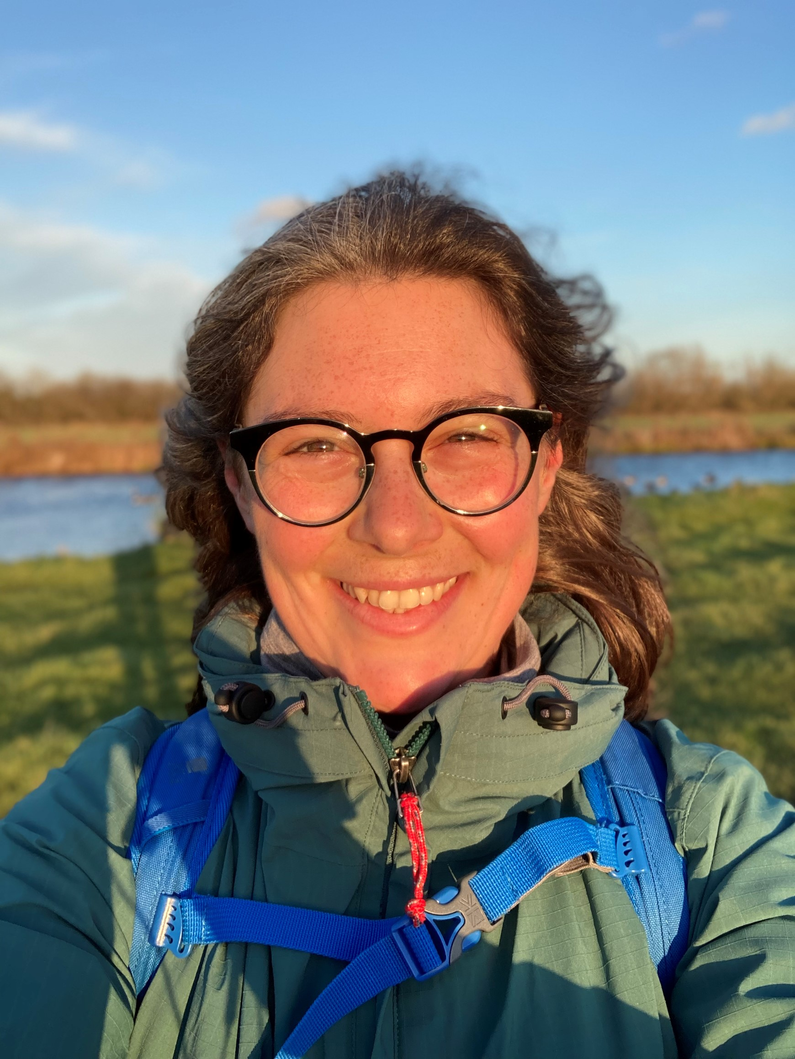
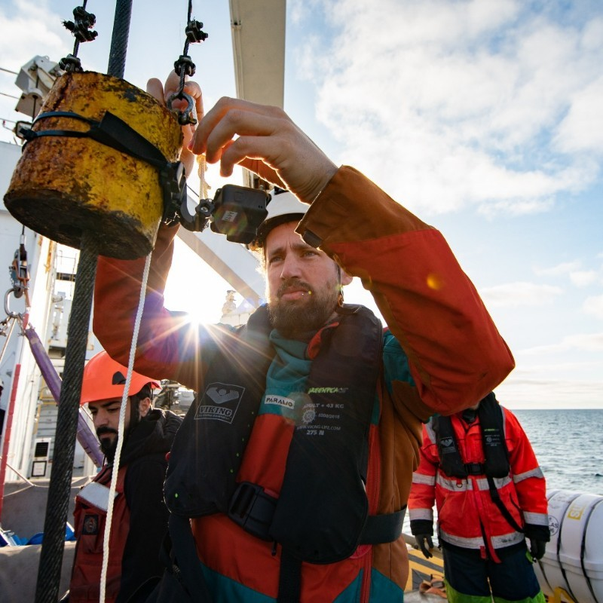
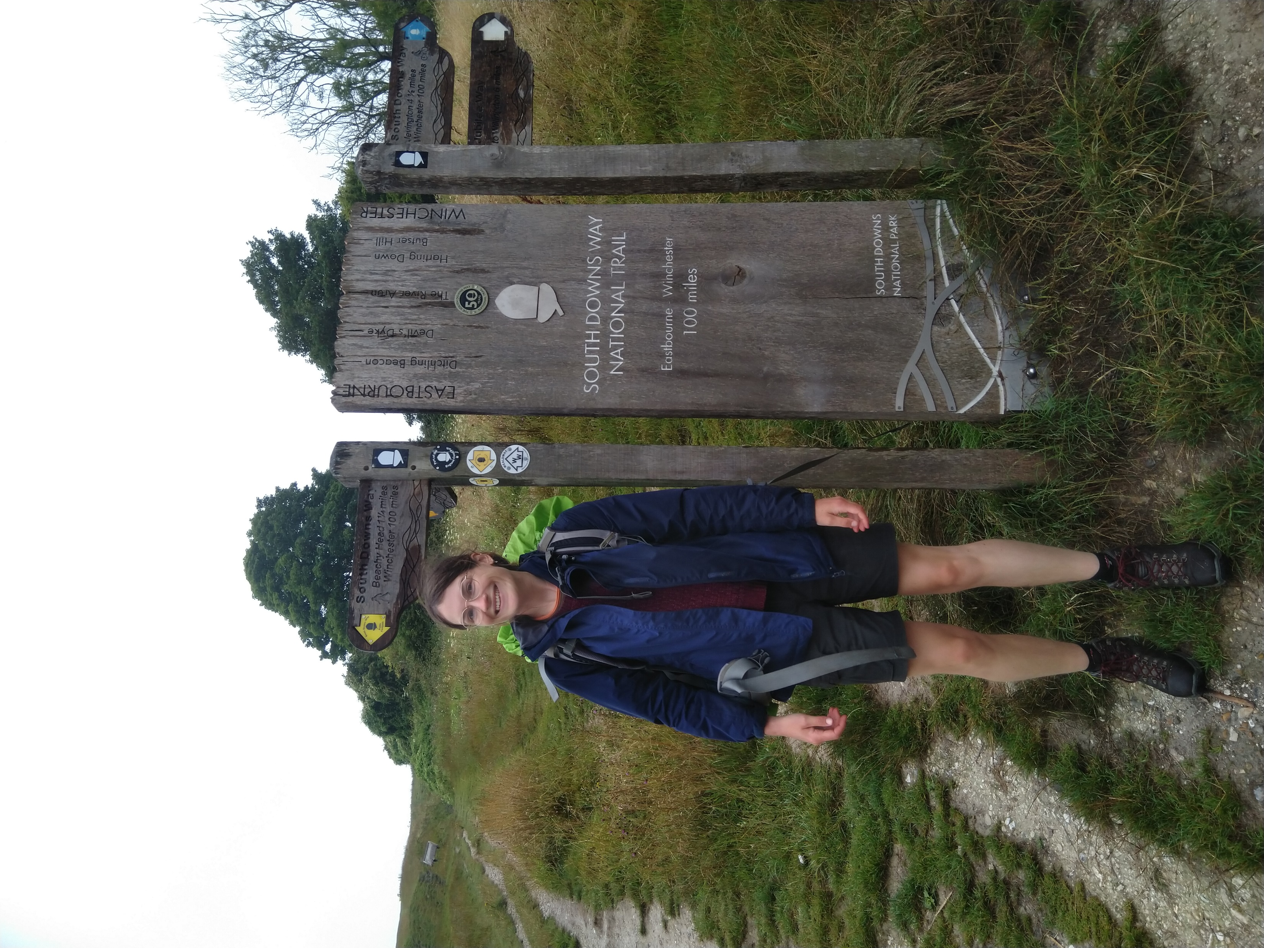
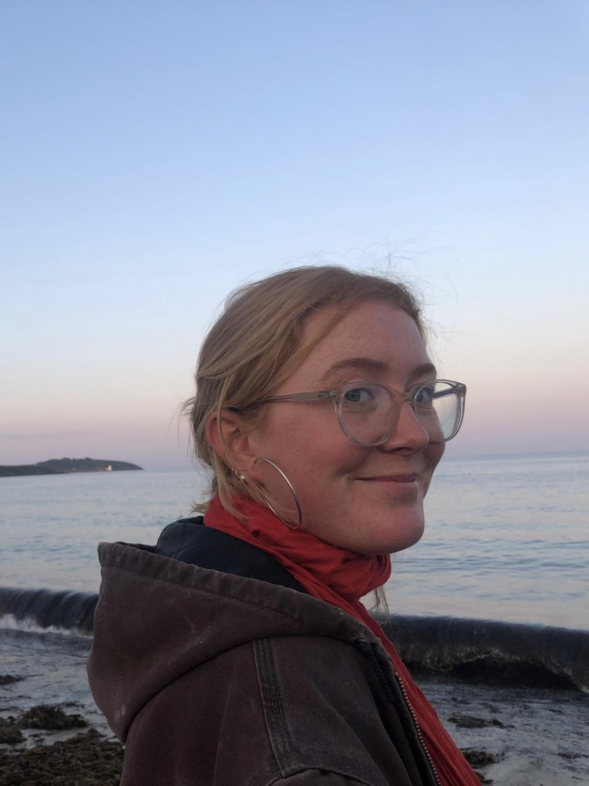
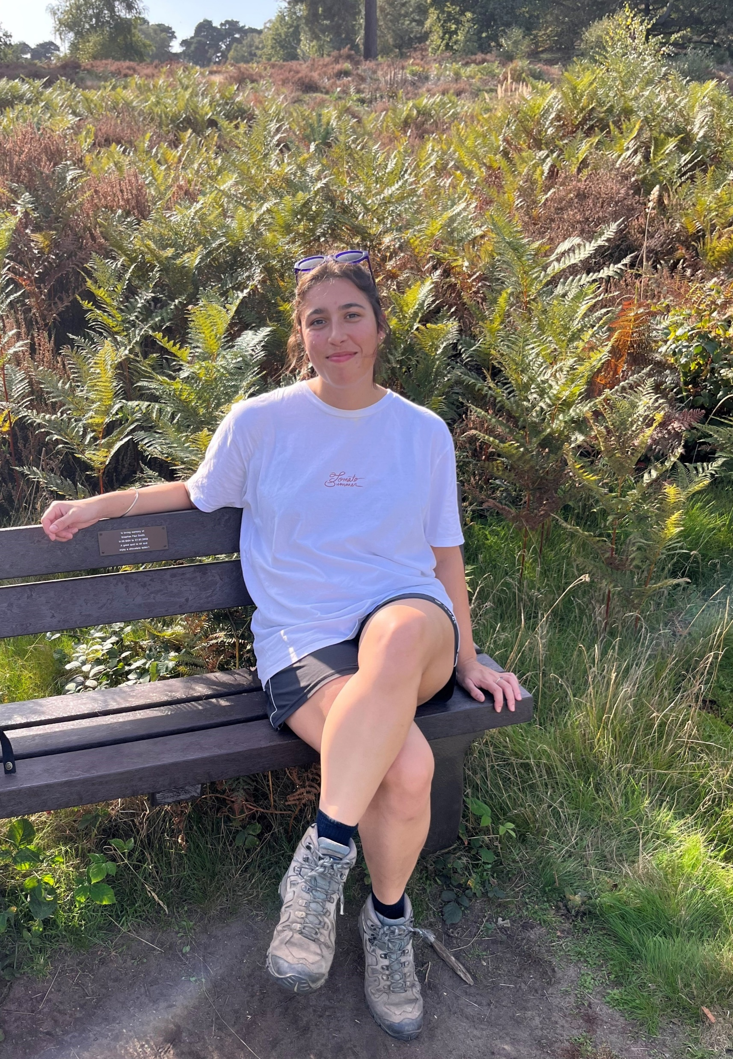
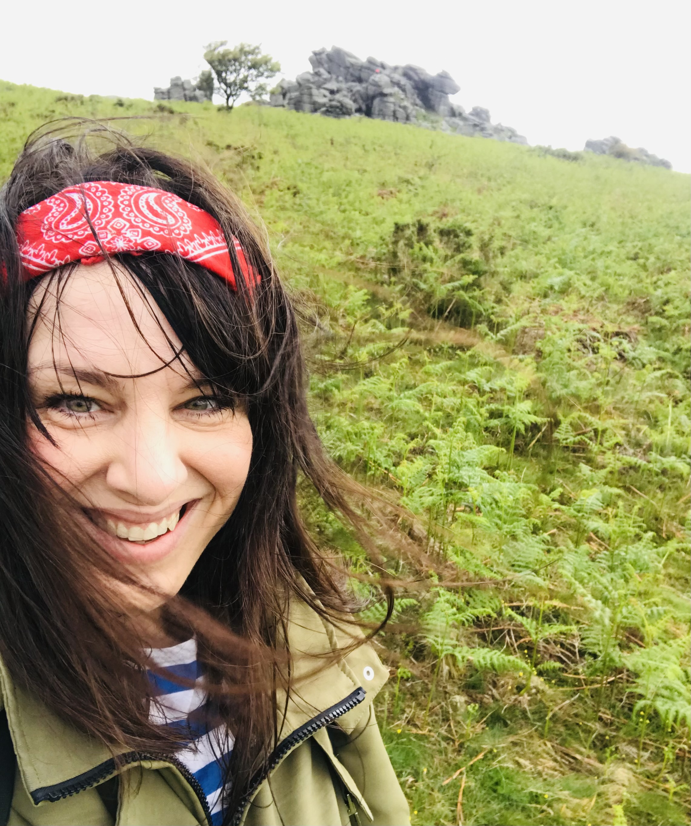
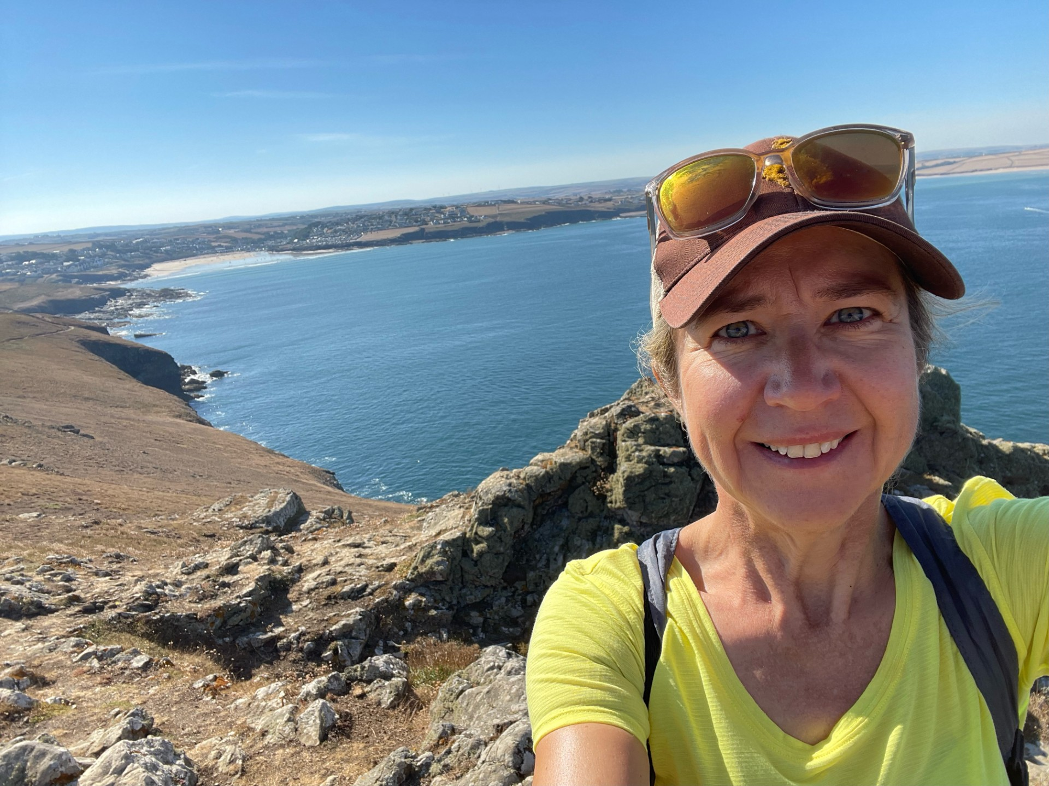
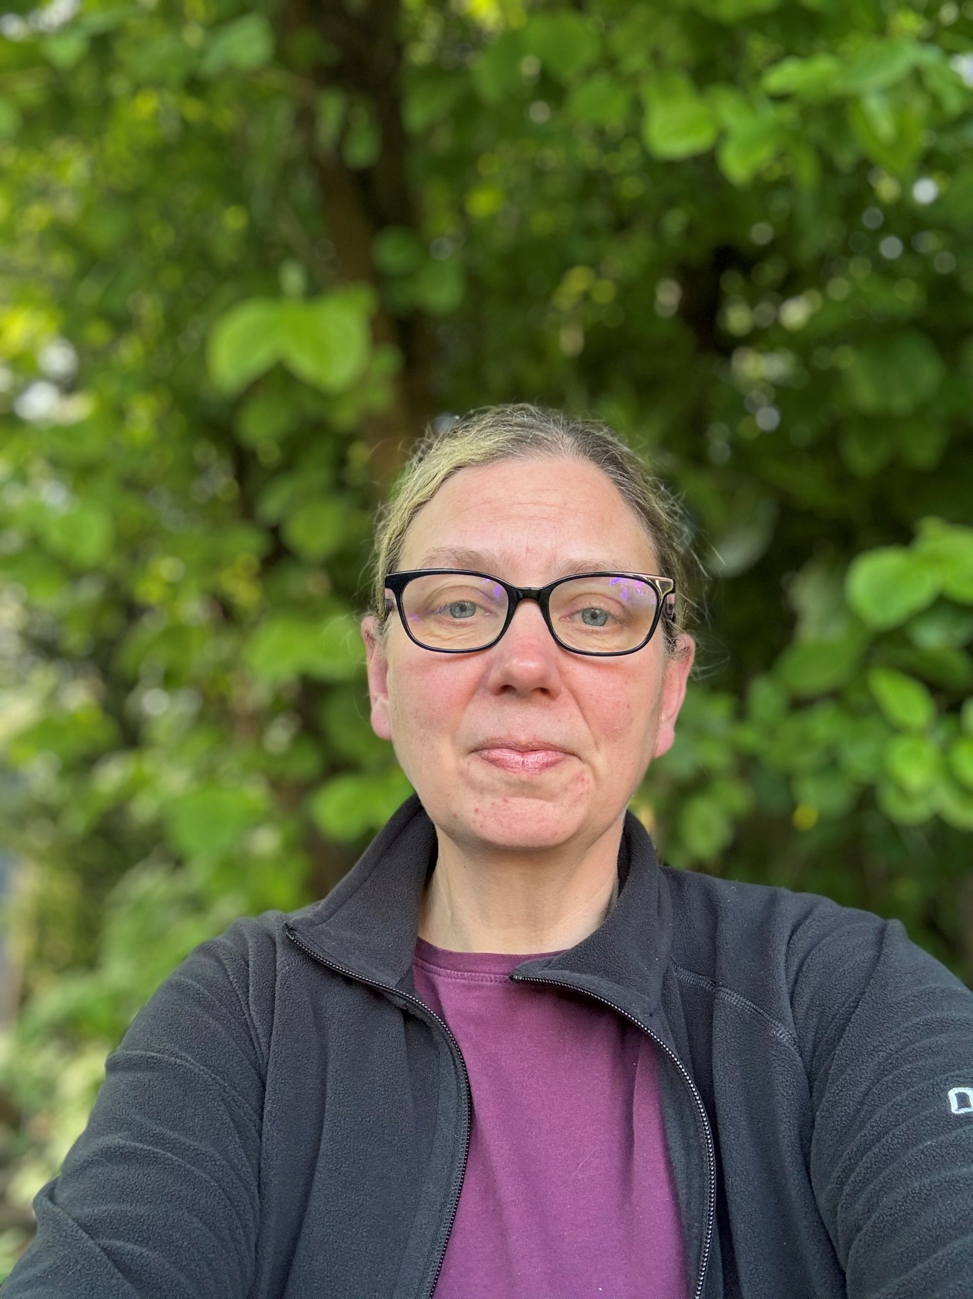
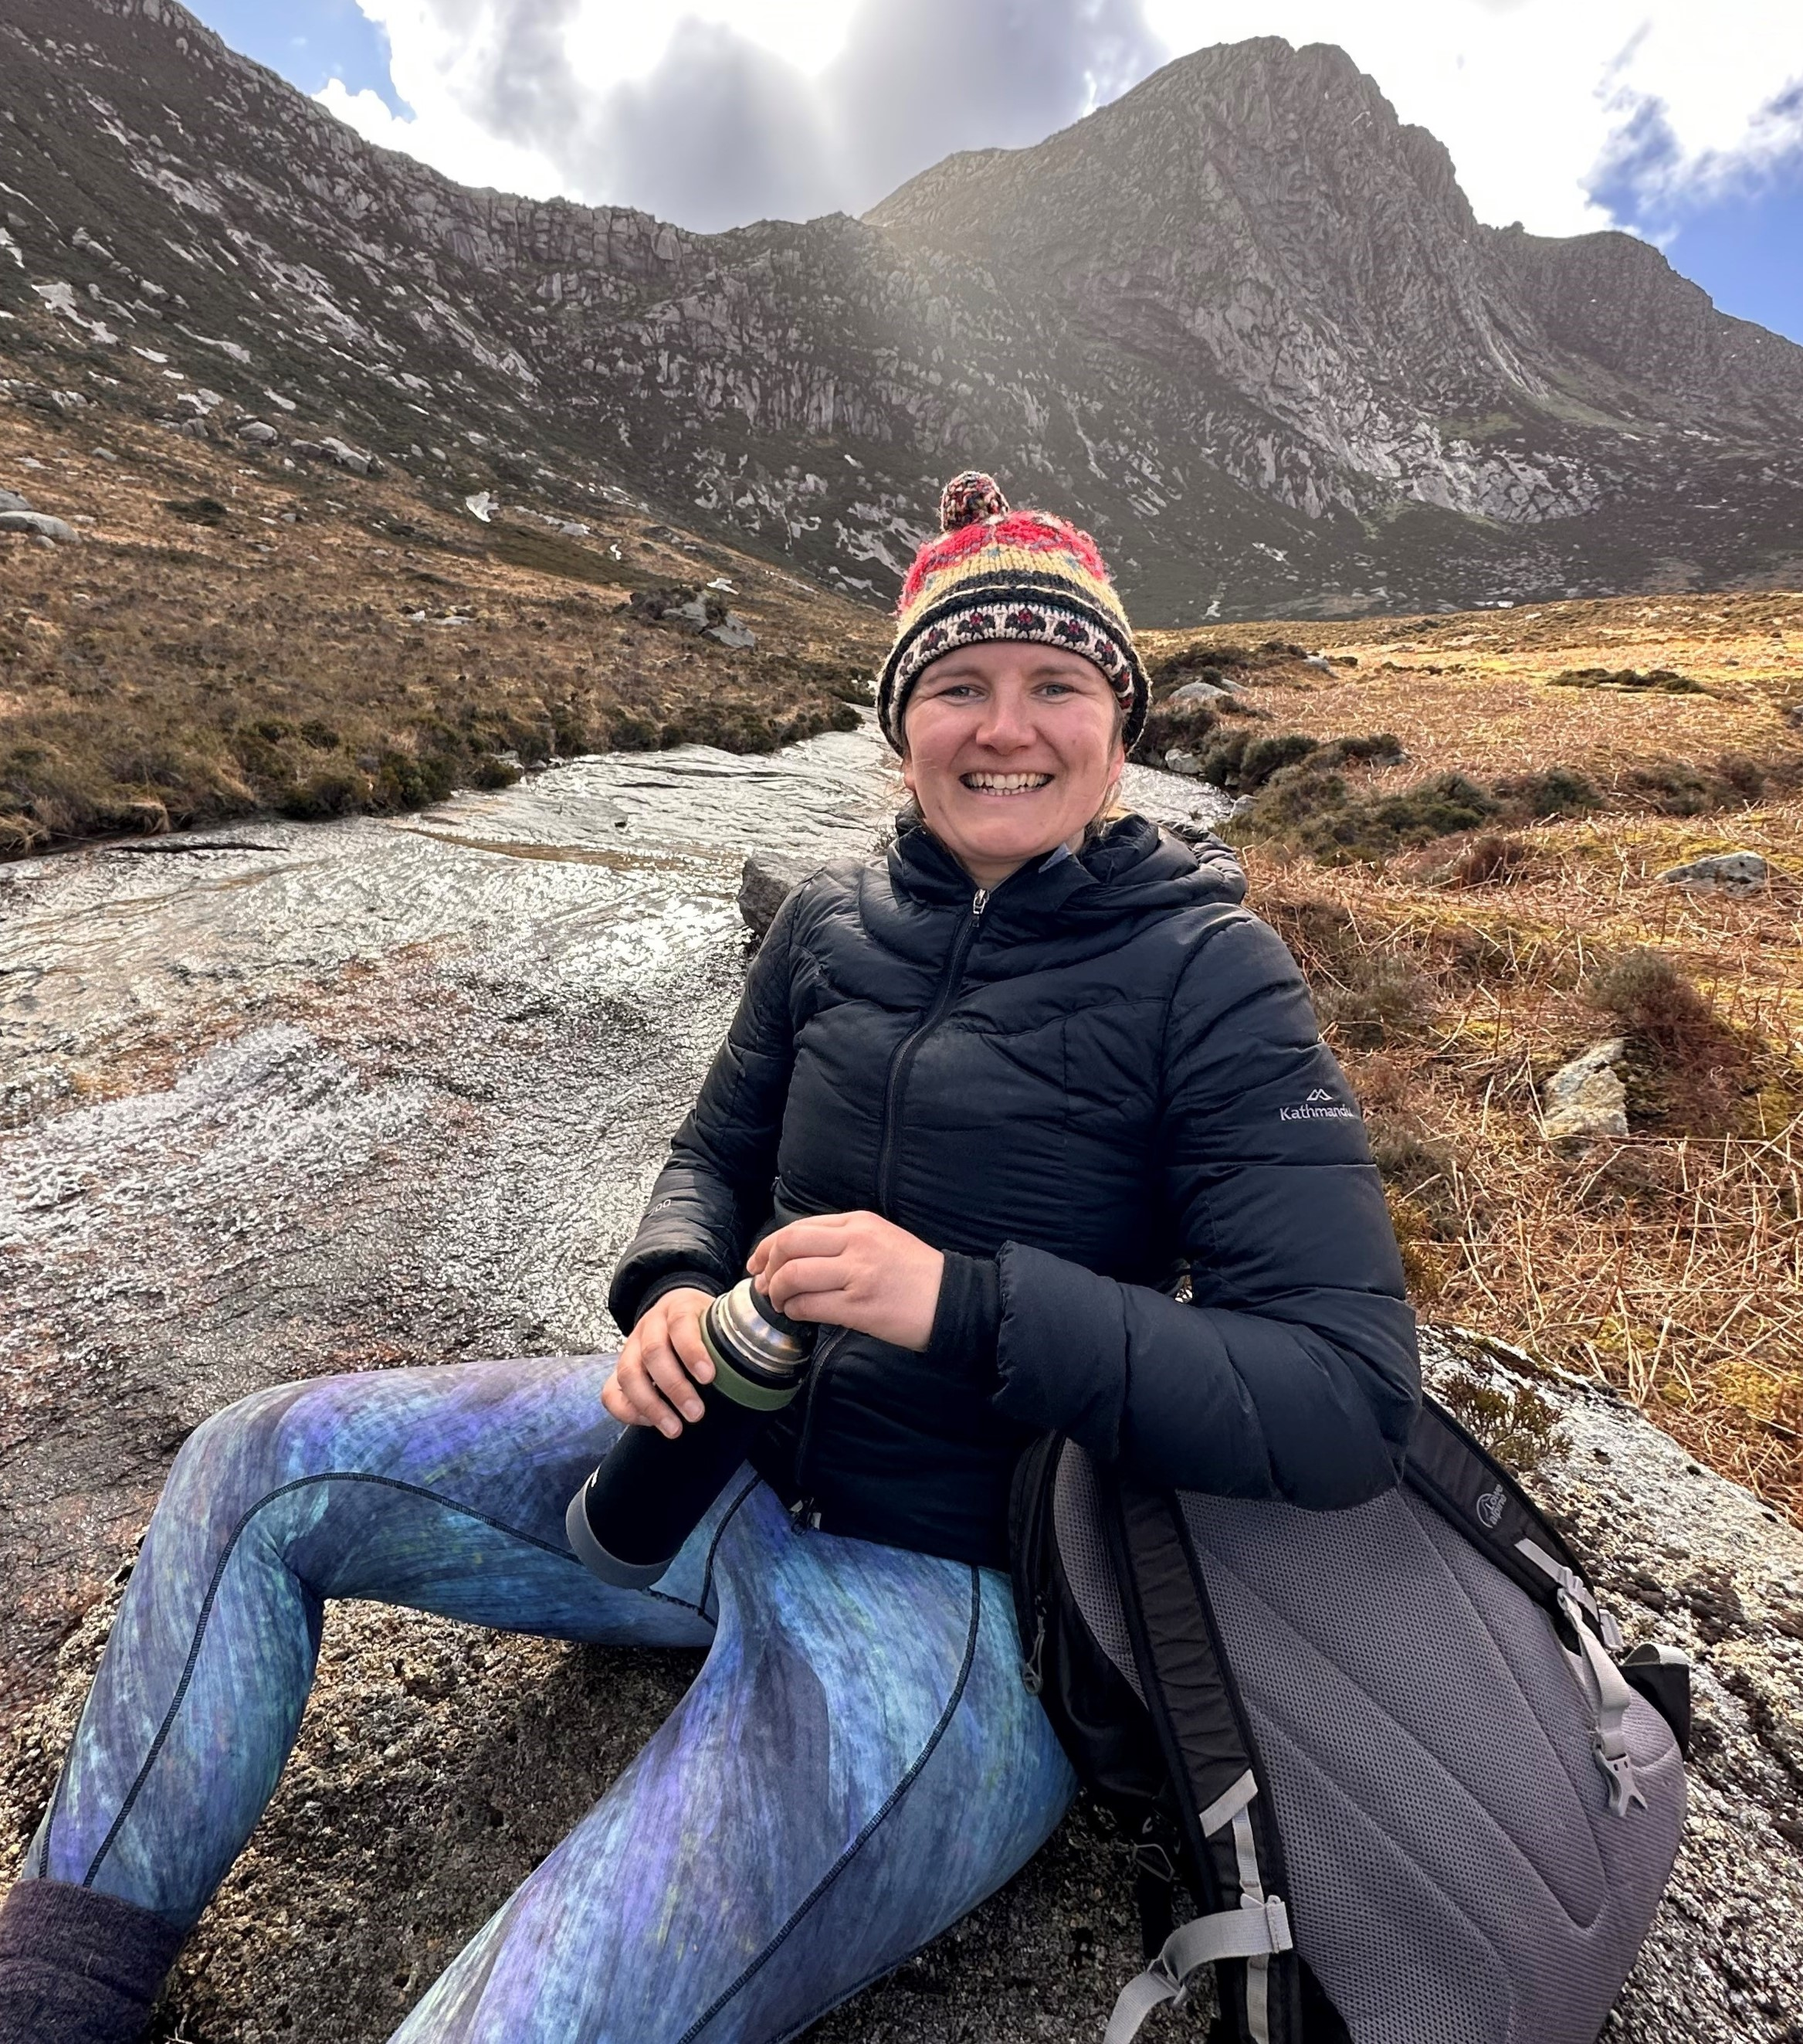
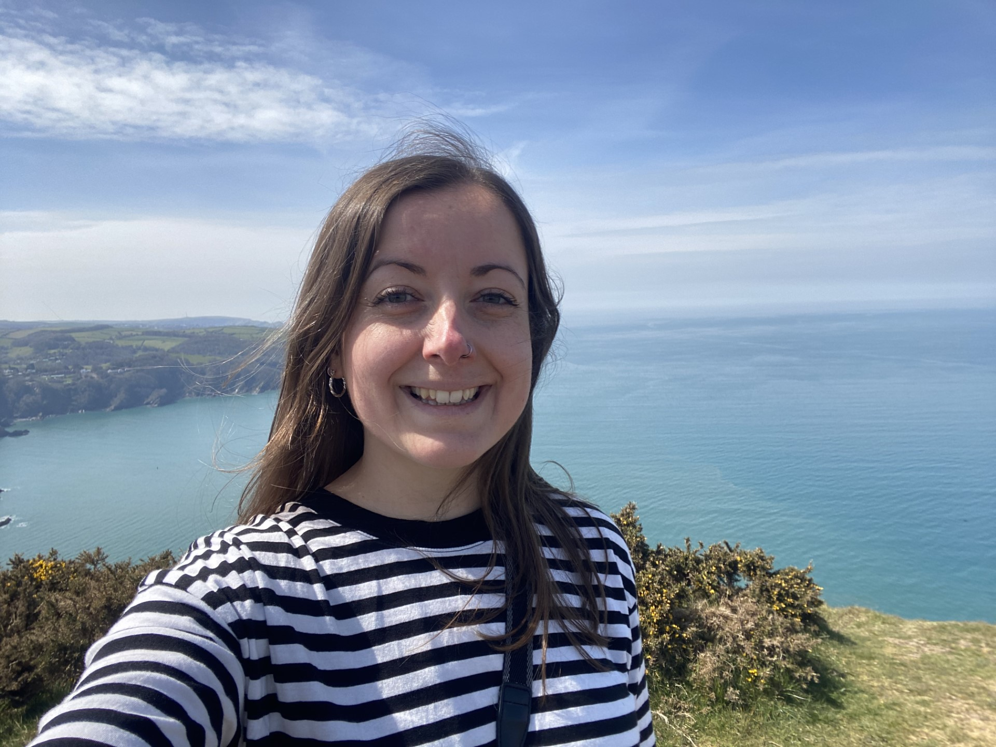
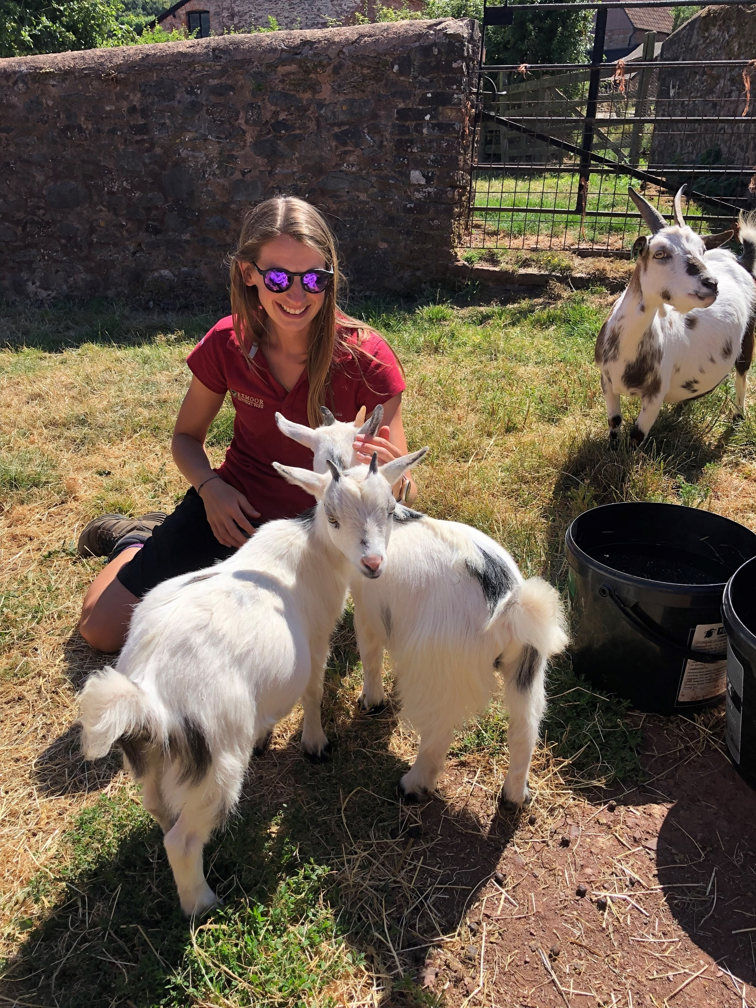
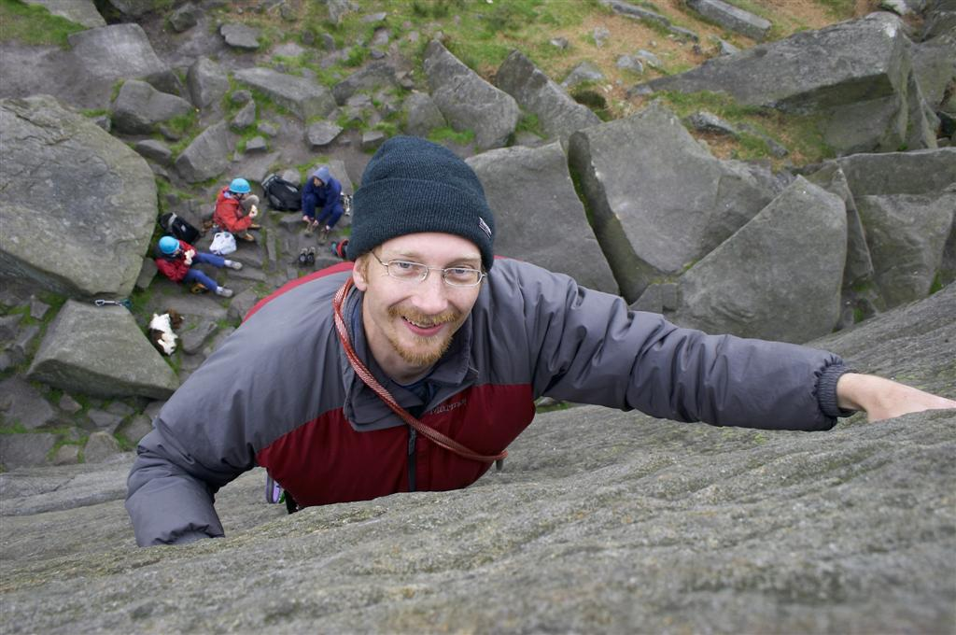
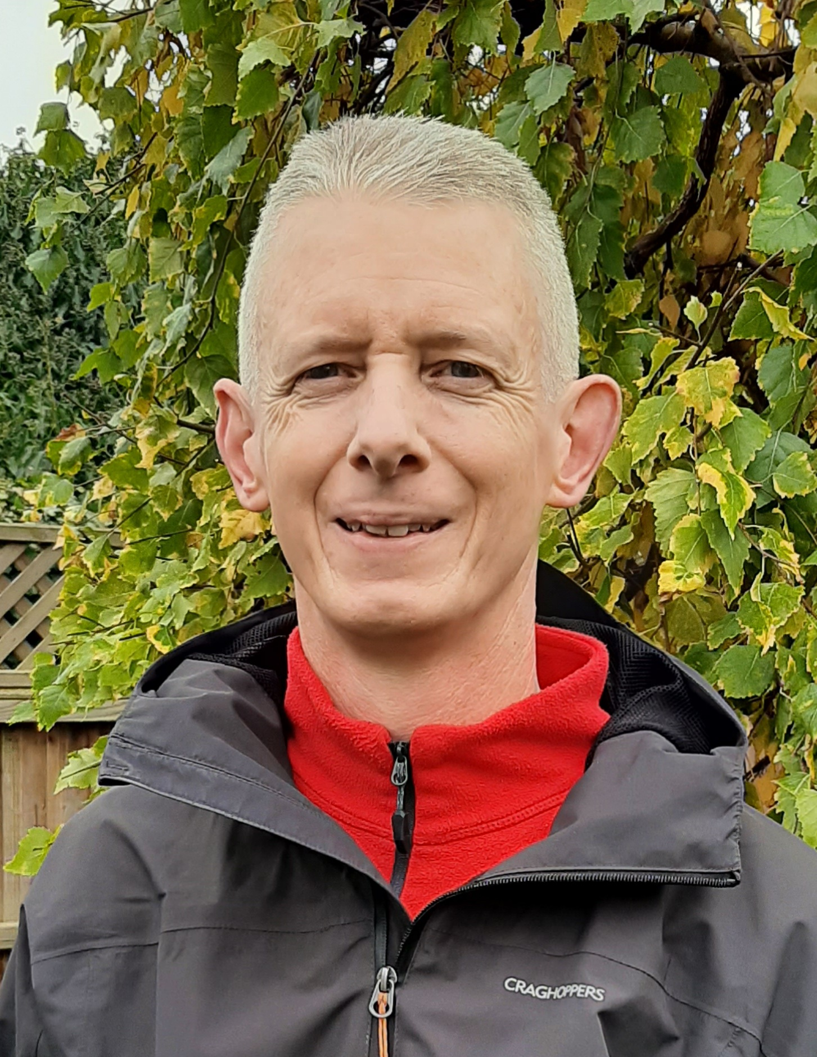
Please scan me and complete the attendee form
Partnership Governance Committee
Melanie Peddle
Collaboration & National Partnerships Lead, NLA
Defra
Madeleine Lundholm
Partnership Manager, NE
Polly Martin
CEO
National Trails UK
Partnership Delivery Group
Tom Johnstone
Nature Recovery Lead
NE
Harriet Knafler
Evidence Coordinator NE
Leo Fisher
Evidence Coordinator
NE
Saskia Luqmani
EDI Lead
NE
Kaye Jemmeson
Comms Manager
NTUK
Deb Brookes
Strategic Engagement Manager, NPE
Hazel McDowall
Principal Landscape Officer, NE
Hannah Brightley
NR Coordinator
NTUK
Kate Jury
Coastal Wildbelt
NTUK
Kate Lacey
NR Coordinator
NPE
Bruce Winney
NR Coordinator
NLA
Dave Hoccom
Big Chalk
(NLA)

Slide 3
What are we working on?
Please scan me and complete the attendee form
Nature Recovery Coordination
EDI Training & Resources
Nature
Recovery
Equity, Diversity & Inclusion
Evidence & Data
Comms, advocacy and
storytelling
Climate Leadership
Language of Access
Landscape-scale Initiatives
Pilot Projects
Coastal Wildbelt
Big Chalk
A Vision
For Belonging in NPs
Nature Calling

Slide 4
Framing – basic fundamentals
Lots of folk have been working really hard for a long time, but nature is still in decline
The rate of decline won’t be fixed by incremental gains
We need to act at Scale and Pace to tackle natures decline
Systems / Organisations create challenges, not the individuals who’s role it is to uphold them
Please scan me and complete the attendee form

Slide 5
Format of the workshop
Please scan me and complete the attendee form
What are our 30by30 objectives? A technical update and consensus check in
Examples of where challenges have been met or overcome
Our 5 broad themes for today
Peatland restoration
Priority Terrestrial habitat
Freshwater systems
Species translocation / reintroductions
Coastal / intertidal
What are the challenges we face delivering work in these areas
Workshop
- discuss the challenges and work arounds (these go on the S&L board)
- get into the detail of specific projects that could provide case studies (these go on the worksheet)
Next steps – network mapping and deep dive workshops

Slide 6
Nature recovery in protected landscapes: 30by30
Leo Fisher
Leonora.Fisher@naturalengland.org.uk

Slide 7
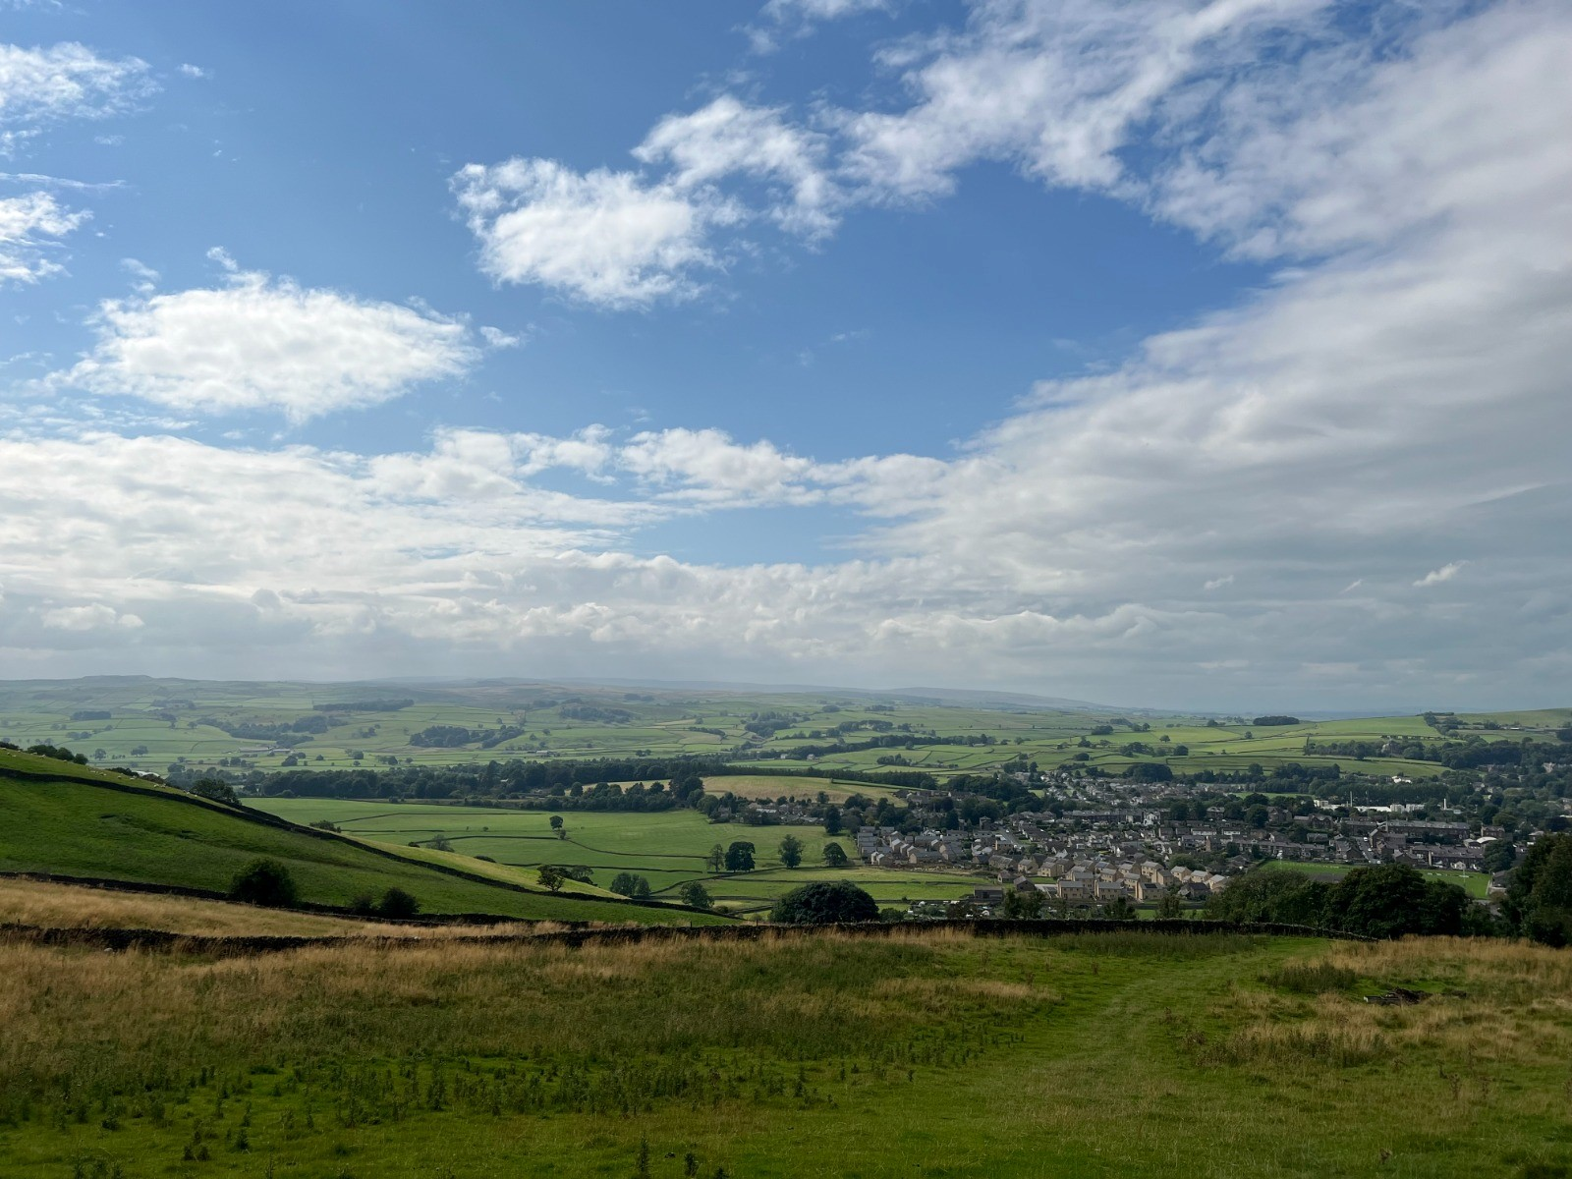
International 30by30 target
‘Effectively protecting and conserving at least 30% of the earth’s land, sea and freshwater ecosystems by 2030’ IUCN
proposed in Dec 2022, as part of the Global Biodiversity Framework at the UN Biodiversity Summit COP15.
cornerstone of a healthy, natural environment upon which our society and economy can flourish – WCL
Image PLP Kate Lacey
Notes:
A new global target to effectively protect and manage at least 30% of land, waters and sea for nature was negotiated at the international Convention on Biological Diversity (CBD COP15). This target of 30by30 was agreed as part of the Global Biodiversity Framework.
UK committed to meeting this international target.
30by30 could be the cornerstone of a healthy natural environment upon which our society and economy can flourish’ WCL
Protecting and managing 30% of land, including inland waters, and sea for nature can contribute to the Government’s aim to expand nature-rich habitats such as wetlands, peat bogs and seagrass and will be essential to meeting the legally-binding target to halt the decline of species abundance. Doing so has the potential to restore and support biodiverse ecosystems that provide essential services such as pollination, improving water quality and sequestering and storing carbon dioxide

Slide 8
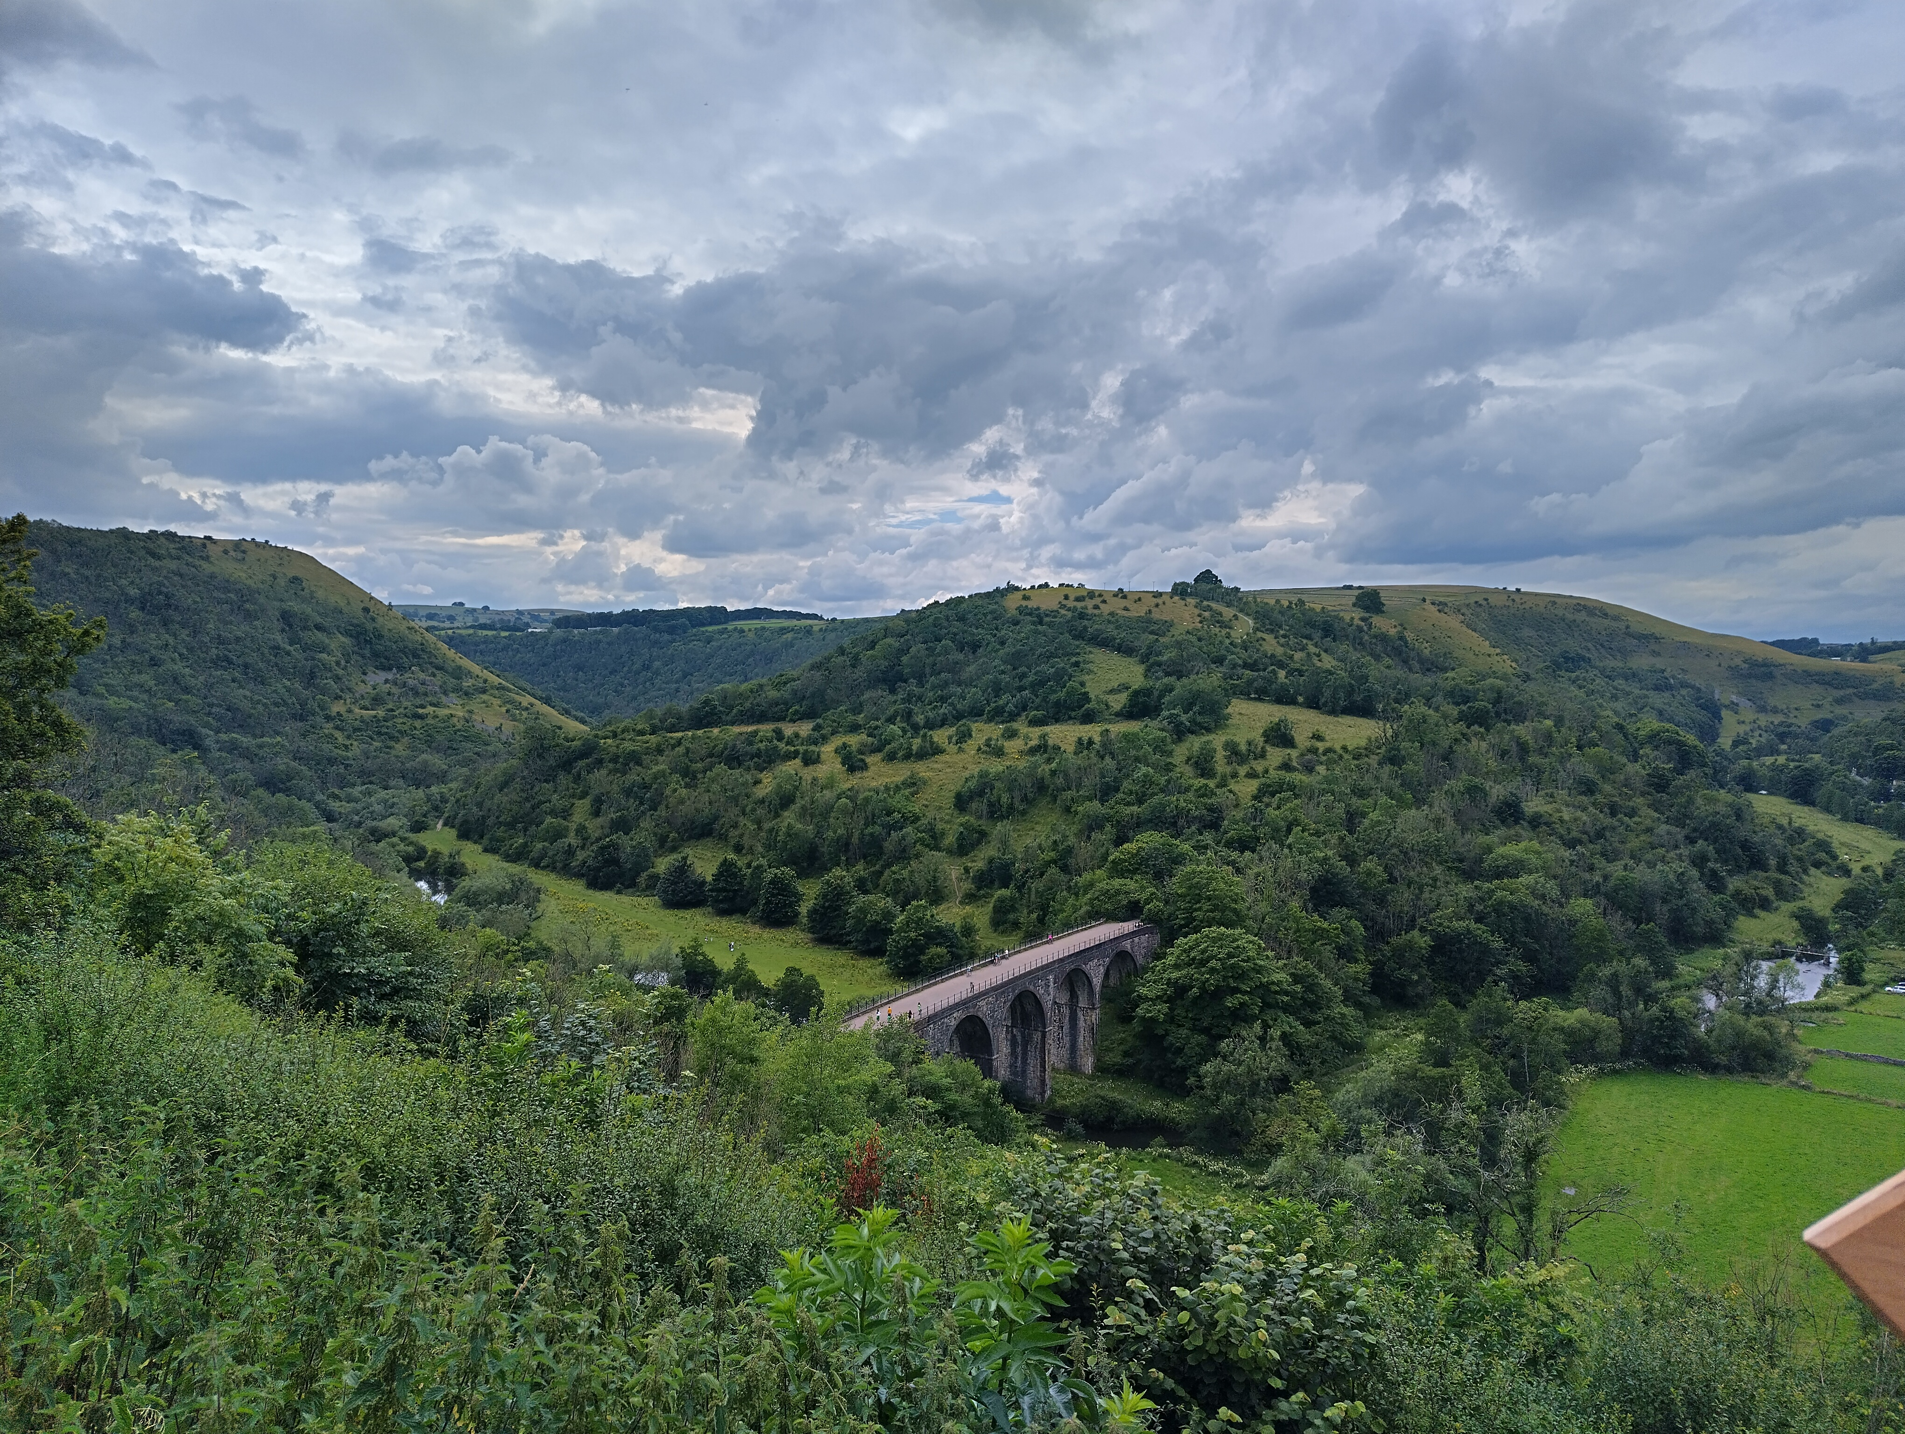
5 years away from 2030: Where are we now?
Defra published the criteria and next steps during the COP16 in Oct 2024 and are now establishing the assessment and reporting process
Purpose – purpose or management objectives will ensure delivery of in-situ conservation outcomes.
Protection – in-situ conservation will be sustained for at least 20 years
Management – areas should be effectively managed and show progress towards conservation outcomes
Total areas that currently count (indicative): 7.1%
Image PLP Harriet Knafler

Slide 9
Protected landscapes are the backbone of 30by30
Protected landscapes cover 25% of England and contain:
  ~50% of priority habitats and SSSIs
  60% of deep peat and nearly 88% of heather and acid grassland habitats.
Potential to contribute:
  We estimate they could contribute 38% of their land without land use conversion
  9.3% of England
Existing structures, partnerships, management plans and Targets and Outcomes framework
The more ambitious protected landscapes can be, the more achievable for the rest of England
Protected Landscapes | 30% | 35% | 38% | 40% | 45% | 50%
Outside PLs to hit 30% total | 30% | 28% | 27% | 27% | 25% | 24%
Notes:
We conservatively estimate that protected landscapes on average have the potential to contribute 38%, and this varies a lot through different PLs. This is without any land use change, and just using nationally available data. If we were able to get all of this land under the right management, and protection this is 9.3% of England.
This will be driven by the Protected Landscapes Targets and Outcomes Framework, as well as further action to ensure that these special places are wilder and greener. Through their management plans, existing structures and strong partnerships, Protected Landscapes organisations can also play a convening role to champion, identify and support areas that meet, or have potential to meet, the 30by30 criteria.
Although much land within Protected Landscapes should meet the first of the 3 30by30 criteria (purpose), these areas will only contribute towards 30by30 where they also meet the protection and management criteria. Only areas within Protected Landscapes which are assessed as meeting all 3 of the 30by30 criteria will be able to contribute towards the target.

Slide 10
What’s next?
How much of this currently counts? We estimate that 40% of potential 30by30 land in PLs is managed effectively, which means about 15% of PLs could currently count
How can we get all of this land under effective management, protection and purpose for 30by30?

Slide 11
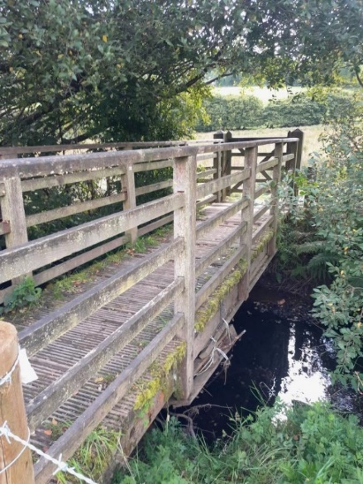
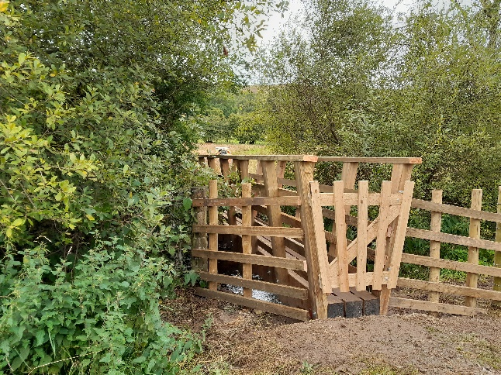
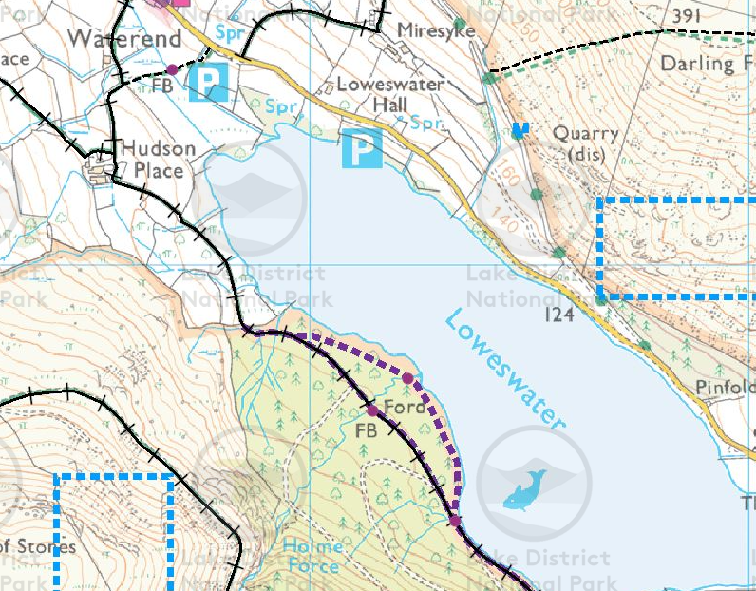

Case study #1
Freshwater systems / PROW
Hudson Place Bridge ~38ha
Consents – Planning, FRAP
Time – 70 hours on consenting, 30+ hours on EA permit
Duration – TBC
Cost - £4,701.25 (total project cost)
Outputs –
Streamlined consenting proposal –
Time for streamlined –
Cost for streamline – £500 - £800 per bridge.
Outputs streamlined –
Notes:
Take aways – consenting is leading to projects taking longer to deliver and with fewer additional benefits

Slide 12
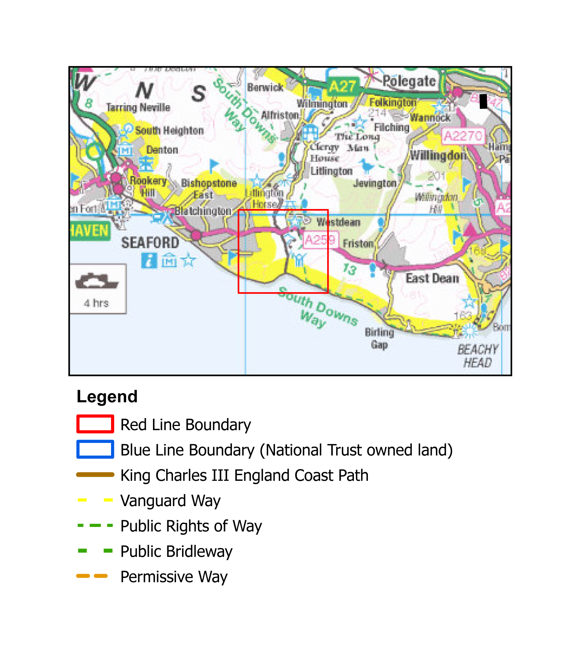
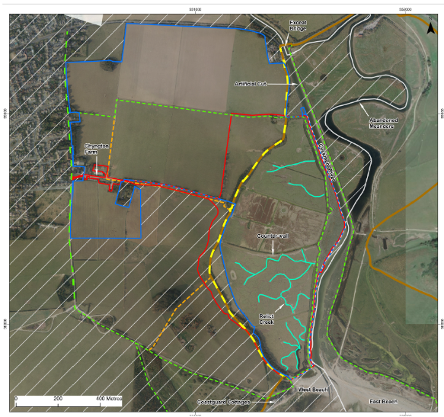
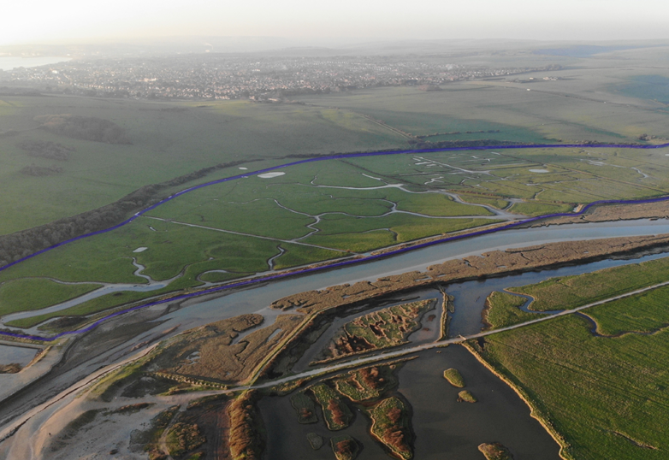

Case study #2
Coastal / intertidal
Chyngton Brooks – restore and enhance an intertidal terrestrial habitat through managed realignment
Consents – Planning, BNG, EIA, FRAP
Time – 95-98% of the work is consents and licenses – Alex full time for 2.5 years
Duration – 3 years
Cost - £500k ish
Outputs – No alteration in ambition
Streamlined consenting proposal – No BNG, ideally no planning, legislation changes around footpaths would’ve completely changed the entire project.
Time for streamlined – 1.5 years
Cost for streamline - £100k
Outputs streamlined – no change
National need - TBC
Project area
Notes:
Take away – nature may deliver the ambitions of this project this winter anyway by overtopping the flood defences EA stopped maintaining 10 years ago

Slide 13
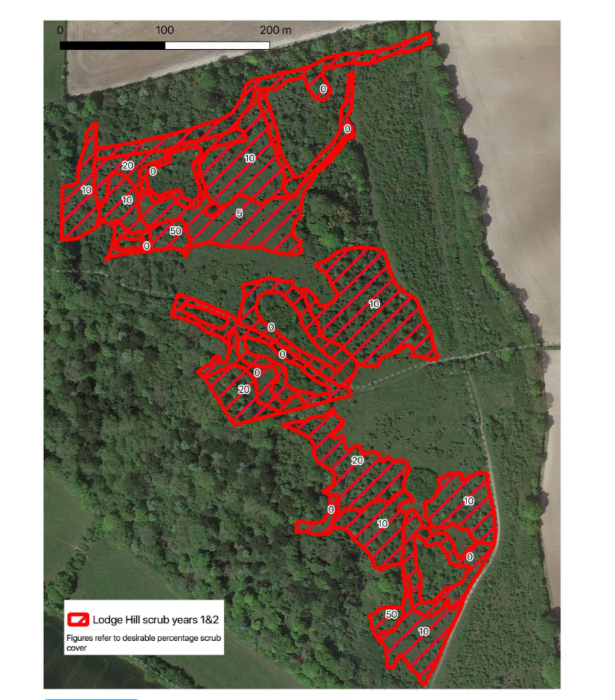

Case study #3
Theme – Priority habitat
Project name – Chalk grassland recovery in the Chilterns
Consents – SSSI & SAM
Time – 4 -5 days per site navigating consents, managing landowners and ensuring the project succeed
Cost – TBC
Outputs – Scrub removal to introduce grazing
Streamlined consenting proposal – S28G assent process extended to SSSI work being led by S28G body on land owned by others.
Time for streamlined – vastly less
Cost for streamline – TBC
Outputs streamlined – retain goodwill of landowners for future work on SSSI / SAM’s
Notes:
Take away – farmers having gone through the consenting process have now said they’ll never do it again, so many sites cannot be revisited for further work

Slide 14
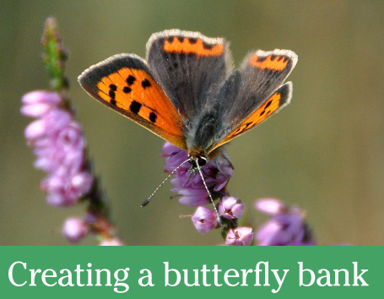

Case study #4
Supporting species recolonisation
Butterfly banks
Consents – Planning, Archaeological assessment, EIA
Time – staff time not tallied, but considerable
Duration – 4 months +
Cost – Circa £20k
Outputs – Creation of one butterfly bank
Time for streamlined – considerably less
Cost for streamline – possibly £0
Outputs streamlined – Butterfly banks would be built to the spec needed for the ecological functional need, rather than built to the spec that will be approved by planning.
Butterfly Bank Factsheet_FINAL.pdf
Notes:
Key take away – the planning constrains are driving the design of butterfly banks, so that banks can be created without the need for planning, but this undermines their ecological function.

Slide 15

Challenges to delivery 30by30
Funding
Enough money
Blended / private finance
Funding certainty / duration
Reporting & constraints
Staffing
Retention / fixed term contracts
Recruitment challenges
Diversity of the sector
Salaries
Effort
Apply for & managing funding
Consents & licenses
Alignment with political priorities
Delivery
Delivery in the places of greatest need / potential
Condition assessments
Existing management
Shifting climatic envelope
Land sharing vs land sparing (land use framework?)
Landowner buy in
Monitoring
Cost, complexity and necessity
Achieving change
Delivering at scale and pace
Add your challenges to our slido wordcloud

Slide 16

Regulatory processes
SSSI consent / assent
Planning permission
FRAP / OWC
Felling licences
EAI / argi / forest EAI
Secretary of State consent
….and others?
Add your consents to our slido wordcloud

Slide 17

Workshop time
Chatham house rules!
Can we record voice notes to aid our note taking?
Anyone wanting to NOT be in photos please speak to Madeleine as we move tables
Please use the post it notes and note taking sheets
Peatland restoration
Priority Terrestrial habitat
Freshwater systems
Species translocation / reintroductions
Coastal / intertidal

Slide 18
Snakes and ladders
What costs you time, money, ambition or morale – these are the snakes
What processes do you have to keep going repeatedly– these may be snakes
What workarounds have you developed – these are ladders
What local relationships do you have that boost impact / delivery? – these are ladders
Aspirational outputs go on box 100
Actual outputs – decide how far down the board these go – how close to the ‘100’ could you aim?

Slide 19
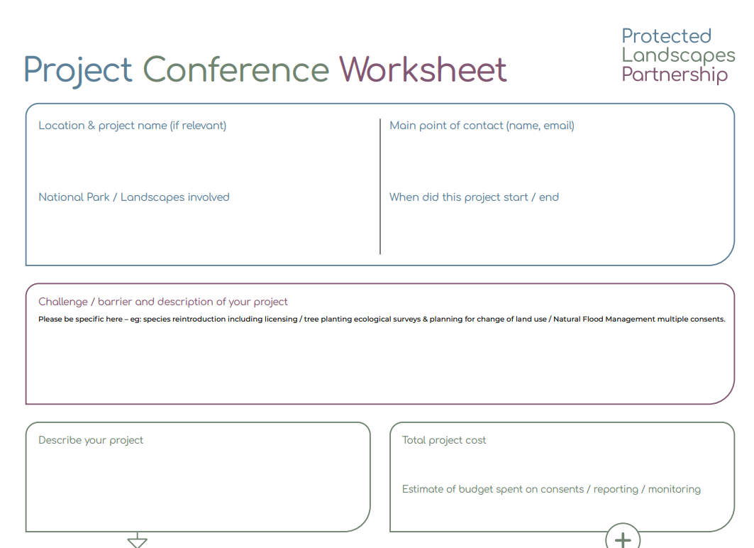
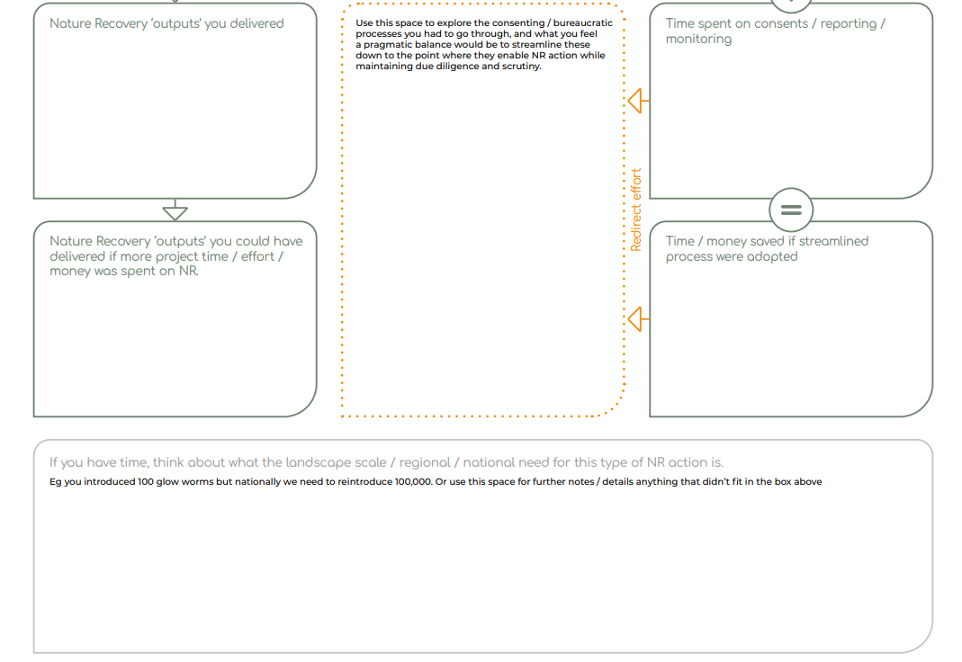
Workshop case study sheets
On your table choose a couple of specific projects to document as case studies, these should either:
Showcase good practice
Spotlight a major hurdle
Quantify in financial terms a significant difference between the current regulatory processes and your streamlined proposed process
The ‘project owner’ should not scribe and others should ask probing questions to get as much detail onto the worksheets.

Slide 20
Framing our discussion & case studies
NR theme – challenge you’re trying to overcome
Specific, measurable, documentable case studies
Time & money spent on consent / license process
Nature recovery outputs NOT included due to bureaucratic process
Your reflection on what a pragmatic level of bureaucracy is needed (streamlined process), while enabling NR work of this type
Time & money saved if streamlined process were adopted
NR outputs that would have been achieved / attempted if streamlined process adopted
IF you have time, think about what the landscape scale / regional / national need for this type of NR action is. Eg you introduced 100 glow worms but nationally we need to reintroduce 100,000

Slide 21
Feedback

Slide 22
Deep dive workshops
Workshop 1 – Peat – Tues 26th Nov 1200
Workshop 2 – TBC – Wed 11th Dec 1000
Workshop 3 – TBC – Tues 7th Jan 1300
Workshop 4 – TBC – Tues 14th Jan 1500
Workshop 5 – Coastal – Thurs 16th Jan 1000
TBC workshops will include
– priority terrestrial habitat
– species reintroductions / translocations
– freshwater / riparian systems
A series of Teams online workshops to deep dive in a solutions focused approach to streamlining the consents / licenses needed for each thematic area of Nature Recovery.
All attendees who’ve completed the form will be emailed invites to join. Sessions are open to others as well.
Please scan me and complete the attendee form

Slide 23




Staying in touch
Stay in touch with the workshop facilitators
Tom’s LinkedIn
Leo’s LinkedIn
Madeleine’s LinkedIn
See the network map of attendees to these workshops

Slide 24
Additional information on consents

Slide 25
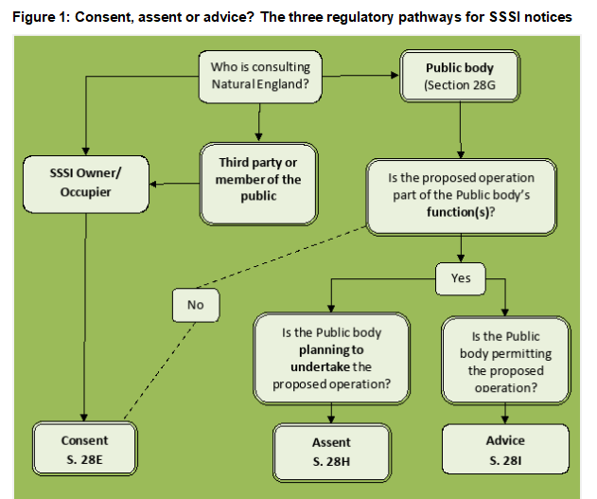
30by30 – potential consents / licenses needed – SSSI’s
In order to provide all SSSIs with protection from potentially harmful activities, the Wildlife & Countryside Act (1981) requires:
• owners and occupiers of SSSI land proposing to carry out or permit operations that may damage the special interest of their SSSI to first apply for Natural England’s consent.
• public bodies proposing to carry out operations which they consider are likely to damage the features of special interest within a SSSI (whether within or outside the boundary of an SSSI) to first apply for Natural England’s assent
• public bodies proposing to authorise or permit others to carry out operations that may be likely to damage the special interest of a SSSI (whether within or outside the boundary of an SSSI) to first seek Natural England’s advice
Section 28G bodies – Local Authorities, National Park Authorities, Natural England, Environment Agency, Forestry Commission, Forestry England and Defra are all clearly S28G bodies, but National Trust, Wildlife Trusts, the RSPB etc are not.
Consents, assents and advice for Sites of Special Scientific Interest: determining notices submitted under sections 28E, 28H and 28I of the Wildlife and Countryside Act 1981 Guidance Note 2: The three regulatory pathways for SSSI notices

Slide 26
Section 28G bodies
a) a Minister of the Crown (within the meaning of the Ministers of the Crown Act 1975) or a Government department;
b) the National Assembly for Wales;
c) a local authority;
d) a person holding office –
(i) under the Crown,
(ii) created or continued in existence by a public general Act of Parliament, or
(iii) the remuneration in respect of which is paid out of money provided by Parliament;
e) a statutory undertaker (meaning the persons referred to in section 262(1), (3) and (6) of the Town and Country Planning Act 1990);
f) any other public body of any description.

Slide 27
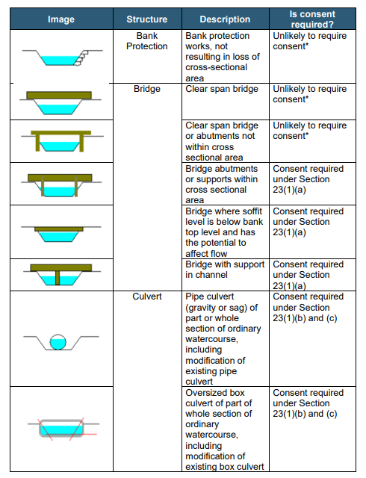
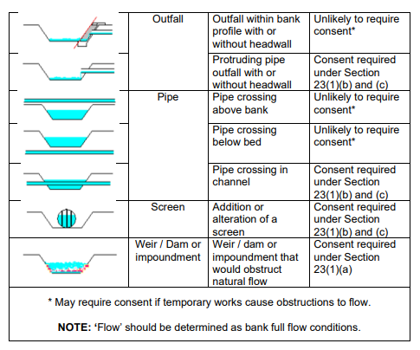
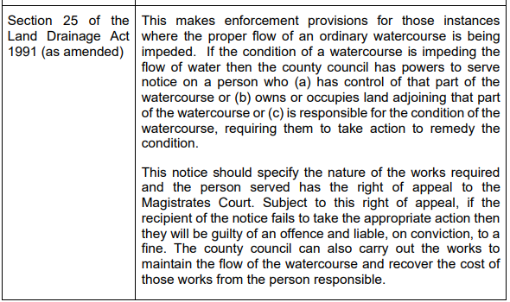
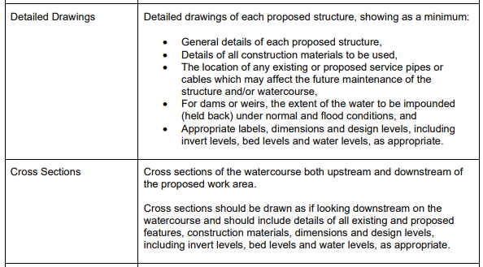
30by30 – potential consents / licenses needed – OWC’s
Section 23 of the Land Drainage Act 1991 requires written consent to be obtained from the county council as the Lead Local Flood Authority (LLFA) for the area prior to undertaking certain works to an ordinary watercourse.
An ordinary watercourse, as defined under Section 72 of the Land Drainage Act 1991, is a watercourse that does not form part of a main river, and includes all rivers and streams and all ditches, drains, cuts, culverts, dikes, sluices, sewers (other than public sewers within the meaning of the Water Industry Act 1991) and passages, through which water flows.
Ordinary Watercourse Regulation Guidance Guidance for complying with ordinary watercourse regulation in Lancashire. Version 3: 18 March 2024

Slide 28
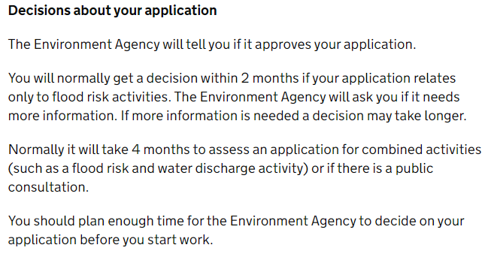
30by30 – potential consents / licenses needed – FRAP’s
You may need permission for a variety of regulated flood risk activities, including:
Building or altering a structure designed to contain or divert flood water
Excavation within 16m of a main river, flood defence or culvert
Any activity within 8m of a main river bank (or 16m of a tidal river bank)
Activities on the floodplain of a main river, culvert or flood defence structure.

Slide 29
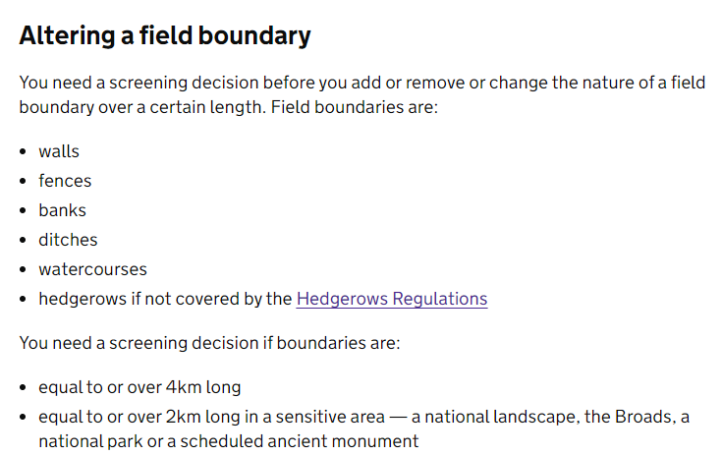
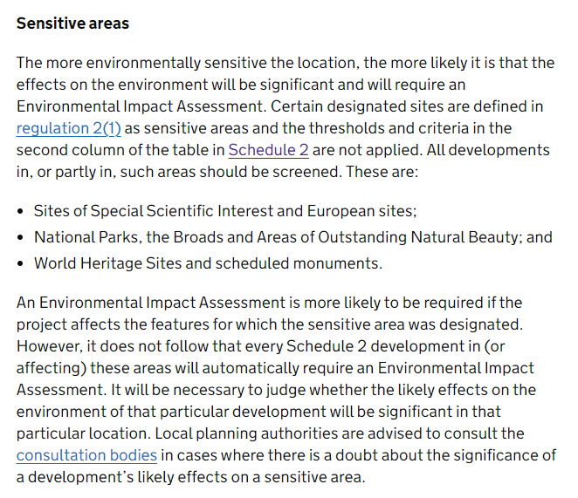
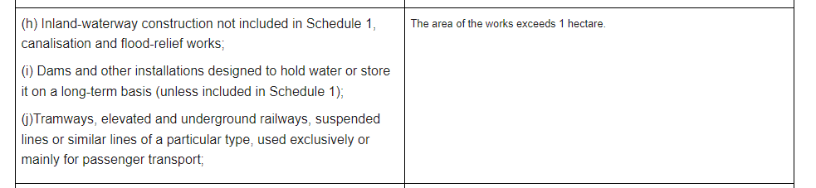
30by30 – potential consents / licenses needed – EIA’s
Schedule 2 developments needing EIA - The Town and Country Planning (Environmental Impact Assessment) Regulations 2017

Slide 30
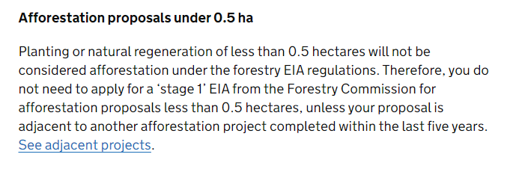
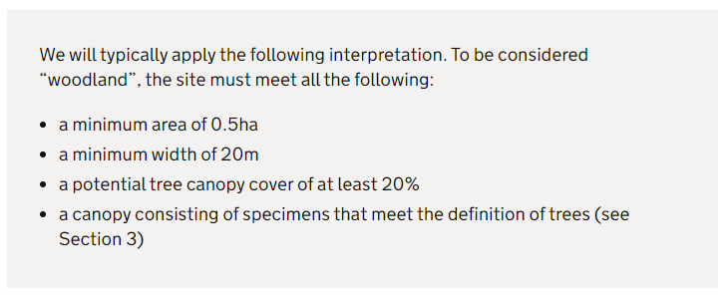
30by30 – potential consents / licenses needed – Forest EIA’s
Notes:
Definition of trees and woodland - GOV.UK

Slide 31
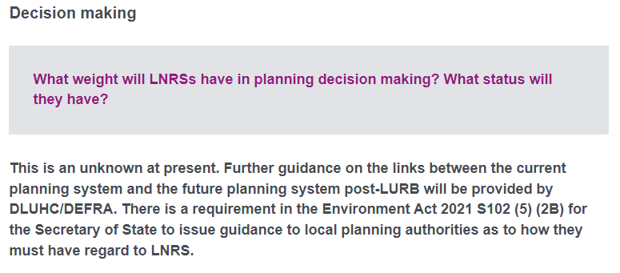
30by30 – potential consents / licenses needed – Planning
Development’ is defined within Section 55 of the Town and Country Planning Act 1990 (as amended) as:
the carrying out of building, engineering, mining or other operations in, on, over or under land, or the making of any material change in the use of any building or other land
he 1990 Act states that the following operations or uses of land are not taken to involve development:
(e) the use of any land for the purposes of agriculture or forestry (including afforestation) and the use for any of those purposes of any building occupied together with land so used;
Some works, which might otherwise fall within the definition of development are so minor in nature that they fall outside of the scope of the planning system – i.e. they are ‘de minimis’.
The Oxford English Dictionary defines ‘de minimis’ as
“too trivial or minor to merit consideration, especially in law”
Planning Advisory Service - Nature recovery frequently asked questions (FAQs) - January 2023

Slide 32
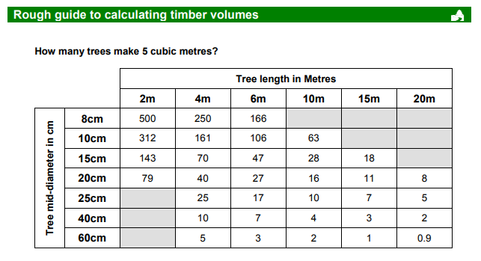
30by30 – potential consents / licenses needed – felling license

